Slide 1
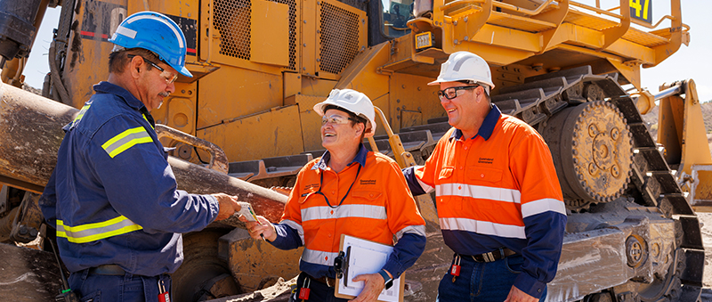
Incident Periodical
MARCH 2026
Coal Mines Inspectorate

Slide 2
March 2026 periodical overview
This month’s periodical includes incidents that have taken place at Queensland coal mines, controls that should be considered to minimise risk and reference materials, including:
pressure events
near crush injury
grease injection
person falling through failed grid mesh.
This month there is also an information share concerning wildlife safety at coal mines.

Slide 3
Pressure events
Several pressure events have been reported since November 2025 across a range of operations. Review the incidents and reference materials provided to support effective mitigation of pressure event risks.
Reported incidents
Reference materials
YouTube - Pressurised refuelling systems 1 - lessons learned
YouTube – Pressurised refuelling systems 2 – process overview
Recognised Standard 23: Fluid power safety in coal mines
Safety Alert 471 (13 February 2026)
Lufting cylinder – Potential Fluid Injection
Hytorc hose failure – Potential Fluid Injection
Failure of HME Tyre x 3 – Shattered excavator window
Battery-powered grease gun – Fluid Injection
Pressure filter failed on a Long Wall
The discharge pipe in a CHPP dislodged as no thrust clamp being fitted
Diffuser pipe failed – sending debris approximately 20 metres
Fuel screen blown off whilst refuelling
Compressed air pipe failed in service
Underground pressure pipe failure whilst applying a pipe bandage
Jameson Cell hose failure
Compressor 4-inch airline failed – debris found 20 metres away
Pin-prick failure of a roof bolting rig hose inside the crimp ferrule
Brake oil was released from the POS2 brake calliper through a broken bleed fitting

Slide 4
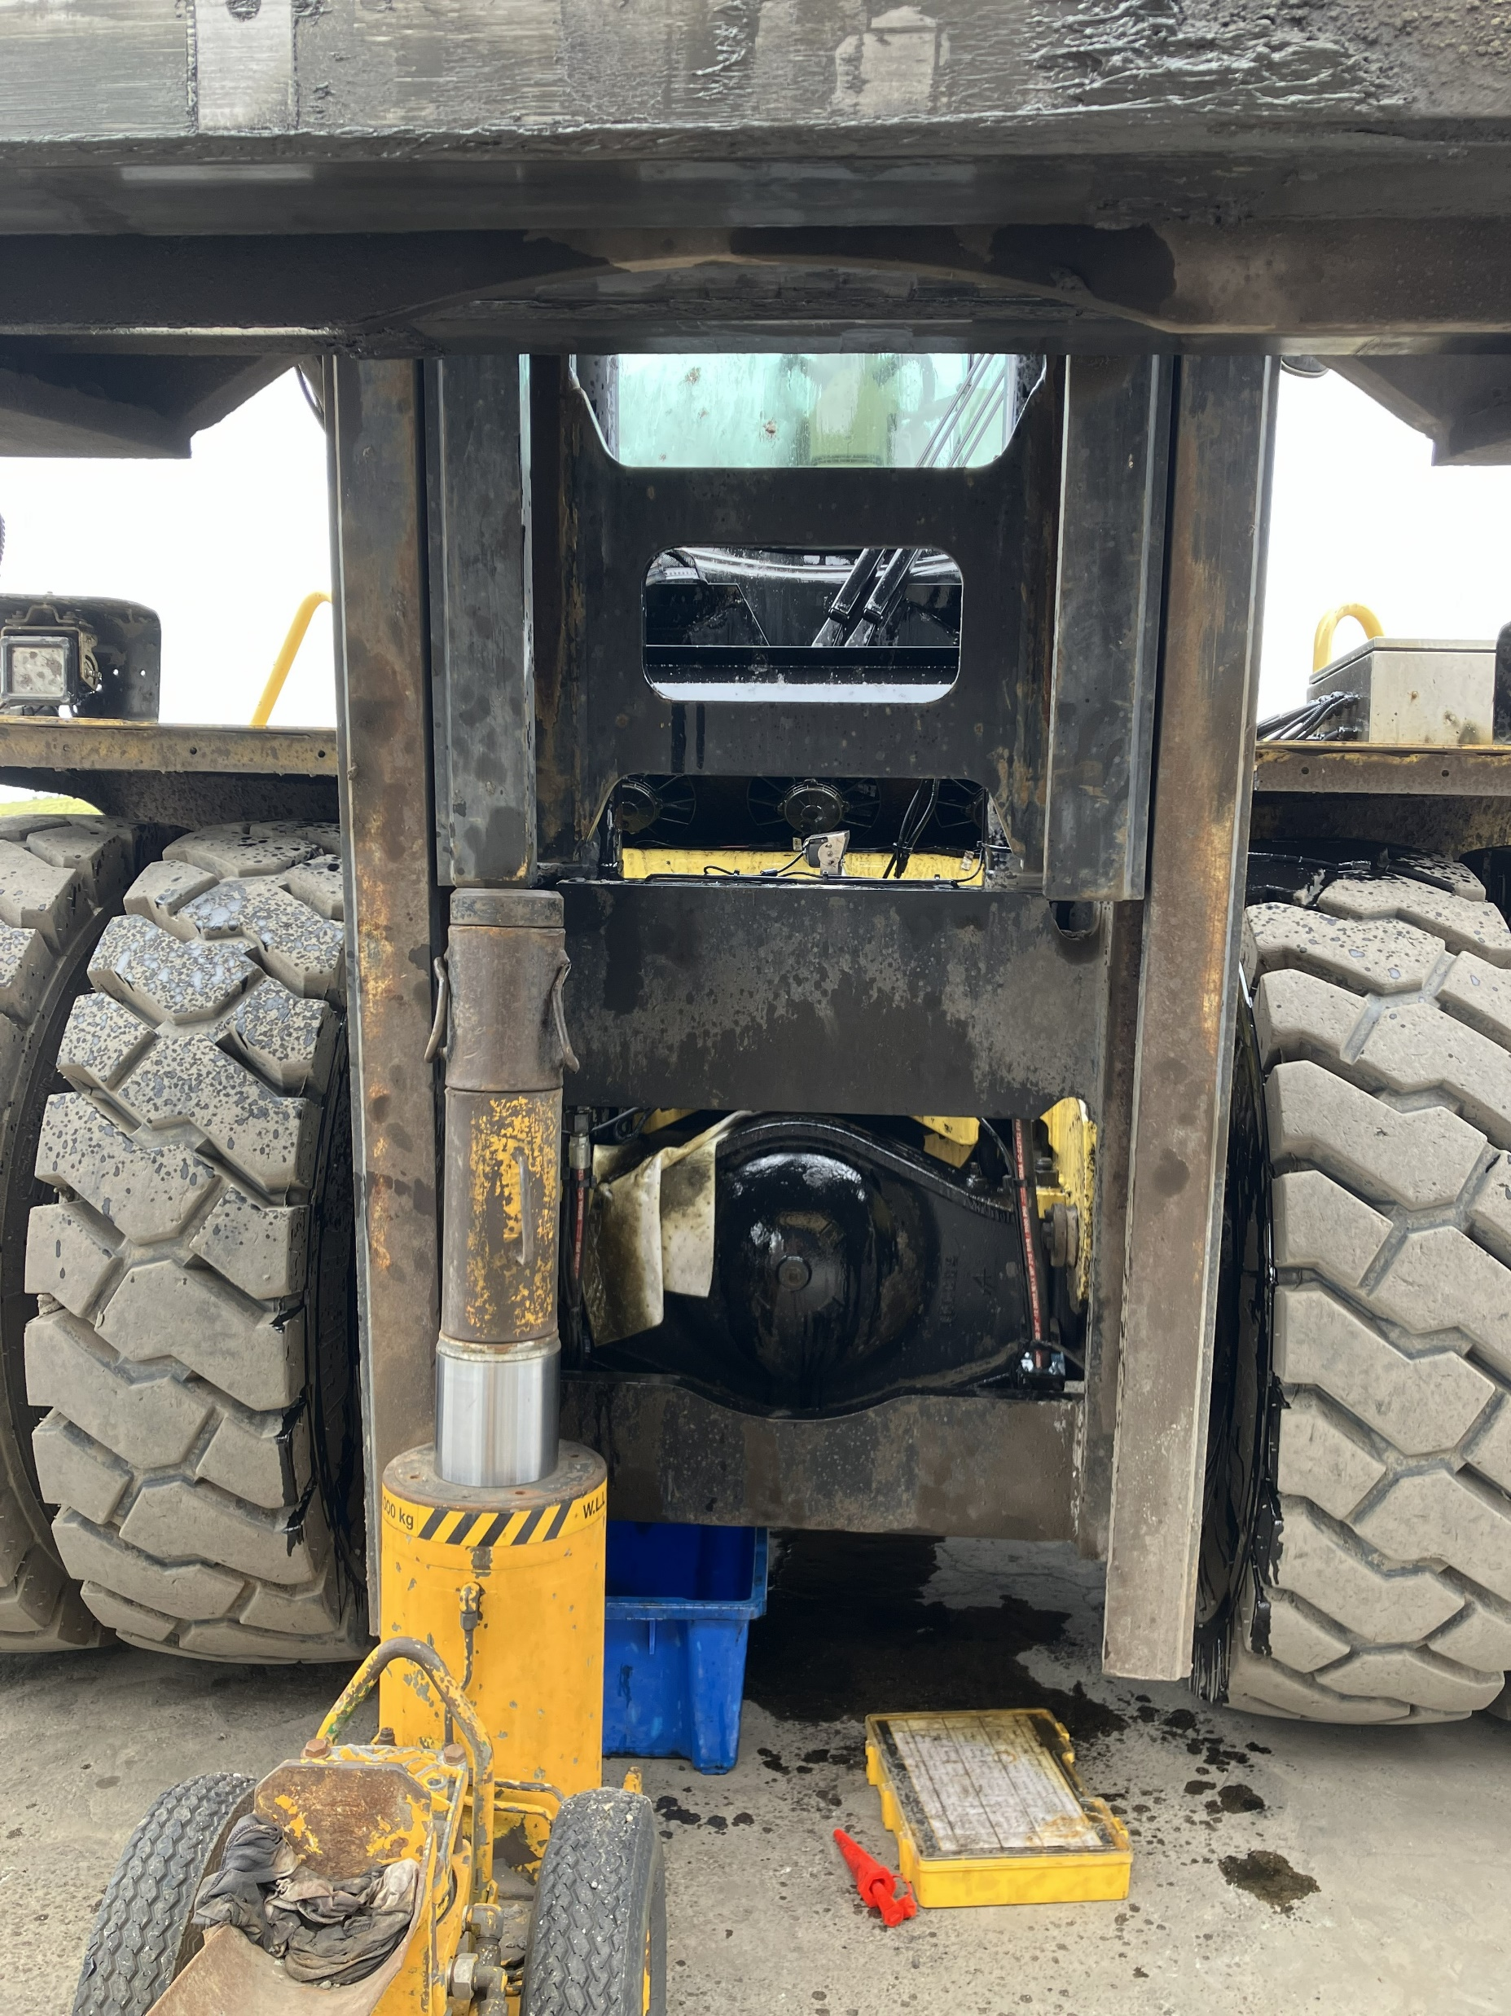
Near crush injury
An apprentice was undertaking repairs (fluid leak) on the mast of a trye manipulator when he was trapped in the handler.
He was working on a tyre pad and had started the job before his supervisor arrived at the site.
The machine was configured as shown in the photo, with the jack not in situ.
To access the leak, the apprentice positioned himself in front of the mast and leaned through the mast frame.
The mast and mast frame hole was large enough for him to access the hose.
As the hose was undone, oil pressure was released, and the mast began to descend, trapping the apprentice.

Slide 5
Near crush injury

apprentice was working alone, and his immediate supervisor didn’t attend the job site prior to him starting work
the machine was not isolated before starting work
the pressure was not released prior to starting work
the apprentice did not understand the machines' function
the mast was not supported
there were other people within ear range that could assist
the apprentice survived with minimal bruising.







Slide 6
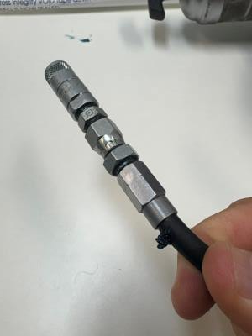
Grease injection
A coal mine worker was recently injured at an open-cut coal mine in Central Queensland while servicing a light vehicle inside the mine’s workshop.
The worker was lubricating the leaf spring bush assembly on the vehicle using an 18V cordless grease gun. The grease pump hose then failed next to the grease coupler, resulting in a sudden release of energy that caused a grease injection injury to the worker’s left thumb.
Minimum safety requirements for the cordless grease gun were not met.
Sites should review all cordless grease guns to ensure they are fit for purpose.
The hose failed at the connection between the hose and fitting at the coupler end of the assembly.

Slide 7
Grease injection
References and further information
Safety Alert #469 - Fluid injection whilst using a cordless grease gun | Resources Safety & Health Queensland
Safety Alert #440 – Fluid injection into CMW’s skin
Recognised Standard 23: Fluid power safety in coal mines (Gazetted 27 August 2021)
Safety Bulletin 139: Risk management of high-pressure fluids and gases
Safety Alert 271: Longwall fluid-injection injury
Safety Bulletin 67: Managing high-pressure fluids and gases
Coal Mining Safety and Health Regulation 2017 - (Chapter 4, Part 4, Section 149 - Principal hazard management plan)

Slide 8
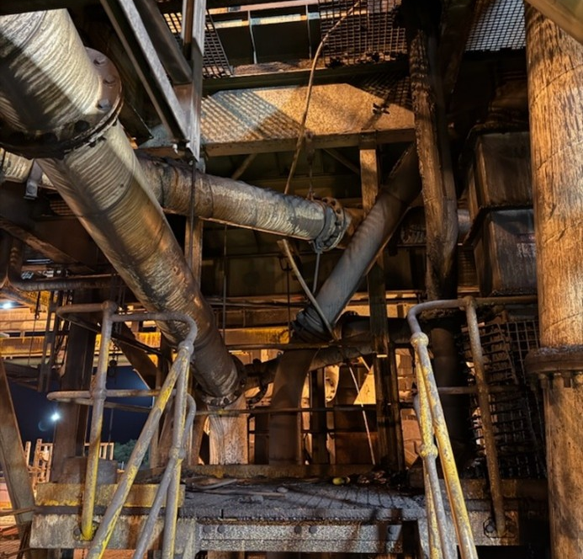
Floor mesh integrity
While performing duties on the screen floor of the Coal Handling and Preparation Plant (CHPP), a CHPP operator was involved in an incident in which a section of the grid-mesh flooring failed. This failure resulted in the operator falling approximately 3.8 metres to the level below.
The coal mine worker (CMW) sustained significant injuries to his ankle and other areas of his body as a result of the fall.
All mine sites are reminded of the requirement to ensure that regular inspections of floor mesh are conducted and appropriately recorded in accordance with site procedures and statutory obligations.

Slide 9

Wildlife safety at mining sites
Roof
Occasionally on mine sites there may be a requirement for an ecologist or otherwise qualified professional to handle bats or other wildlife as part of their role.
Site Senior Executives should be sure that people performing tasks that require the handling of wildlife are provided with the appropriate PPE.
In the case of bats further vaccinations may be required should the person receive a bite or a scratch. In all of these instances workers should be referred for further medical advice due to potential ABLV exposure
Wildlife interactions should be covered in a sites workplace policy.

Slide 10
NOTICE BOARD
UPCOMING FORUMS
OCE Forums
28 April Toowoomba
30 April Brisbane
MEM Forums
20 May Mackay
21 May Mackay
28 May Toowoomba
SSE /SMM Forums
27 August Brisbane
3 September Mackay
10 September Yeppoon
SAFETY NOTICES
Safety Alert 471
Worker struck by poly pipe after release of stored energy
Safety Alert 470
Coal mine worker injured by forklift tipping bin
Safety Alert 469
Fluid injection whilst using a cordless grease gun
Safety Alert 468
Worker suffers crush injuries after incident at coal mine
QUICK LINKS
Coal Mining Safety and Health Act 1999
Mining Hazards Database
Periodicals
Recognised Standards
RSHQ Consultation

