Slide 1
March 2024 Incident periodical
Industry Performance HPIFR and SIFR
Recent High Potential Incidents
Risk Controls identified by mine-site investigations
Queensland Coal Mines Inspectorate
Coal Inspectorate

Slide 2
Risk Control Effectiveness
This month’s periodical looks at three regularly reported HPIs:
Coal Mine Worker (CMW) interaction with ventilation control devices eg machine double doors and trap doors leading to injury.
Equipment roll-overs in both open cuts and underground operations.
Porta-power unit incidents.
These types of HPIs are reported regularly suggesting that accident investigations are not finding the effective risk controls to prevent incidents from happening again.
Administrative controls recommended following an incident are at the lower end of effectiveness
Recycled failed lower order (administrative) controls do not prevent the same sort of incident happening again.
HPI and accident investigations must find the risk controls that prevent the incidents happening again.
Higher order controls including engineering, isolation, substitution and elimination are more effective

Slide 3
CMWs interaction with ventilation control devices (VCDs)
Since 2019 there have been at least 11 HPIs reported to RSHQ were CMWs have been injured while passing through either a machine door airlock or a personnel man-door.
Injuries sustained have been frighteningly serious including loss of consciousness, fractured arms / legs / fingers, a dislocated knee and crush injuries. Fortunately, no CMW has died from these incidents however several CMWs have sustained injuries requiring surgery and protracted recovery periods. Some may carry these injuries for the rest of their lives.
Some machine doors were found not to be on a maintenance and inspection schedule. In one example the horn that sounds when doors open or close had been disconnected and no repairs organised. In several cases there were obvious leakage paths around the perimeter of the doors. This meant the airlock function was not effective. The floor was often not maintained with deep rills causing trip points for pedestrians and jamming points for the doors.

Slide 4
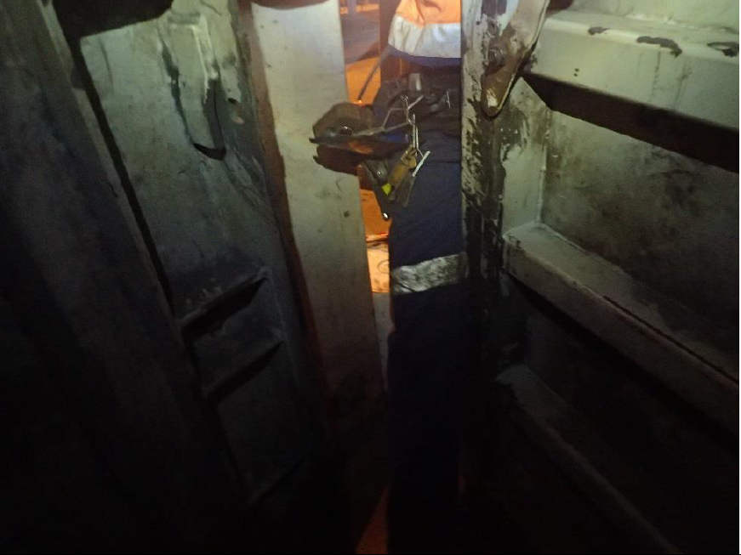
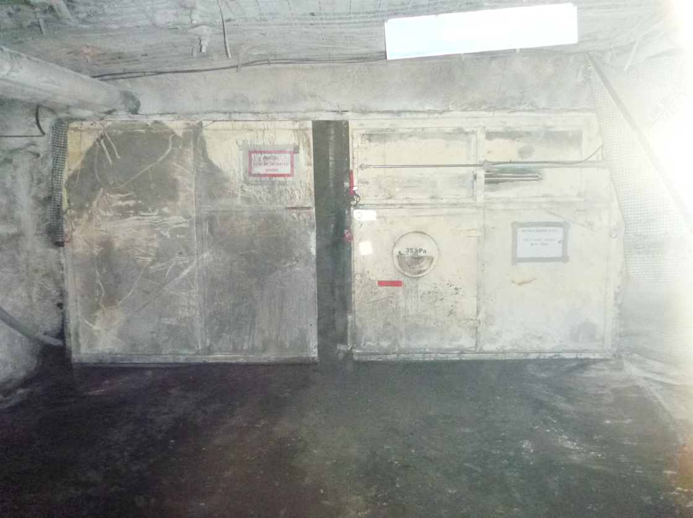
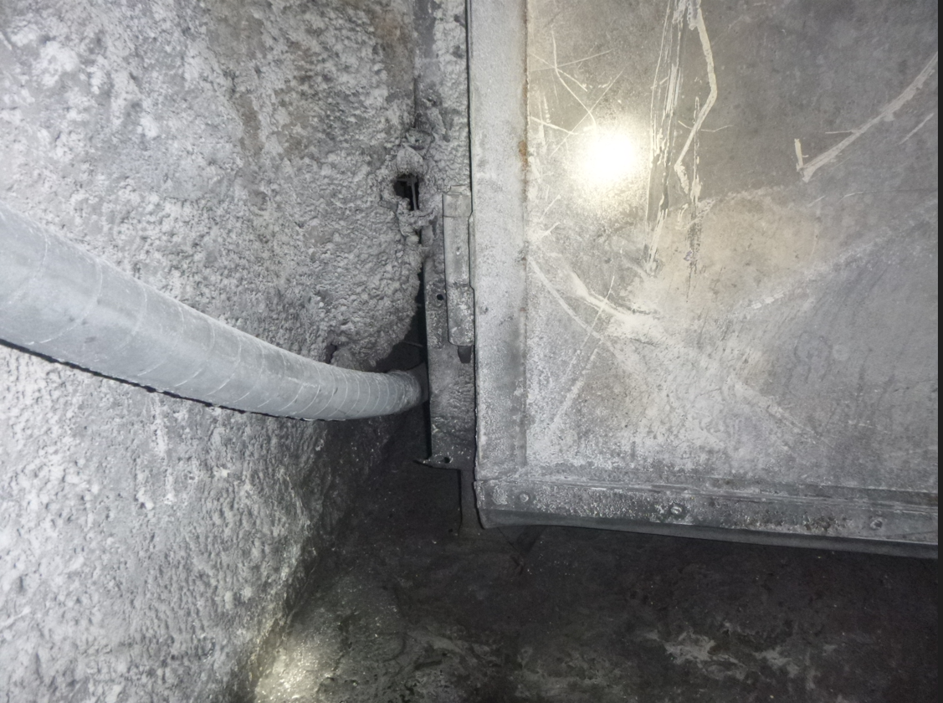
CMWs interaction with VCDs
Re-enactment
Machine doors
Leakage path around door

Slide 5
CMWs interaction with VCDs
Review the SHMS to ensure it includes maintenance and inspection provisions for the machine door airlocks and man-doors. Consider if this maintenance system is effective?
Conduct a pressure survey across all VCDs where a man-door is fitted to a VCD to determine the pressure drop across these devices. Ensure all such doors are capable of being opened without personnel being placed at an unacceptable level of risk.
The SSE should ensure their mine conducts a site based risk assessments to determine the maximum allowable pressure across a man-door. Above this pressure point an airlock arrangement needs to be installed. Audit your machine door and trapdoor integrity and functionality.
Review the effectiveness of your site maintenance system.

Slide 6
Equipment rollovers in opencut and underground coal mines
A significant proportion of vehicle roll-overs occur in open-cuts compared to underground coal mines. Underground coal mines still have a substantial total number of vehicle roll-overs particularly light service vehicles operating on the surface.
A review of HPIs going back to 2005 indicates there have been multiple notifications reported with the majority of these involving light vehicles, articulated moxys, off-highway haul trucks, franna cranes, graders, road registered road train and trailers, dozers, scrapers, excavators, loaded concrete truck, and lighting plant. Essentially most items of plant designed to be driven or towed have been rolled over.
The contributing factors are varied but typically include excessive speed, diverted attention, fatigue, wet / slippery conditions leading to a loss of traction, poorly maintained corrugated roads, less than adequate or non-existent bunding, inadequate servicing and maintenance of vehicles, not following the documented procedures and exceeding operating design/load limits.

Slide 7
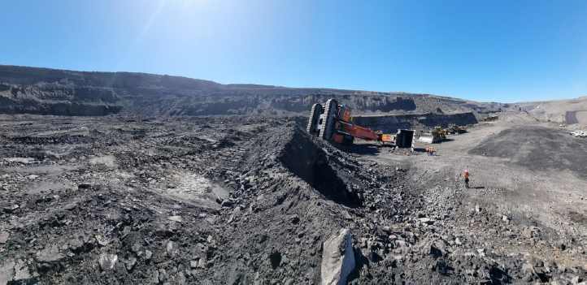
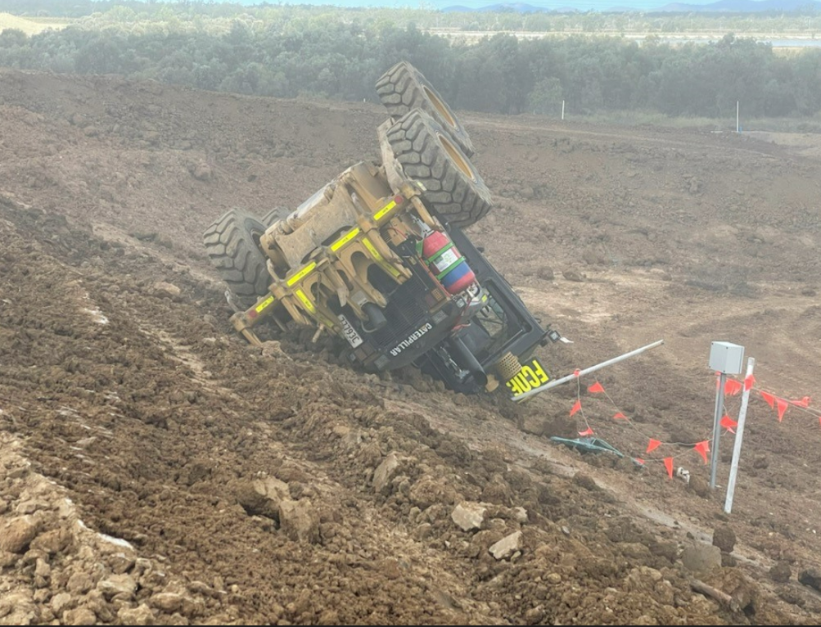
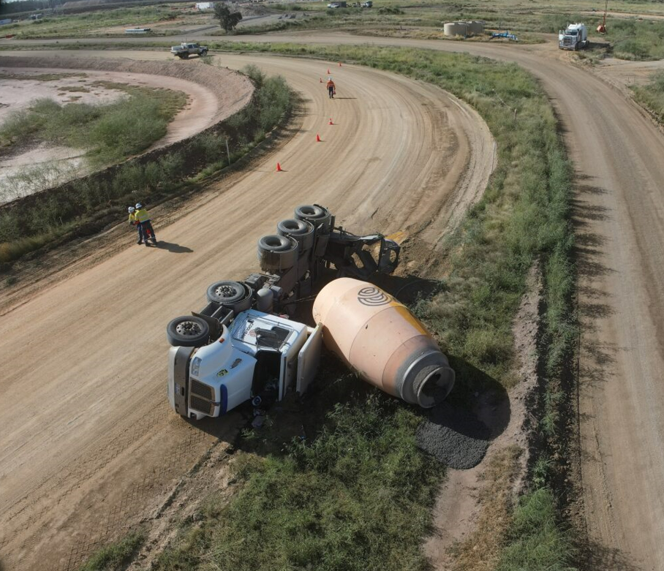
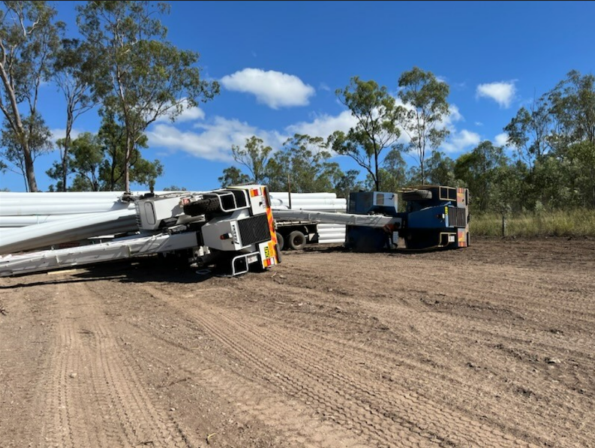
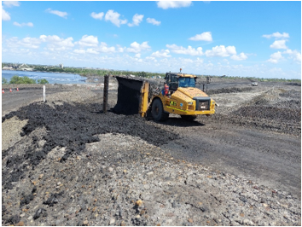
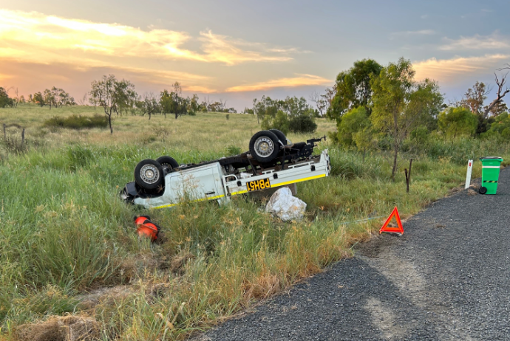
Equipment rollovers in opencut and underground coal mines

Slide 8
The following sample preventative actions were listed in the incident notifications. Are all of these actions effective in stopping a repeat of the incidents?
Develop a working group with content experts. Develop a set of guidelines on when to cease operations and seek assistance. Determine what is the clear signal to stop and seek assistance.
Counsel the operator.
Review ongoing maintenance of bunds.
Place sub-contractor under the direct control of the Maintenance Superintendent who approves JSAs and lift procedures.
Undertake a thorough review of the Construction procedure to align to the intended construction methodology.
Reset expectations and re-train the project team.
Develop an audible alert system so all road users will be able to alert each other of adherence to 4WD policy in pit.
On moxys: speed limits to be confirmed as part of daily prestarts. Vehicle monitoring systems fitted and actively monitored to all articulated trucks.
Review prestart checklist to include “windscreen visibility”.
Update SOP and TARP for watercart operations.

Slide 9
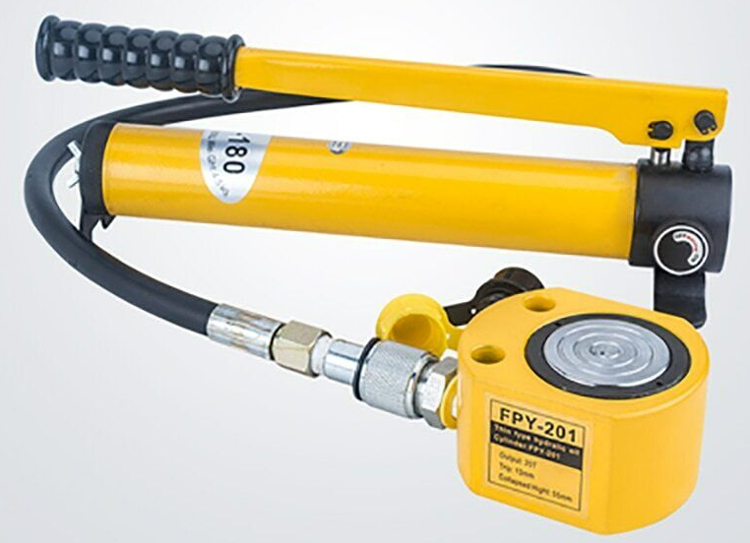
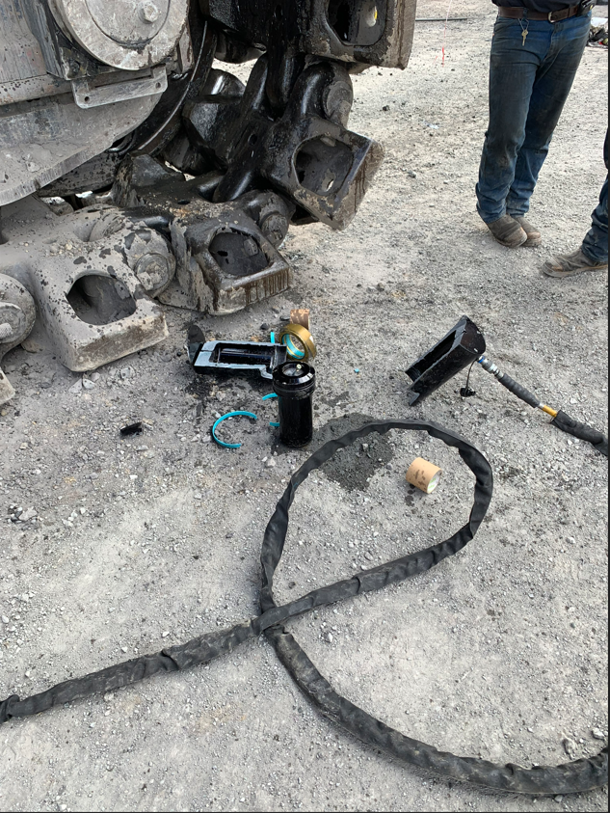
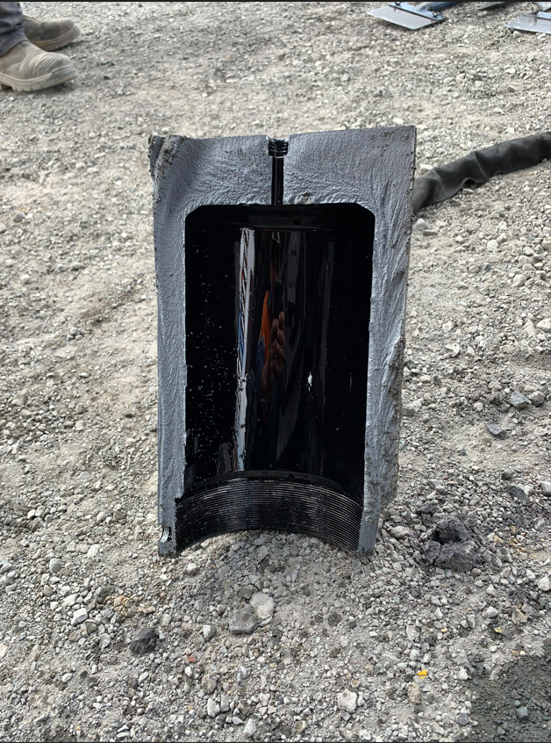
Incidents involving porta-power cylinders
Numerous incidents have been reported involving the miss-use of porta-power units.
Some of the Do’s and Don’ts applicable to the use of Porta Power units are highlighted below. Failure to comply with the OEM procedures and site based SWPs may have contributed to mine site incidents involving this equipment:
Do provide a level and solid support for jack base, entire jack must be in contact with the load, provide a cylinder saddle to prevent plunger mushrooming, protect cylinder threads for use with attachments, keep hydraulic equipment away from heat above 65 degrees C. Use dust caps on couplers. Release pressure fully and retract cylinder before detaching hoses. Always check jacks, hoses, couplings, cylinder plunger for potentially dangerous conditions.
Don’t override factory settings of relief valves. Don’t use handle extenders. Don’t use force to close release valve. Don’t overfill ram above recommended oil level. Don’t ever put any part of your body under a suspended load without cribbing it.

Slide 10
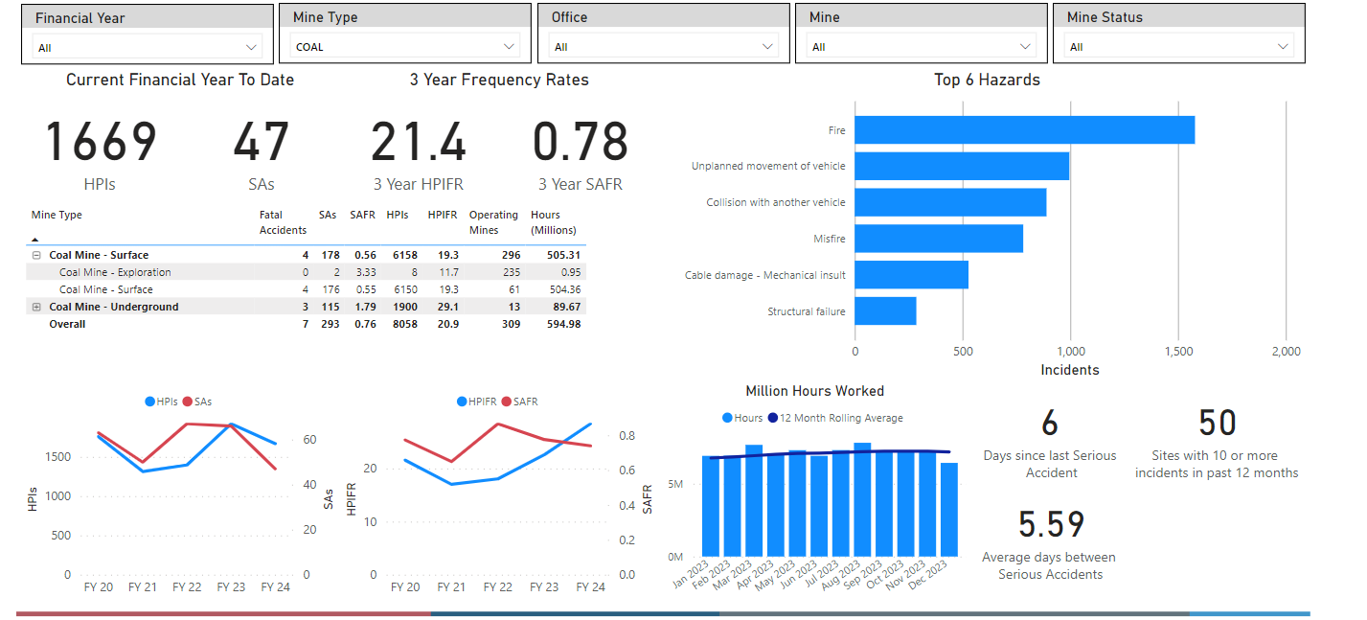
Coal Statistics – for Financial Year to Date 2023-2024

Slide 11
NOTICE BOARD
QUICK LINKS
COMMUNICATIONS
Board of Examiners
RSHQ Consultation
OCE Seminars March + April 2024
MEM Forums
May + June 2024
FREE Registration for the PCS Scheme
Periodicals
Mining Hazards Database
Coal Mining Safety and Health Act 1999
DPM Forum
12 June 2024
Diesel guideline exposure limit reduction
Recognised Standards
QMI Forums
RECENT SAFETY NOTICES
Safety Alert 446
Electric shock from accessing a high voltage enclosure
Safety Alert 445
Uncontrolled movement of longwall transformer cart
Safety Alert 444
Coal mine worker struck by rotating dragline
Safety Alert 443
Fatal accident involving light vehicle and stationary B-double
Safety Bulletin 217
Dozer operator risks their life by driving into a water body
Safety Alert 442
Uncontrolled movement of remote-controlled mining equipment
To subscribe to communications from the Queensland Mines Inspectorate please email
QldMinesInspectorate@rshq.qld.gov.au

