Slide 1
December 2021 – January 2022 Incident periodical
Recent High Potential Incidents
Learnings and Recommendations
Queensland Coal Mines Inspectorate
Coal Inspectorate

Slide 2
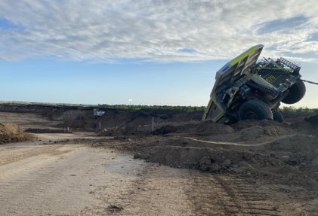
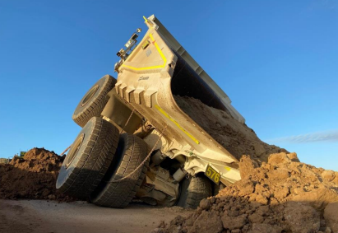
Incident – Uncontrolled Movement – Surface Mine
An ultra class rear dump carrying approx. 380t was travelling up a 1 in 10 ramp at 16km/hr when Pos 5 and 6 wheels became stuck in a large blow hole on the right-hand side of the incline.
The ramp had been in use for several weeks with no signs of degradation.
The operator was rescued using an EWP, and was not injured.

Slide 3
Recommendations
Site Senior Executive
Ensure the mine’s SHMS contains effective specifications for the design and construction of mine roads as per the requirements of Section 128 of the Qld Coal Mining Safety & Health Regulation 2017 and Recognised Standard #19.
Supervisors / OCE’s
Carry out routine inspections of their respective work areas, including mine roads.
Coal mine workers
Carry out inspections of their work area prior to commencing work.
Immediately report any hazards / defects that can cause harm to a person’s safety and health.
Ensure any abnormalities / defects in mine roads are dealt with as per the requirements of Section 107 Qld Coal Mining Safety & Health Regulation 2017.

Slide 4
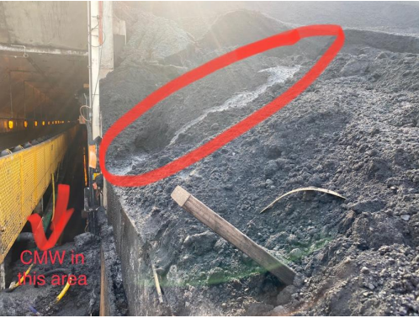
2. Incident – Worker partially engulfed – CHPP
Coal slumped above the face of a tunnel entrance as a stockpile dozer was relocating in the area.
A coal mine worker who was performing hosing duties in the tunnel’s entrance was partially engulfed.
This event is a timely reminder that in December 1990 a Qld coal mine worker lost their life when fluidised coal engulfed the person in a ROM feeder.

Slide 5
Recommendations
Site Senior Executive
Supervisors
Coal mine workers
Conduct their work in a way that does not expose themselves or someone else to an unacceptable level of risk.
Ensure that activities under their supervision can not be hazardous to any other activities being performed.
Ensure the risk to persons from any plant provided by the site senior executive for the performance of work is at an acceptable level.

Slide 6
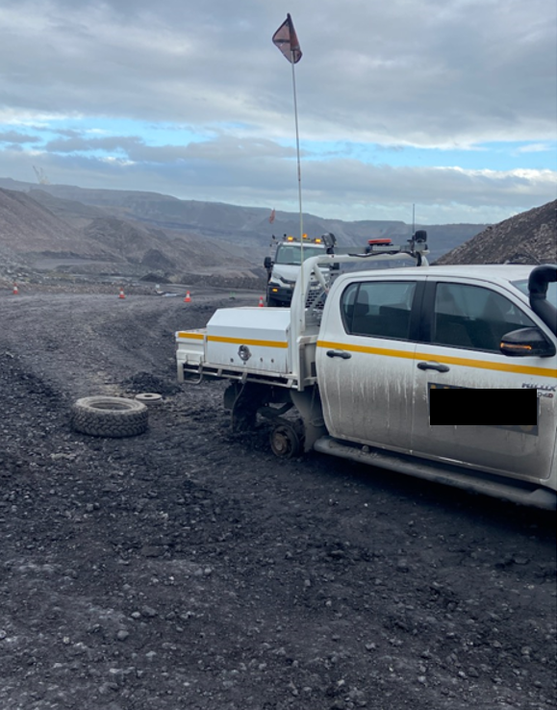
3. Incident – Mechanical Failure - Surface Mine
A Toyota Hilux Dual Cab was travelling along a mine road when the rear driver’s side wheel separated from the vehicle
The wheel studs sheared off after the wheel nuts worked themselves loose.
An operator had previously identified wheel nut indicators missing during a pre-start inspection, but didn’t have a maintainer check the vehicle.

Slide 7
Recommendations
Site Senior Executive
Ensure the SHMS contains an effective maintenance strategy for maintaining mobile equipment including light vehicles.
Supervisors
Ensure that maintenance steps are carried out as required.
Coal mine workers
Carry out pre-start inspections as per the requirements of the mine’s SHMS.
Identify and report / record defects.

Slide 8
4. Incident – Heat Stress – Surface Mine
A boilermaker was repairing cracks (welding) on a dragline bucket during a planned maintenance day.
After completing the shift and travelling back into town the worker fell ill and took themself to the hospital.
The worker was admitted to hospital with heat stroke, and treated in hospital for the ensuing two days.
There were very hot conditions on the day of the planned maintenance.

Slide 9
Recommendations
Site Senior Executive
Conduct a gap analysis of the mines SHMS against QGN32 “Managing exposure to heat in surface coal mines and surface areas of underground coal mines” and address deficiencies.
Supervisors
Ensure that protections are made available to workers who maybe subjected to working in heat, for example by providing cool drinking water, portable air conditioners/ fans, shade, job rotation and etc.
Coal mine workers
Recognise the signs / symptoms of heat exposure and report it to your supervisor.
Ensure systems are in place to adequately assess the risk to workers who are required to work in heat. Consideration to be given to type of work, PPE and clothing that may restrict heat transfer, measurement of the thermal environment, appropriate work / rest regimes.
Ensure processes in place to recognise and treat heat related illness.
Monitor work conditions to identify increasing level of risk.
Report to work in a fit state giving consideration to personal hydration levels and other personal factors that may impact heat tolerance (e.g. some prescribed medications).
Further guidance provided in Section 4.3 of QGN32.

Slide 10
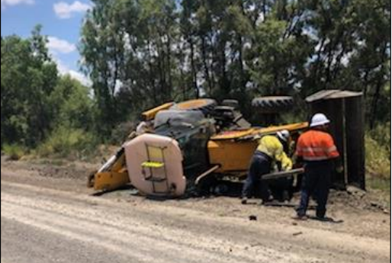
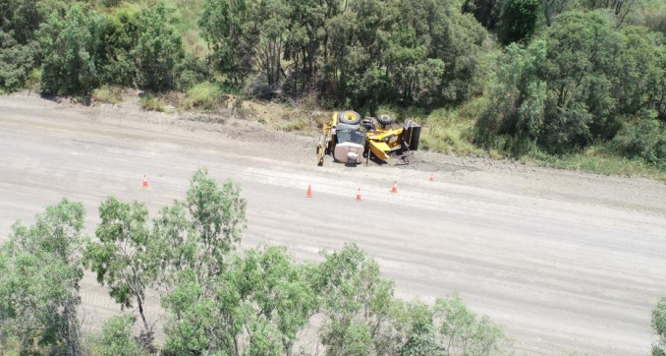
5. Incident - Equipment Rollover – Surface Mine
A coal mine worker was travelling along a haulroad in a hire backhoe when the person became distracted from the task of driving. The backhoe has gradually veered off the haulroad running up an embankment, resulting in backhoe rolling over and coming to rest on its side.
CMW exited the cab of the backhoe and raised the emergency by radio.
CMW was assessed and treated by the mine’s paramedic.

Slide 11
Recommendations
Site Senior Executive
Ensure all coal mine workers are made fully aware of the immediate risk present when a person is distracted whilst operating / driving equipment.
Supervisors / OCE’s
Monitor driver / operator behaviour and intervene if unsafe practices are identified.
Coal Mine Workers
Must not become distracted when operating mobile equipment of any type.

Slide 12
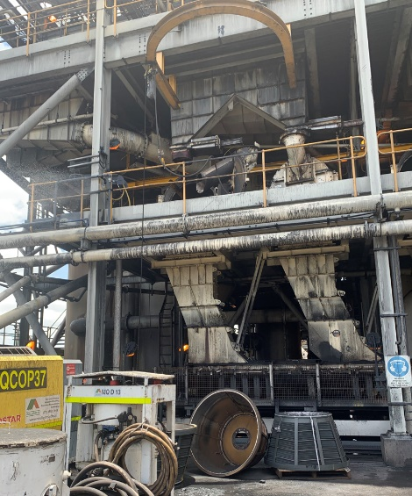
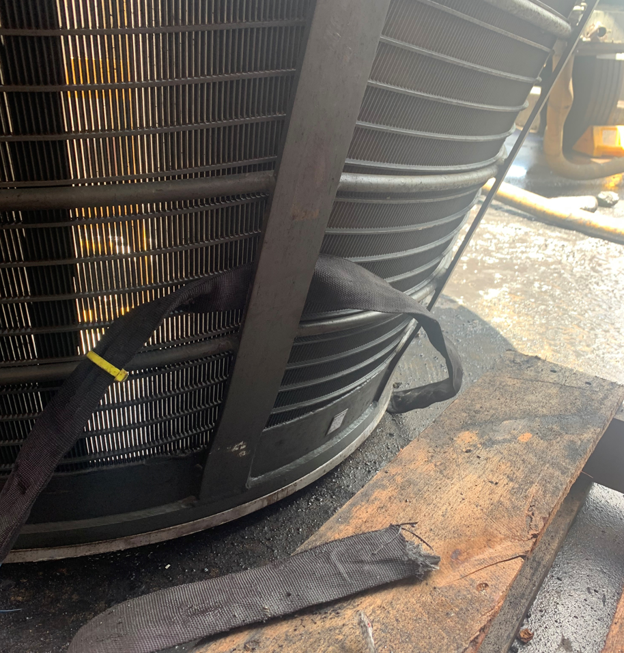
6. Incident - Lifting and slinging – CHPP
While lifting a new coarse coal centrifuge basket from the ground floor of the CHPP to the centrifuge floor the soft sling that was being used has failed, resulting in the basket being lifted falling to the ground.
The workers had also failed to barricade off the work area, however no one was in the area where the basket fell.

Slide 13
Recommendations
Site Senior Executive
Audit and monitor the effectiveness of the mine’s SOP for selecting, maintaining and using lifting plant.
Supervisors
Ensure work is being conducted as per the requirements of the work instruction and risk assessment.
Coal Mine Workers
Must ensure the type of lifting equipment specified in the work instruction is used.
Must ensure all steps listed in the risk assessment are followed.

Slide 14
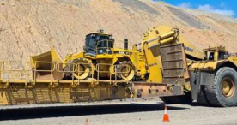
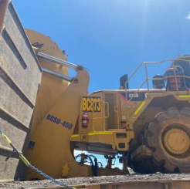
7. Incident - Uncontrolled Movement – Surface Mine
A soil compactor being transported on a float has moved approx. 5.6 metres whilst travelling, and came to rest against the float’s gooseneck.
The float operator did not feel any movement or contact, but noticed the soil compactor had moved when checking a side mirror and camera.

Slide 15
Recommendations
Site Senior Executive
Ensure the SHMS contains a SOP that provides for the safety of persons when heavy plant and supplies are being transported at the mine.
Supervisors / OCE’s
Ensure coal mine workers within their area of responsibility are complying with the mine’s SHMS.
Coal Mine Workers
Prior to travelling ensure that equipment placed on floats is immobilised as per the requirements of the mine’s SHMS.

Slide 16
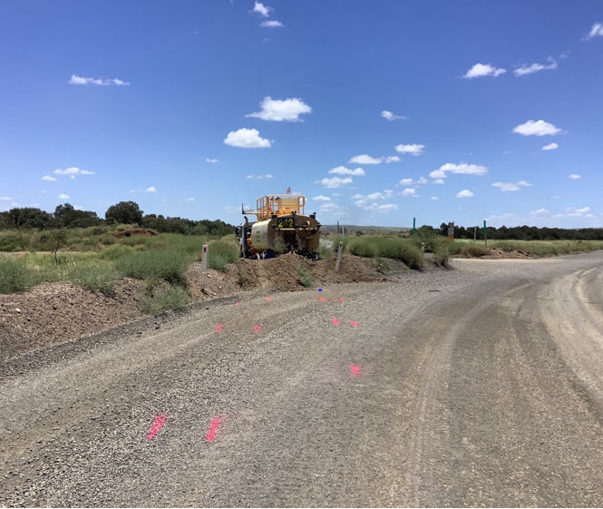
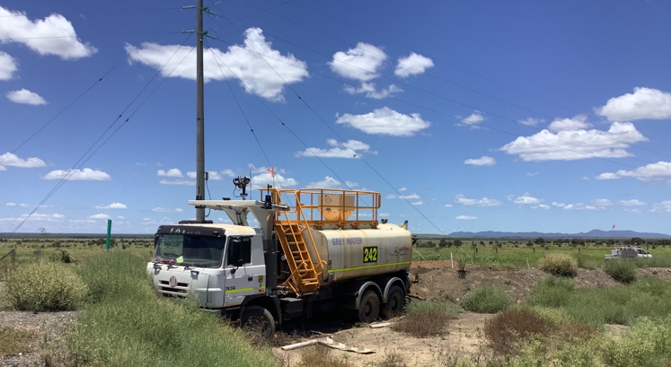
8. Incident - Microsleep – Surface Mine
A medium size water truck run off the road and crossed a safety berm before coming to rest directly under an overhead powerline.
The water truck operator acknowledged that she may have had a microsleep which caused the loss of control.
The incident occurred at 11:45am.

Slide 17
Recommendations
Site Senior Executive
Ensure that the SHMS provides for controlling personal fatigue, and this is audited / monitored for its effectiveness.
Supervisors OCE’s
Encourage workers to report any self-fatigue.
Coal Mine Workers
Do not continue operating / driving if you are experiencing fatigue symptoms. Stop and notify your supervisor.
Regularly check on the wellbeing of workers within your area of responsibility.

Slide 18
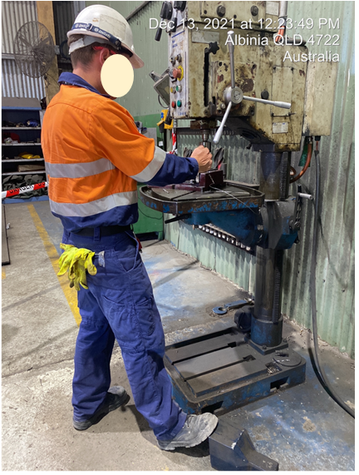
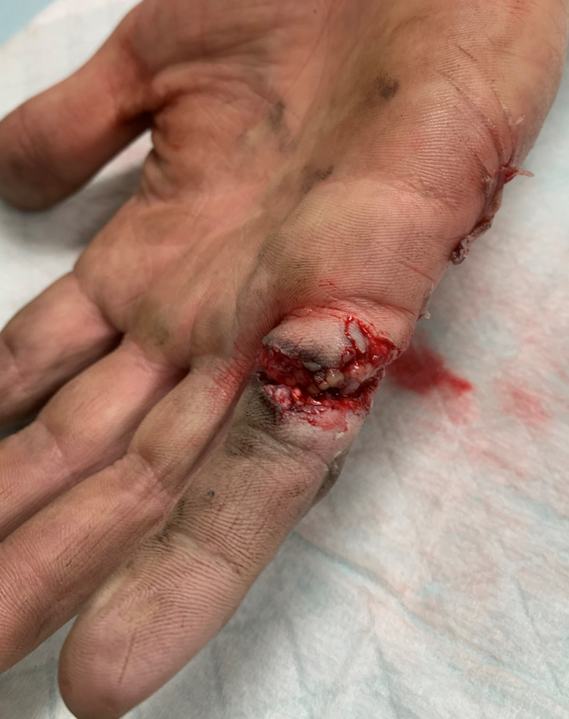
9. Incident - Serious Accident – Surface Mine
Whilst a coal mine worker was in the process of tightening a pedestal drill chuck utilising the key provided the worker has inadvertently started the drill press (via foot pedal) resulting in the chuck key lanyard entangling with his right hand little finger.
The injured person was transported to a local hospital for further assessment, and then transported to Brisbane for remedial surgery.

Slide 19
Recommendations
Site Senior Executive
Ensure the risk to coal mine workers at the mine is at an acceptable level by providing and maintaining a place of work and plant in a safe state.
Supervisors
Observe and monitor work being conducted to ensure all hazards are being controlled.
Coal Mine Workers
Must assess all tasks for potential hazards / risks prior to commencing, and ensure effective controls are in place.
Check the quality and effectiveness of personal risk assessments conducted by workers within their area of responsibility.
Deadman switches should be one part of a two step process for activating the start-up of machinery.

Slide 20
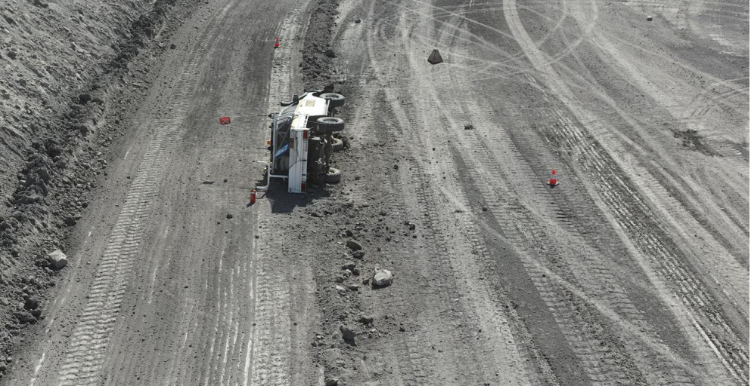
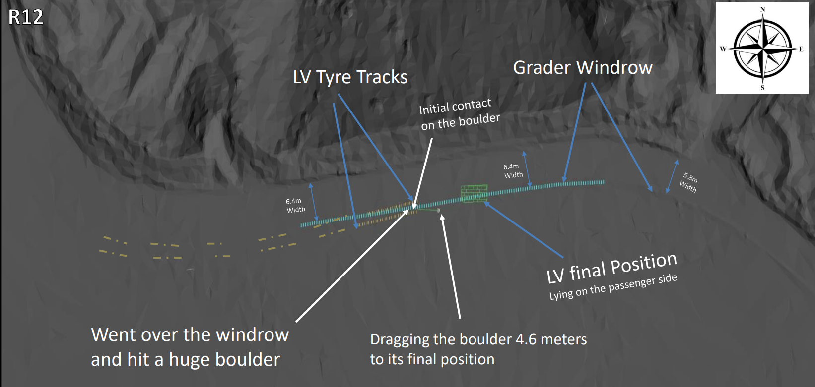
10. Incident - Light Vehicle Rollover – Surface Mine
A light vehicle was rounding a corner when the driver called a grader operator on the radio for permission to pass. The sun was directly in front of the windscreen as the driver made the turn, limiting their vision. In an attempt to manoeuvre around the grader rill the LV connected with a large rock, causing the LV to roll over coming to rest on its passenger side.

Slide 21
Recommendations
Site Senior Executive
Ensure the SHMS provides for an acceptable level of risk for other road users when maintenance activities are being carried out on mine roads.
Supervisors OCE’s
Ensure road users are made aware of any potential hazards when maintenance activities are being carried out on mine roads.
Coal Mine Workers
Comply with their mine’s procedures when operating mobile equipment.
Must always be vigilant when operating, and on the lookout for the unexpected to happen.
Drive to conditions
Ensure appropriate controls are in place for managing the above potential hazards.

Slide 22
Queensland Mines Inspectorate Presentations
The Queensland Coal Mines Inspectorate, as part of Resources Safety and Health Queensland, promotes improved safety and health outcomes through a variety of publications.
Two presentations on “Management of trailing cables in coal mines” and “Airborne exposure measurement” from our subject matter experts have recently been uploaded to the RSHQ website.
MANAGEMENT OF TRAILING CABLES IN COAL MINES AIRBORNE EXPOSURE MEASUREMENT

