Slide 1
August 2023 Incident periodical
Recent High Potential Incidents
Learnings and Recommendations
Communications
Coal Inspectorate

Slide 2
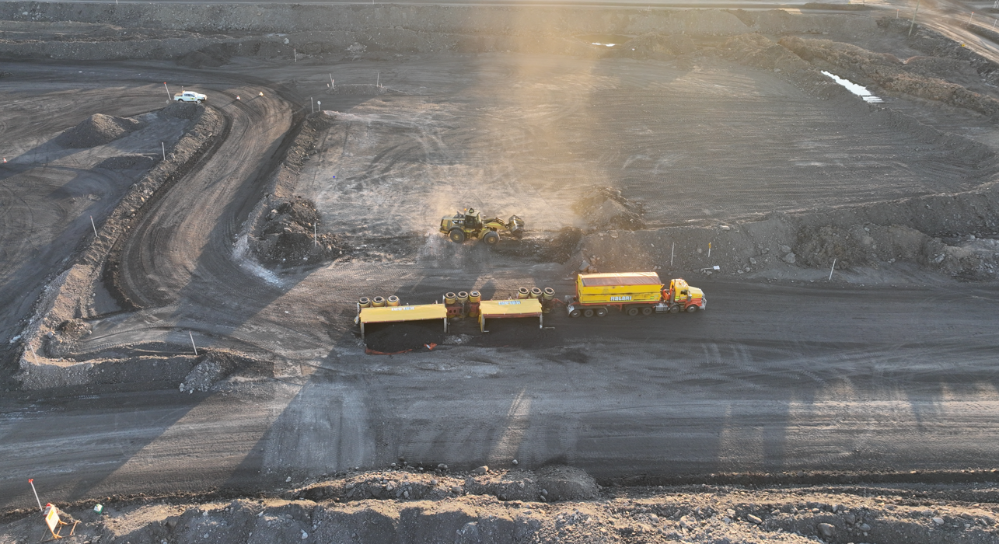
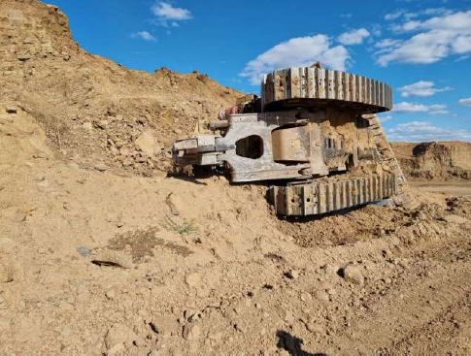
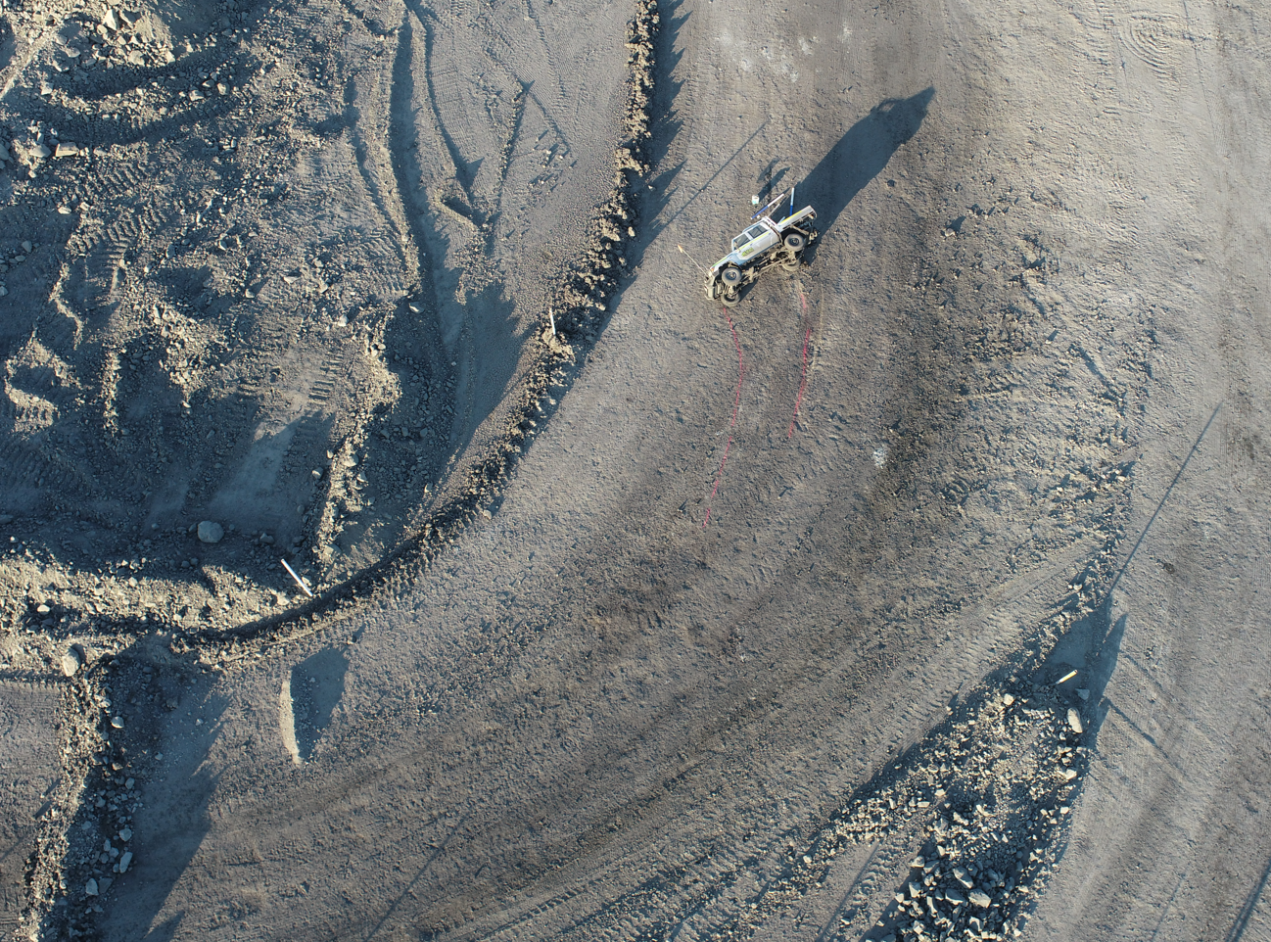
1. Incident – Rollovers

Slide 3
There have been a significant amount of rollover incidents of which 19 dozer rollover incidents have occurred between January 2022 and August 2023.
Key Issues
Edge protection substandard or absent
Failure to adequately assess work area for hazards prior to work commencing
Hazard identification absent or ineffective
Training or skillset not considered for the task

Slide 4
Recommendations
Site Senior Executive
Supervisors
Coal Mine Workers
Ensure that regular monitoring and review of supervisor’s effectiveness for hazard identification and risk control and undertake corrective action when deficiencies are detected.
Ensure the SHMS documentation is regularly audited for the controls applied to mitigate the likelihood of a rollover event occurring such as adequate edge protection.
Monitor the effectiveness of risk controls applied and take corrective action when deficiencies are detected.
Inspect their respective work areas for hazards that may be introduced when task commences.
Ensure the task being undertaken is within the capability of their knowledge and skillset.
Ensure that mitigating controls such as edge protection are installed in accordance with the mines SHMS.

Slide 5
2. Incident – Steel Shard Ejection
While changing a track on a D11 Dozer, a Coal Mine Worker was struck by a shard of metal that was ejected from the end of the track. area. The end has fallen sharply onto the underside of the old track as it being flipped over to clear the work area.

Slide 6
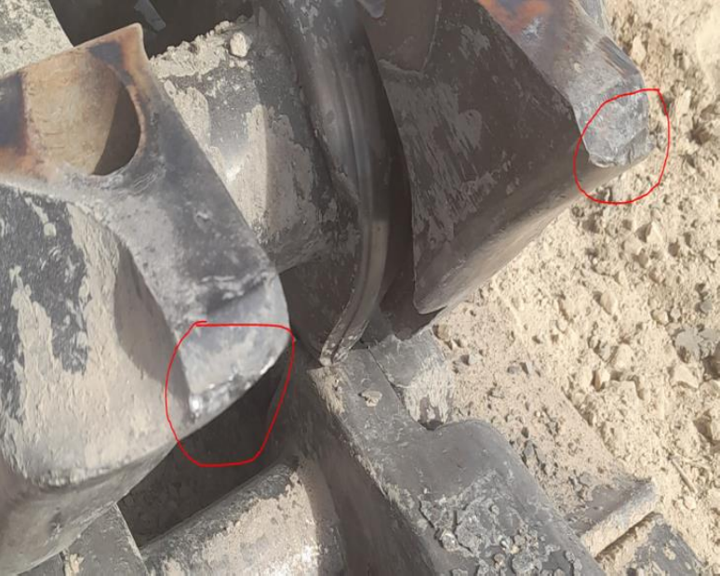
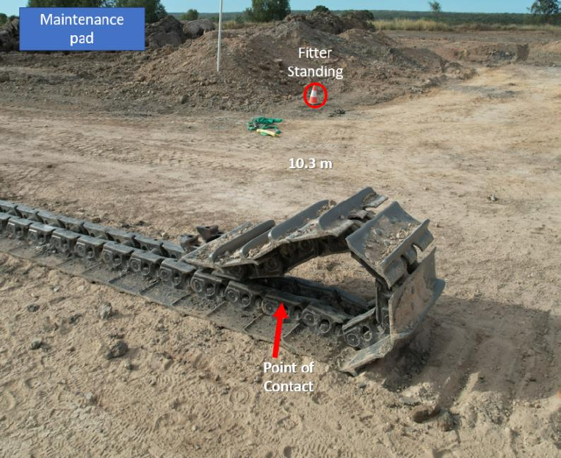

Slide 7
Recommendations
Site Senior Executive
Supervisors
Coal Mine Workers
Ensure that regular monitoring and assessment of the working environment, work procedures, equipment, and installations at the mine is conducted.
Ensure the SHMS documentation for procedures that assist to control remote in-pit and workshop task are reviewed for adequacy for changing work area environments.
Ensure the extent of the responsibilities and duties allocated to the worker or person, that the work and activities under the worker’s or person’s control is conducted in a way that does not expose the worker or person or someone else to an unacceptable level of risk.
Inspect their respective work areas for hazards that may be introduced when task commences.
Ensure the task being undertaken is within the capability of their knowledge and skillset.
Ensure all reasonable and necessary courses of action are taken to ensure anyone is not exposed to an unacceptable level of risk if additional hazards are identified when engaging in task.

Slide 8
3. Incident – Struck by Projectile
Two coal mine workers were replacing steering linkages on a Caterpillar 793F truck when the Y link retaining bolts have broken becoming a projectile contacting a coal mine worker in the cheek. The linner steer link ball stud on the rear of the Y Link had been jacked and the coal mine workers were attempting to remove the ball stud from its seat with a hammer.

Slide 9
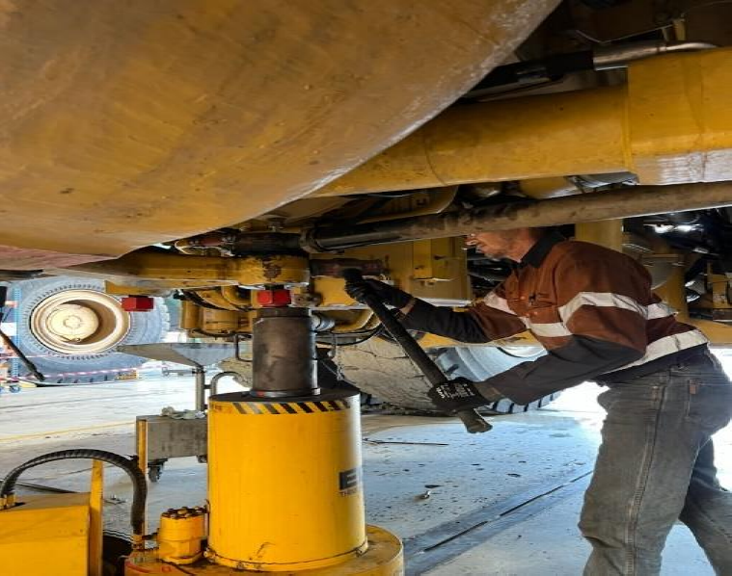
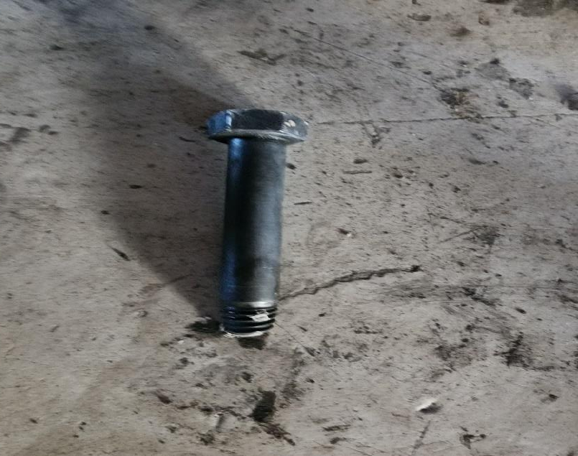

Slide 10
Recommendations
Site Senior Executive
Supervisors
Coal Mine Workers
Ensure the SHMS documentation takes into consideration the guidance from OEM procedures and tooling requirements.
Ensure where applicable the risk management process when developing safe work instructions incorporate for use of the OEM tooling where required.
Ensure the task being undertaken is within the capability of their knowledge and skillset.
Ensure all reasonable and necessary courses of action are taken to ensure anyone is not exposed to an unacceptable level of risk if additional hazards are identified when engaging in task.
Ensure all supervisors and maintainers have the appropriate knowledge and skillset when establishing preventative maintenance tasks.
Ensure positions in the Management Structure are responsible and competent to develop, implement or apply parts of the SHMS that are relevant to the activities that the position is responsible for.
Ensure their responsibility of implementing the relevant parts of the SHMS and the application of plans , including PHMPs, other Hazard Management Plans, SOPs and safe work instructions is undertaken ensure the risk is at an acceptable level.

Slide 11
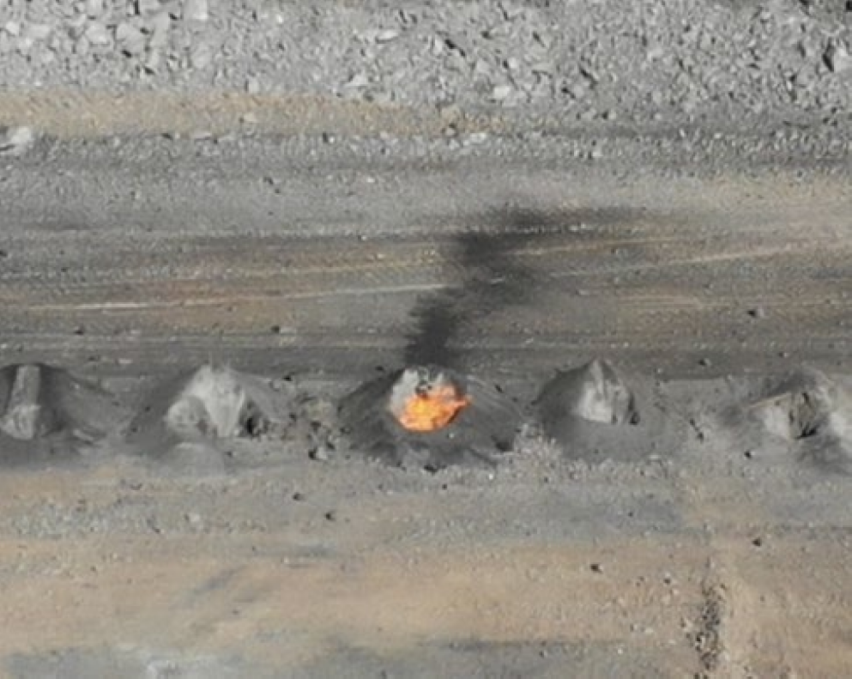
4. Incident - Unplanned ignition of gas
Visible flame identified by shotfirer at top of single blast hole, after firing a pre-split shot.
Methane gas was detected in an adjacent blast hole at 3.8% Visible flame remained contained within single hole and persisted until night fall.

Slide 12
Recommendations
Site Senior Executive
Supervisors
Coal Mine Workers
Ensure that personnel under their control are competent in assessing the risks and hazards associated with the task conducted in their work environment
Ensure a review of the SHMS is undertaken to quantify that drill and blast monitoring procedures for the control of gas emissions and compositions is adequate
Ensure that all hazards identified are monitored and controls implemented are continuously reviewed to effectively manage the risks.
Ensure that a review the SHMS is undertaken for a process to accurately identify and quantify seam gas content and gas compositions specific to the mine
Ensure that personnel under their control are trained and competent in the use of testing and monitoring devices if required to be used in conjunction with task to identify hazardous areas.

Slide 13
5. Incident – Falling into a Liquid
While traversing on a coal floor, a Dozer has driven into a body of water containing a trench. The front has dropped into a water body causing it to become stuck with the operator’s cabin to be partially submerged.
The operator extricated themself from the cabin and remained on the rear of the machine until ERT responded.

Slide 14
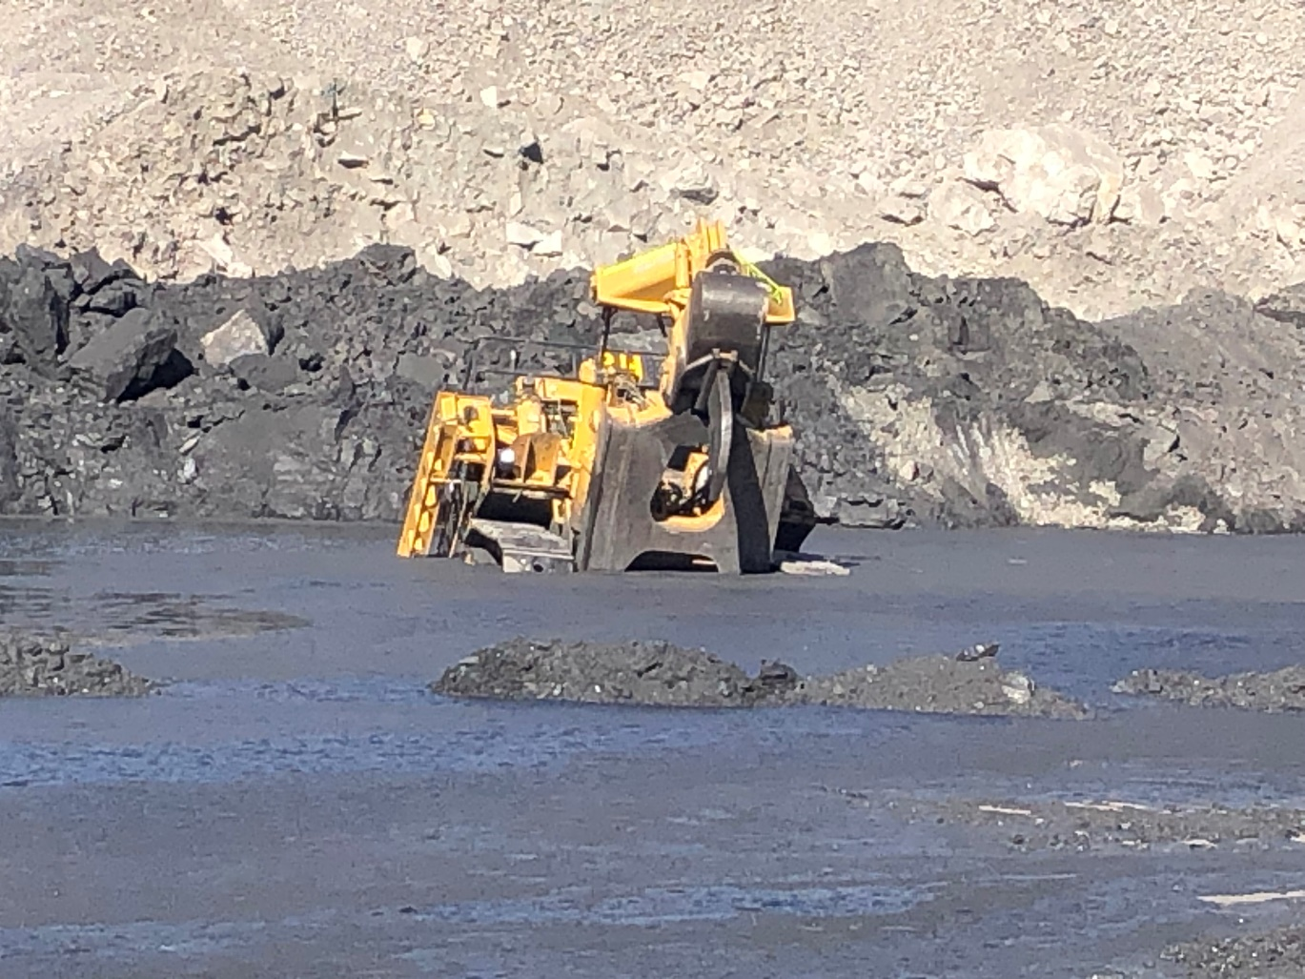
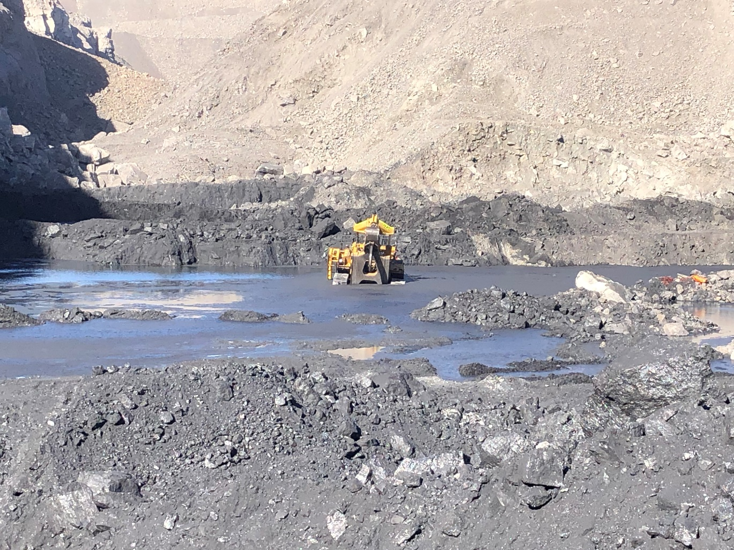

Slide 15
Recommendations
Site Senior Executive
Supervisors
Coal Mine Workers
Ensure continuous monitoring and review of the effectiveness of risk control measures, and take the appropriate corrective action where a non-conformance is identified.
Ensure the task being undertaken is within the capability of their knowledge and skillset.
Ensure all documentation, shift handover reports or active tarps are reviewed and acknowledged to ensure accurate communication of hazards prior to shift change.
Ensure the mines SHMS for effective delineation for sumps and water bodies
Review the systems for survey and geographical measurement when modelling existing structures, such as sumps and trenches where there is the potential for immersion or engulfment for an automatic alarming convention.
Ensure all risk management is undertaken as per the requirements of the mines SHMS prior to undertaking task.
Ensure all plans, work instructions SHMS documentation submitted for the task is validated.

Slide 16
6. Incident – Underground Equipment Fire
Whilst tramming a Dozer underground the machine kept shutting down. While investigating the shutdown cause, the coal mine worker upon opening the filter compartment observed that the filters were beginning to ignite.
The initial investigation found the tap which feeds the scrubber was in the off position and flow control valves incorrectly set. The condition has caused a significant rise in the temperature of the gases passing through the wet scrubber system where the filters are housed. When the canister was opened, exposing the DPM filter to the atmosphere, the filter ignited. Smoke generated from the machine has travelled to the longwall take-off face causing a withdrawal of coal mine workers to a place of safety.

Slide 17
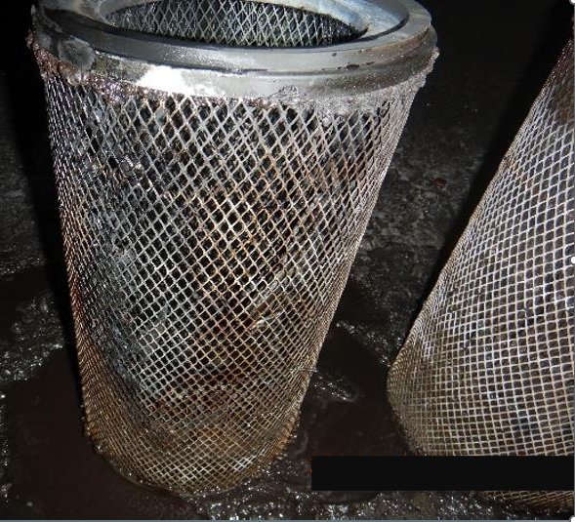
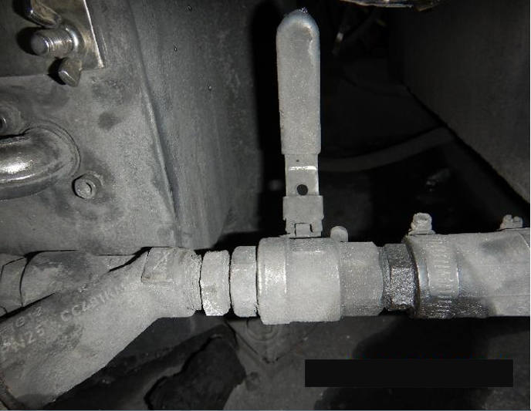
DPM Filters
Scrubber Valve Off

Slide 18
Recommendations
Site Senior Executive
Supervisors
Coal Mine Workers
Ensure pre-start inspections of equipment is effective in identifying potential hazards prior to the operation of mobile plant
Ensure operators of the plant, as soon as practicable after taking control of the plant, check that the plant’s brakes, steering, lights and any other safety features are functioning properly.
Ensure personnel under your control adhere to the mines SHMS for electrical and mechanical equipment used for inspecting, testing and maintaining the safe operation of plant at the mine for using equipment safely and maintaining equipment in accordance with its specification
Review the SHMS for the introduction to site of mobile plant and where applicable replace adjustable flow control valves on safety circuits with either tamper proof or fixed orifice type valves. Ensure personnel who operate or maintain specialised equipment have the appropriate training and skillset when conducting task.

Slide 19
COMMUNICATIONS
2022 Level 1 Mine Emergency Exercise report now available
BOE – Surrender of Certificate of Competency
Gazettal of Recognised Standard 11: Training in coal mines
BOE – Requirements for applying to sit for Certificates of Competency from 1 July 2023
Quarry Fatality Report – Adam Malone
Recognised Standards
Periodicals
Coal Mining Safety and Health Act 1999
Safety Notices
Board of Examiners
FREE Registration for the PCS Scheme
RECENT SAFETY NOTICES
Safety Bulletin 214
Dozer falls into coal stockpile void
Safety Bulletin 213
Dozer rollovers
Safety Alert 432
Light truck travels through bund into creek bed
Safety Alert 431
Dragline collision with cable tractor
Safety Alert 430
Plant access systems
Mining Hazards Database
To subscribe to communications from the Queensland Mines Inspectorate please email
QldMinesInspectorate@rshq.qld.gov.au

Slide 20
Reporting sexual assault or harassment to RSHQ
RSHQ has a dedicated response team for complaints and notifications of sexual assault or sexual harassment
To contact the team, call 1300 581 077 or email complaints@rshq.qld.gov.au.
If you are in immediate danger or your health and wellbeing has been threatened, contact the police (phone 000) and seek medical advice.
Further information is available on RSHQ’s website by scanning the QR code.

Slide 21
What RSHQ can help with
RSHQ’s role is to ensure operators have effective controls and processes in place to:
reduce the risk of sexual harassment and assault in the workplace
receive and respond to complaints and incidents.
RSHQ can also assist workers with referral to support services.
What RSHQ can’t help with
legal advice
workers’ compensation
jurisdiction of other agencies (e.g. incidents occurring off-site)
industrial relations

