Slide 1

Incident periodical
October 2022
Recent High Potential Incidents
Learnings and Recommendations
Industry Performance
Communications
Queensland Coal Mines Inspectorate
Coal Inspectorate

Slide 2
1. Underground Incident – Unintended equipment movement
A CMW was installing primary support for the LW take off roof and face
The hand held bolting unit, known as a gopher was positioned on the steel panline
During operation, the gopher slipped on the steel surface of the panline and struck the CMW on the right foot, causing injuries.
The impact caused fractures to his fourth and fifth toes and a nail bed injury on the CMWs fourth toe that required surgical repair

Slide 3
Recommendations
Site Senior Executive
ERZCs
Coal Mine Workers
Implement controls that prevent inadvertent contact between equipment and coal mine workers.
Ensure the mines SHMS provides adequate processes for checking effective application of risk control measures.
Ensure the mines SHMS provides for appropriate action to be taken if the SHMS risk control measures are identified as not effectively applied.
Be aware of the line of fire
Be aware of the hazard of steel on steel and ensure effective controls are being applied.
Be aware of the hazard of steel on steel.
If you need help to solve the problem, stop and ask the ERZC for help.
Ensure that all of your body parts are out of the line of fire.
Use effective controls, don’t confuse your ambitions with your capabilities.
Be aware and stay out of the line of fire.
Take appropriate action if the SHMS risk control measures are not being effectively applied.

Slide 4
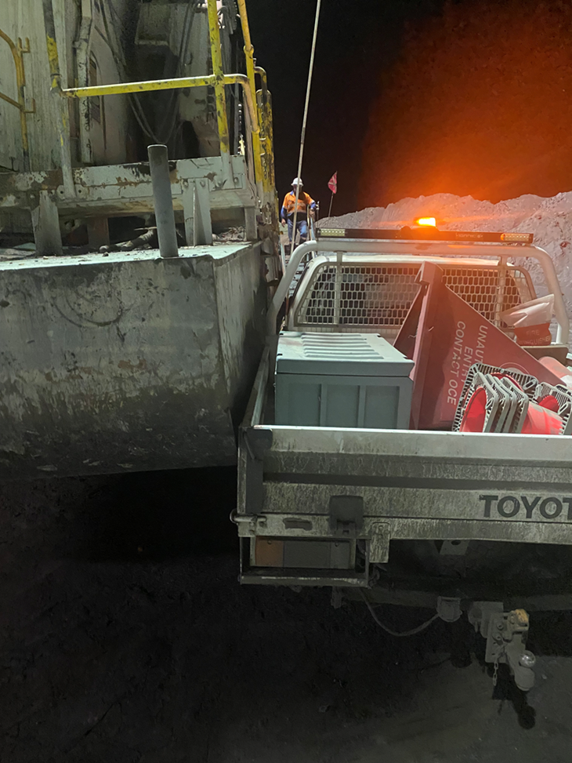
2. Surface Incident – Dragline and light vehicle collision
CMWs conducted a work area inspection, then parked their LV beside the access stairs onto the dragline shoe.
The CMW went to the cabin to review information then decided to use the dragline to check bench heights.
They disengaged the dragline brakes and swung the dragline to the west and placed the bucket on the adjacent strip.
The rotating dragline shoe pushed the LV in an arc as the dragline swung.
Fortunately no coal mine workers were in the vehicle

Slide 5
Recommendations
Site Senior Executive
OCE and Supervisors
Coal Mine Workers
Establish effective controls for parking light vehicles.
Regularly audit CMW compliance with park up locations in and around draglines and other moving equipment.
Take corrective action if the SHMS risk control measures are identified as not being effectively applied by the CMW.
Ensure the mines SHMS provides monitoring for effective application of risk control measures
Park vehicles in the designated parking area and use positive communication with operators to ensure your and your vehicle location is known at all times when operating in and around equipment
The mine procedures and work instructions have the risk controls to save you from getting injured.
Ensure that you are aware of, understand, and comply with park up site procedures relevant to your task.
Ensure the mines SHMS provides for corrective action to be taken when the SHMS risk control measures are identified as not being effectively applied.

Slide 6
3. Underground Incident – Projectile
CMWs were setting up a continuous miner to conduct maintenance.
Boom safety stop pins were being fitted to isolate the boom.
Damage to the chassis clevis had changed the contact point between the clevis and the safety stop pin onto the chamfered end of the pin.
When the boom was lowered, the clevis contact with the chamfer provided the mechanism to eject the safety pin out into the rib with force.

Slide 7
Recommendations
Site Senior Executive
ERZC and maintenance supervisors
Coal Mine Workers
Ensure energy isolation devices are in a fit condition for use, have not been damaged or modified.
Ensure site procedures include a process that confirms the equipment used for isolation of energy is fit for purpose before it is used.
Audit isolation of energy practices to ensure the devices being used are fit for purpose.
Learn exactly how energy isolation devices are designed to work before you use them.
Review the maintenance strategy for plant to ensure that preventive maintenance inspections identify all failure modes of safety boom stops.
Ensure that changes to preventive maintenance work orders are communicated to CMW.
Review OEM safety bulletins and alerts for plant and action recommendations as required.
Ensure that safety related preventive maintenance workorders are completed as a priority.
Review / audit the quality of safety related maintenance work.
Train / retrain CMW in the correct methods of isolating energy.
Never take short cuts when installing safety boom stops. E.g. if 2 pins are required fit bot pins, not just 1 pin.
Slowly lower the cutter boom onto the stops. Do NOT shear down heavily." Applying hydraulic load in addition to the weight of the boom can damage the pins and clevis support.
Be aware of no go zones.

Slide 8
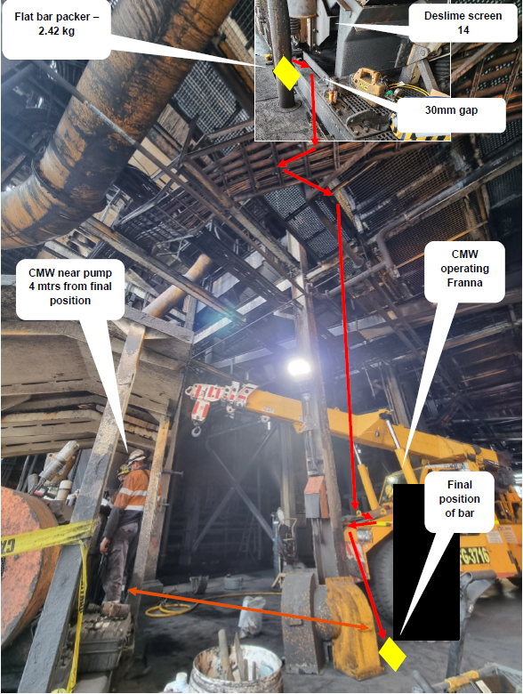
4. CHPP Incident – Falling object
One work team were tasked to replace springs on a desliming screen on one level.
A second work team were completing tasks on the level below.
A steel bar weighing 2.4kg slid through a floor gap and fell 10 metres to the lower level where the other CMW were working.
The bar bounced off the front of a franna, ricocheted into a steel column before landing on the floor.
The two coal mine workers were close to the steel travel path.

Slide 9
Recommendations
Site Senior Executive
Supervisors
Coal Mine Workers
Ensure your SHMS considers the hazards of falling objects, dropping objects and contains effective controls that prevent injury to coal mine workers.
Never allow one group to work above another work group, unless the risk controls for falling objects are in place and effective.
Enforce compliance with critical controls to prevent injury, such as barricading the place above a work area and rescheduling work, to prevent work being undertaken and eliminating the risk of such incidents.
Before commencing work, eliminate the hazard of objects falling into your work area, or of you dropping objects into another CMWs work area when risk assessing your tasks.
Isolate the place above your work area so other CMW cannot drop objects onto you.
Ensure that you critical controls are identified, communicated, validated and effective through visible critical control audits

Slide 10
5. Surface Incidents – Fall from height
A CMW fell to the ground off the access stairs at the front of a rear dump truck.
The CMW had parked the truck and initiated the lowering of the access stairs to get off the truck.
On reaching the lower stair section, the CMW found the stairs were still raised because the attachment to lower the stairs had broken.
The CMW used their foot to push the stairs down.
The ladder section dropped away, the CMW overbalanced, falling to the ground and suffering minor injuries.
BROKEN ATTACHMENT POINT

Slide 11
Recommendations
Site Senior Executive
OCE and Supervisors
Coal Mine Workers
Ensure the risk assessments that underpin your SHMS have considered that CMW will have slips and lapses or make mistakes and the risk controls will still protect them from injury.
Ensure compliance with prestart and defect reporting procedures and processes.
Conduct behavioural observations in the work area.
Maintain 3 points of contact when using plant access systems.
Know, understand, and follow the procedures for accessing plant.
Stop, Look and assess before you take action.
Review your maintenance strategy for access systems
Ensure that changes in maintenance work orders are communicated to CMWs
Follow the SHMS procedures for accessing plant.
Audit the prestart inspection and defect management systems to validate compliance and effectiveness
Validate prestart inspections and defects on equipment
Report defects on equipment and stop the use of the equipment where defects will present an unacceptable level of risk to your health and safety

Slide 12
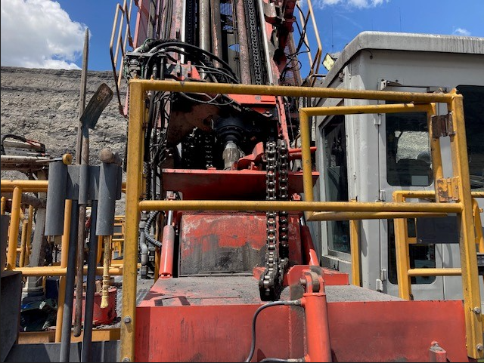
6. Incidents – Falling objects
A rotary blasthole drill rig was operating on a blasthole pattern.
The rotary head fell without warning from the top of the mast, landing on the drill platform in front of the operator’s cabin.
A defective link in the hoist chain connecting links had failed allowing the uncontrolled fall.

Slide 13
Recommendations
Site Senior Executive
OCEs and Supervisors
Coal mine workers
Ensure the SHMS defect management system is easy for CMW to access and use.
Report defects using the correct defect management process at your mine.
Audit CMWs reporting of defects on equipment and assist them to use the reporting system effectively.
Regularly do machine inspections with CMW to help them find the defects.
Ensure that the Change management process is effective and communicated to CMWs.
Review the maintenance strategy for drills to ensure that all failure modes are identified and managed.
Ensure that changes in maintenance work orders are communicated to CMWs.
Ensure that CMWs are aware of the change management system.
Apply the change management as required by the SHMS.
When incompatible parts are supplied for a task, STOP and report it to your supervisor.
Never modify parts without first consulting your supervisor.
Know and understand the change management system.
Comply with the change management system.

Slide 14
Industry Performance Update
July - November 2022

Slide 15
Coal Statistics – October 2022
  144 HPIs received
  9 Serious Accidents
  10 Non-reportable incidents
  17 Cases of reportable disease, 8 not attributable to mine exposure
  17 Dust exceedances
    8 Respirable coal dust (1st trigger levels)
    0 Respirable dust (2nd trigger levels)
    8 Respirable crystalline silica (1st trigger levels)
    1 Respirable crystalline silica (2nd trigger levels)

Slide 16

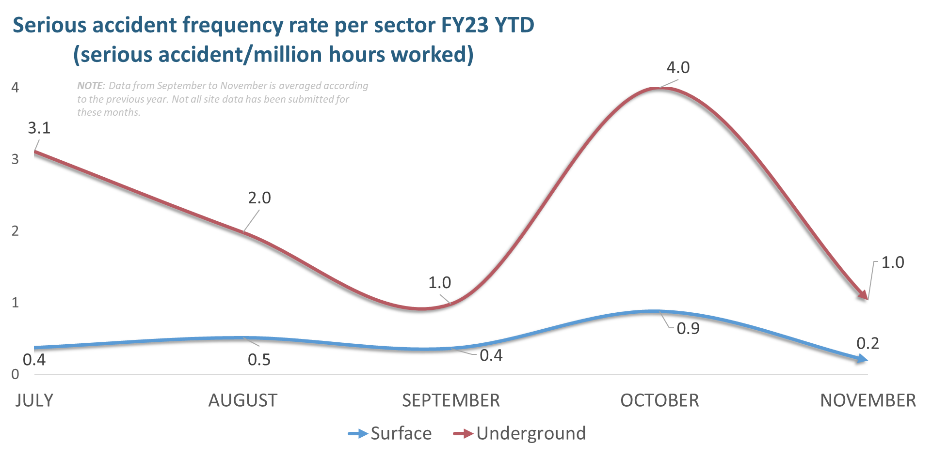
Data taken 5/12/2022
Notes:
Encouraging signs with HPI reporting and SAIFR movement recently Plip in Oct with 9 SA for the month, impact of lower hours in UG resulted in spike

Slide 17
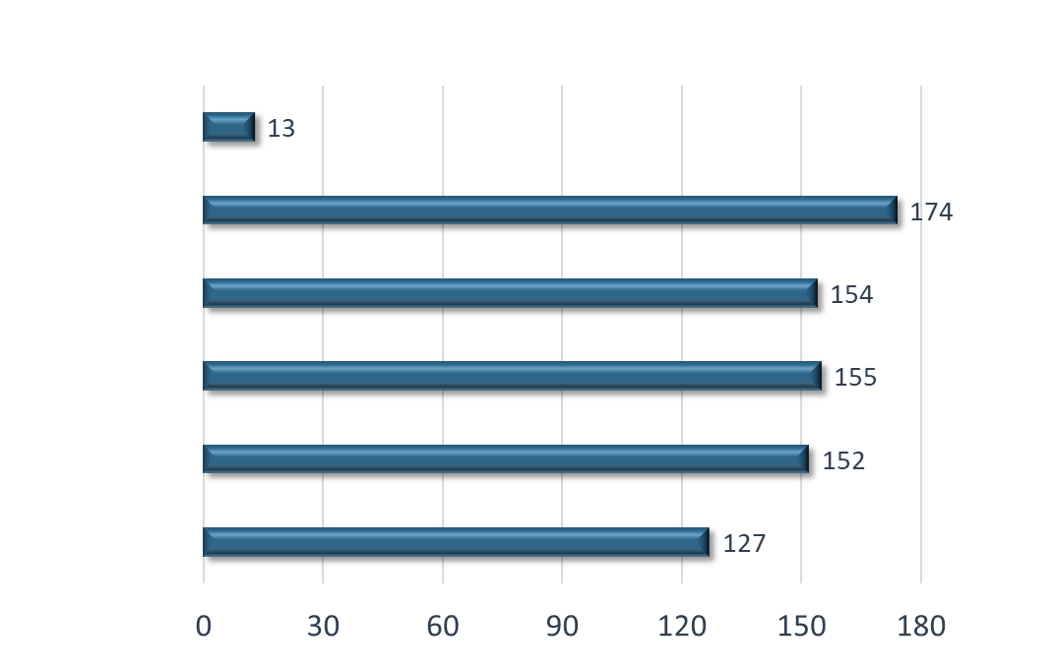
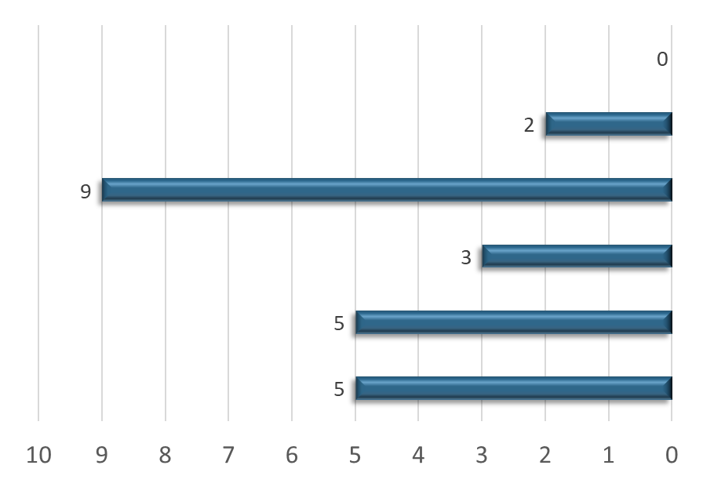
Serious Accidents and High Potential Incidents
24 Serious Accidents
775 High Potential Incidents
DECEMBER (to 5th)
NOVEMBER
OCTOBER
SEPTEMBER
AUGUST
JULY
Data taken 5/12/2022
Notes:
Encouraging reporting in Nov and improved SA performance

Slide 18
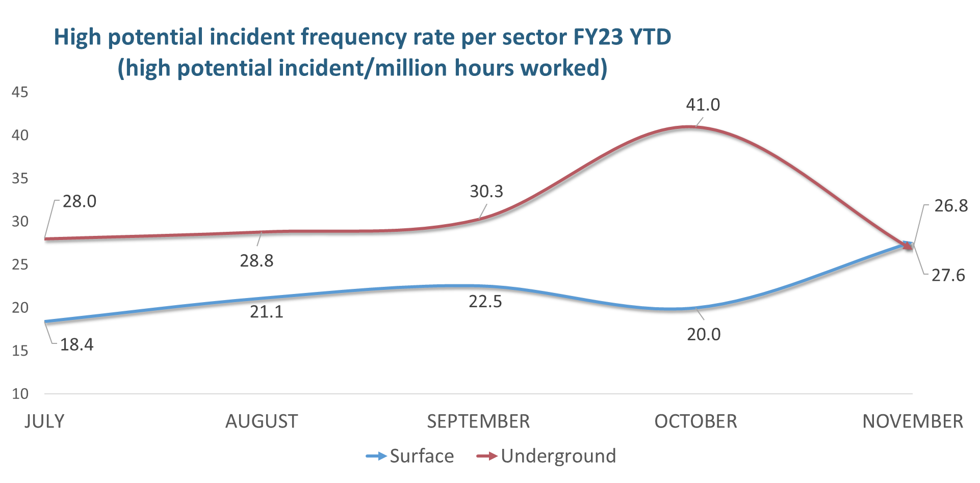
NOTE: Data from September to November is averaged according to the previous year. Not all site data has been submitted for these months.
Data taken 5/12/2022

Slide 19
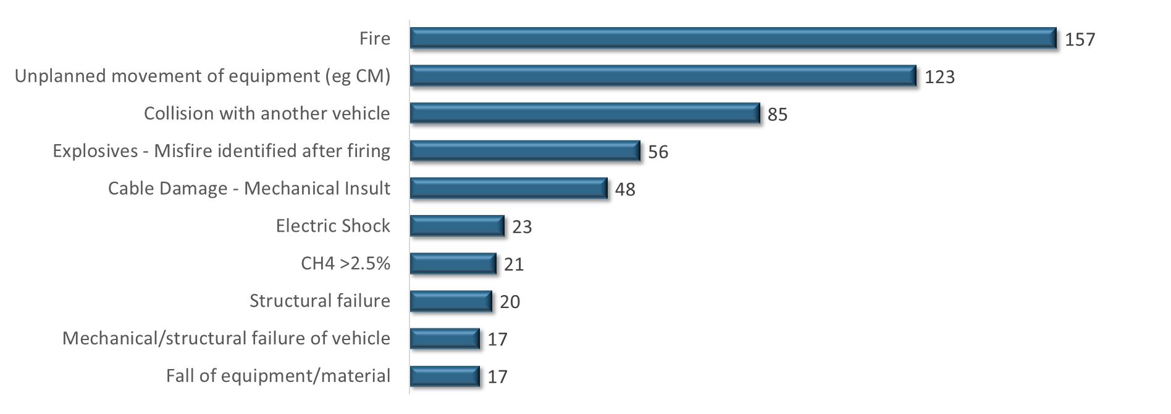
Top ten hazards FY23 YTD
Data taken 5/12/2022
Notes:
Key points Fires continues to be significant issue in the industry, and unplanned movements. CH4 exceedance in the underground sector continues to be a focus area

Slide 20
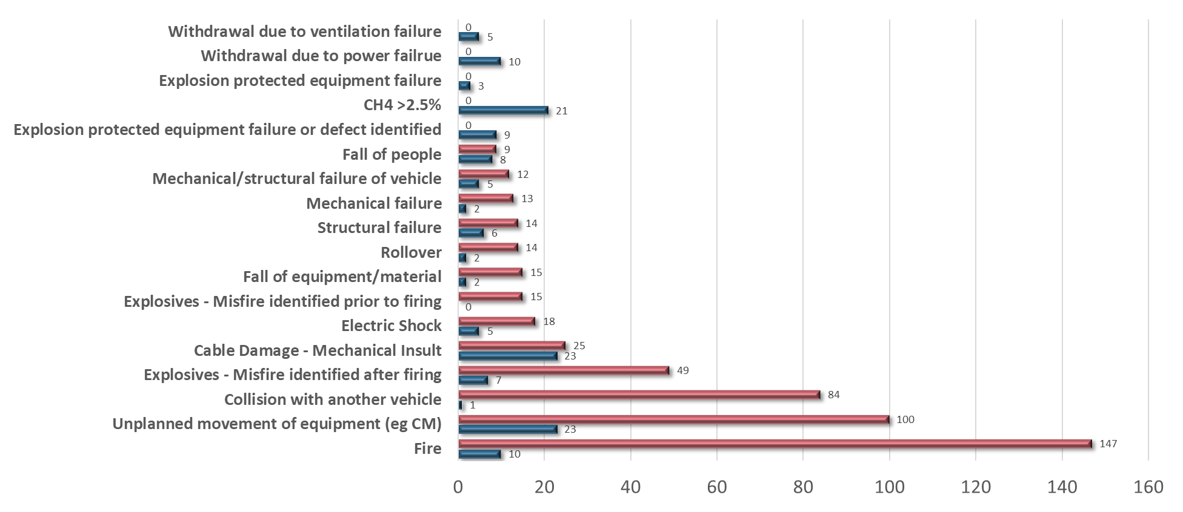
Top Hazards FY23 YTD by sector
SURFACE
UNDERGROUND
Data taken 5/12/2022
Notes:
Methane exceedances and unplanned movements in ug continue to have disproportionate representation and continue to be a concern and focus. In oc fires, unplanned movement and collisions.

Slide 21
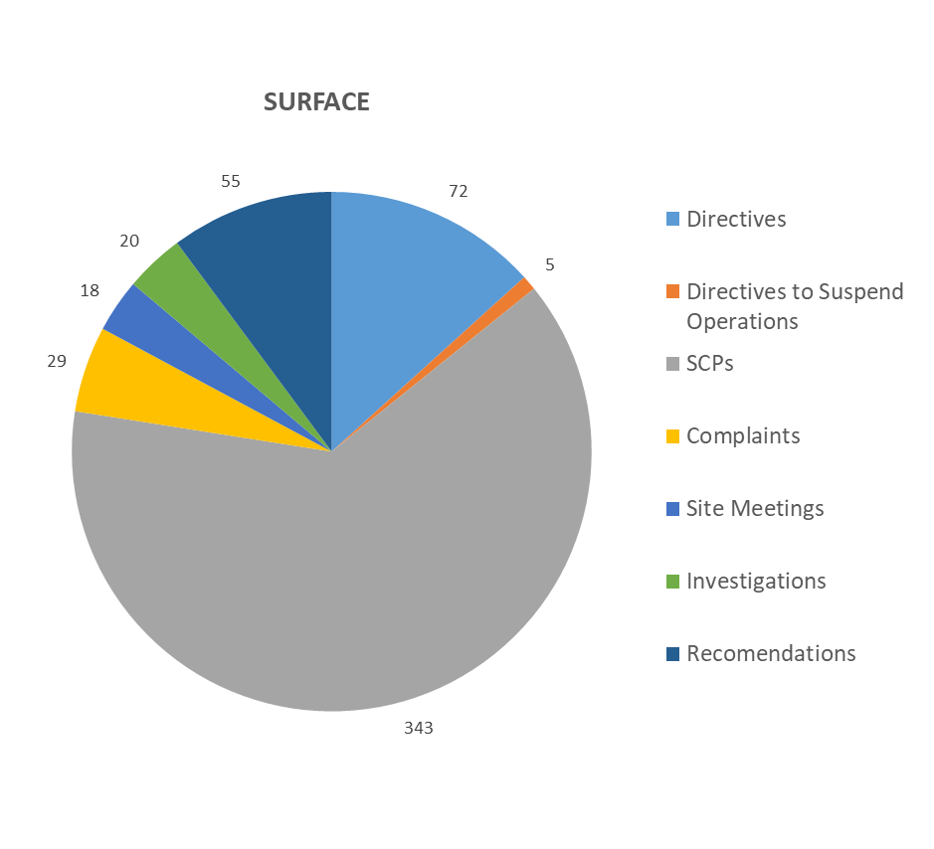
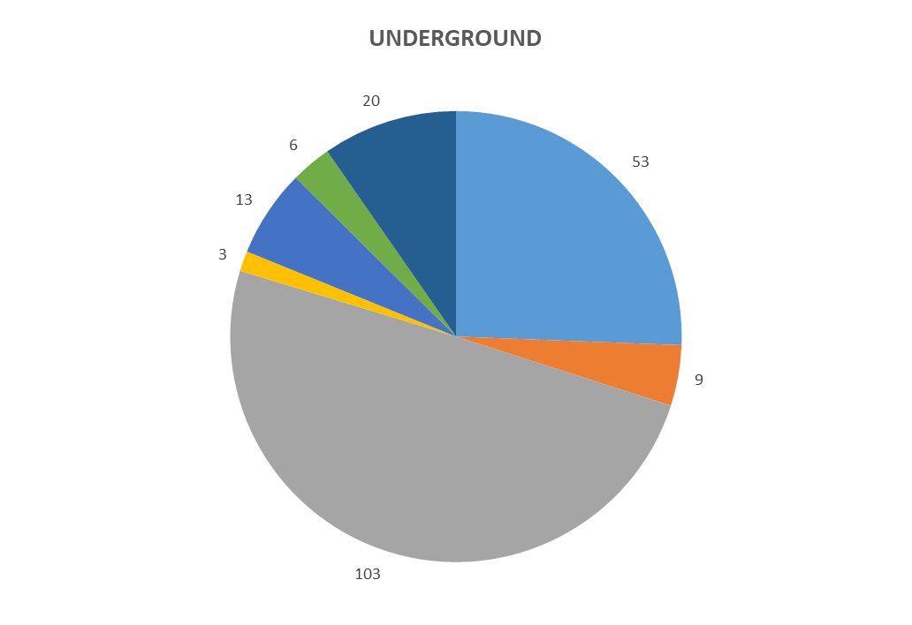
RSHQ Compliance Activities FY23 YTD
Data taken 5/12/2022
Notes:
Continuing to find parts of mine SHMS ineffective during Inspections which mine internal inspections and audits should be identifying and correcting

Slide 22
Communications from the Coal Mines Inspectorate
Expert Report - Assessing the Risk of Operating Mining Equipment During Lightning Storms
Notification from Hastings Deering Australia
QUICK LINKS
Periodicals
Recognised Standards
Safety Notices
Coal Mining Safety and Health Act 1999
RECENT SAFETY NOTICES
Safety Bulletin 207
Managing the risk of storm season
Safety Bulletin 206
Learnings from confined space, spray painting event
Safety Bulletin 205
Risk management during lightning events
Safety Bulletin 191
UPDATED
Managing heat exposure in coal mines
To subscribe to communications from the Queensland Mines Inspectorate please email
QldMinesInspectorate@rshq.qld.gov.au

