Slide 1

Incident periodical
Recent High Potential Incidents
Learnings and Recommendations
Communications
April 2023
Incidents occurred in February 2023
Coal Inspectorate

Slide 2
1. Hot works – Ignition of trapped gas
During demolition of surface structure, a galvanised support was being cut with a grinder.
The pipe was totally sealed.
The cutting process has ignited trapped gas that has been generated and concentrated in the enclosed space. Analysis has confirmed the presence of hydrogen gas.
The ignition has resulted in a flame of approximately 300mm. There were no injuries to CMWs.
The potential hazard of generation of hydrogen gas inside sealed sections of galvanised pipe was not identified in the risk management process.
A partial weld or relief hole in the galvanised section would have prevented build up of gas.

Slide 3
Recommendations
Site Senior Executive
Supervisors
Coal Mine Workers
Review cutting and welding (hot works) procedures to ensure the hazards associated with accumulation of gas in sealed pipes and vessels are included.
Ensure systems are in place so that during design and construction of structures utilising galvanised pipe, arrangements are made to allow for release of gas accumulations (e.g. partial welds or breather holes).
Carefully review procedures and work instructions prior to task.
Review hot work permits and personal risk assessments to ensure hazards associated with accumulations of gas have been considered and effectively managed.
If you encounter sealed pipes or vessels, stop, assess and consult supervisor before cutting or welding.
Make sure CMWs understand and are aware of this hazard.
Consider the line of fire.
Consider potential for accumulation of gas when welding and cutting sealed sections of galvanised and metal pipes when undertaking personal risk assessments.
Ensure processes are in place to communicate this hazard to CMWs.
Include this hazard as a prompt for consideration in the hot work permit hazard ID check list.
Be aware of this hazard during routine inspections of cutting and welding tasks.

Slide 4
2. Light vehicle steering failure
A Light vehicle was being driven on the pit floor at low speed.
The steering arm disengaged leaving the operator without steering function.
Routine maintenance services undertaken by contractor had failed to check for wear on components and provide lubricant to the steering components.
This requirement had not been stipulated in the service sheet items.

Slide 5
Recommendations
Site Senior Executive
Supervisors
Coal Mine Workers
Review site procedures to ensure all items required during services are listed/ itemised.
Regularly review service sheets for accuracy and completion.
Develop a process for undertaking sample checks of workmanship and quality standards.
Follow service sheets carefully.
Ensure all CMWs are aware of their obligations and follow service sheet requirements.
Ensure the mines SHMS provides for a process that monitors the quality and standards of maintenance.
Do not assume service items that are not listed will be conducted.
Ensure all items are completed.
Complete all documentation as required including observations of wear and defects.
Ensure all CMWs are aware of maintenance standards and follow the requirements, including record keeping.

Slide 6
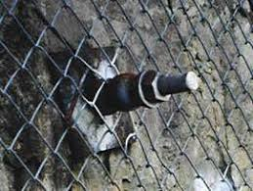
3. Fall of roof material
The continuous miner had just finished mining out a stub.
There was a fall of roof material covering 1.3m (l) x 5m (w) x 2.5m (h).
The bulk of this material landed on the heads of the continuous miner and drill rig platform as it trammed back into the stub.
All coal mine workers were behind the continuous miner in a safe location when the roof collapsed.
Change management process was not effective when the mining sequence plan changed and the risk of creating a canche was not identified.

Slide 7
Recommendations
Site Senior Executive
UMM /Geo techs
Coal Mine Workers
Ensure the SHMS provides for effective change management process.
Observe no go zones.
Ensure mining sequence plan accounts for the design and configuration of the continuous miner.
Remain vigilant and alert. More CMW are killed due to strata related incidents than any other hazard.
Consider support requirements for canches, fenders and drivages that are not considered normal operations.
Ensure changes to mine sequencing and mine layout are subject to the change management process.
Participate in the risk management process.

Slide 8
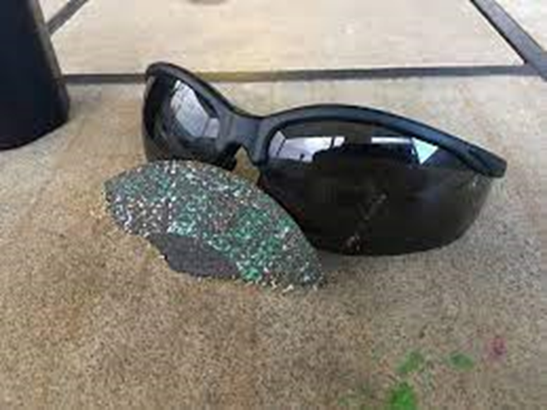
4. Disintegration of cutting disc.
CMW was using a grinder with cutting disc to undertake repairs of a float screen in the CHPP.
The cutting disc disintegrated striking the spotter on the right cheek causing abrasions and swelling.
The cutting disc had been secured with incorrect nut (not fit for purpose).
The cutting disc had been re-used (one use and disposal policy at this site)
Hazards to spotter not appropriately considered and assessed in risk assessment.

Slide 9
Recommendations
Site Senior Executive
Supervisors
Coal Mine Workers
Review site work procedures and work instructions to ensure hazards associated with disintegration of cutting discs are effectively managed.
Regularly inspect tasks and activities in the work area to ensure procedures are being followed, equipment is fit for purpose and PPE is being worn.
Conduct regular inspections of workshop tools and consumable stores.
Ensure processes are in place to routinely audit and inspect tools used for grinding and cutting tasks. Including the correct consumables (cuttings discs etc) and accessories (guards and locking nuts) that are fit for purpose and appropriate for the task.
Consider hazards to spotters and adjacent CMWs when undertaking personal risk assessments and JSA’s.
Only use fit for purpose equipment.
Consider introducing single use policy for cutting discs.
Follow work procedures and work instructions.
Always inspect cutting discs for damage, defects or prior use.
Routinely review personal risk assessments for cutting tasks to ensure hazards associated with projectiles and potential for striking spotters and nearby workers are being identified, assessed and controlled.
Be aware of the line of fire.

Slide 10
5. Unplanned movement of earth – Tip head
The edge of a tip head failed as a rear dump truck reversed up to dump a load.
The operator self escaped without injury.
Two dozers were used to secure the rear dump.
Recent rainfall had triggered a red TARP on the dump. This had just been changed back to green TARP conditions.
Inspections had failed to identify the hazard.
The grade of materials had not been adequately considered in the dump design.

Slide 11
Recommendations
Site Senior Executive
OCE and Supervisors
Coal Mine Workers
Review site operating procedures and dump/ tip head design standards.
Regularly inspect dumps & tip head for compliance with site procedures and operational design standards (such as use of incompetent materials).
Consider changing conditions, such as recent rainfall and impacts on tip had stability.
Ensure the mines SHMS provides for effective and appropriate monitoring of tip head stability.
Follow site operating procedures on dumps and tip heads.
Take corrective actions and/or initiate TARPS when conditions deteriorate.
Remain vigilant and immediately report any hazards or changes in conditions that may indicate reduced stability.
Ensure the mines SHMS provides for the monitoring of the grade of materials being dumped.
Ensure TARPS include identification of different types of dumped material and effective controls to manage any increase in risk.

Slide 12
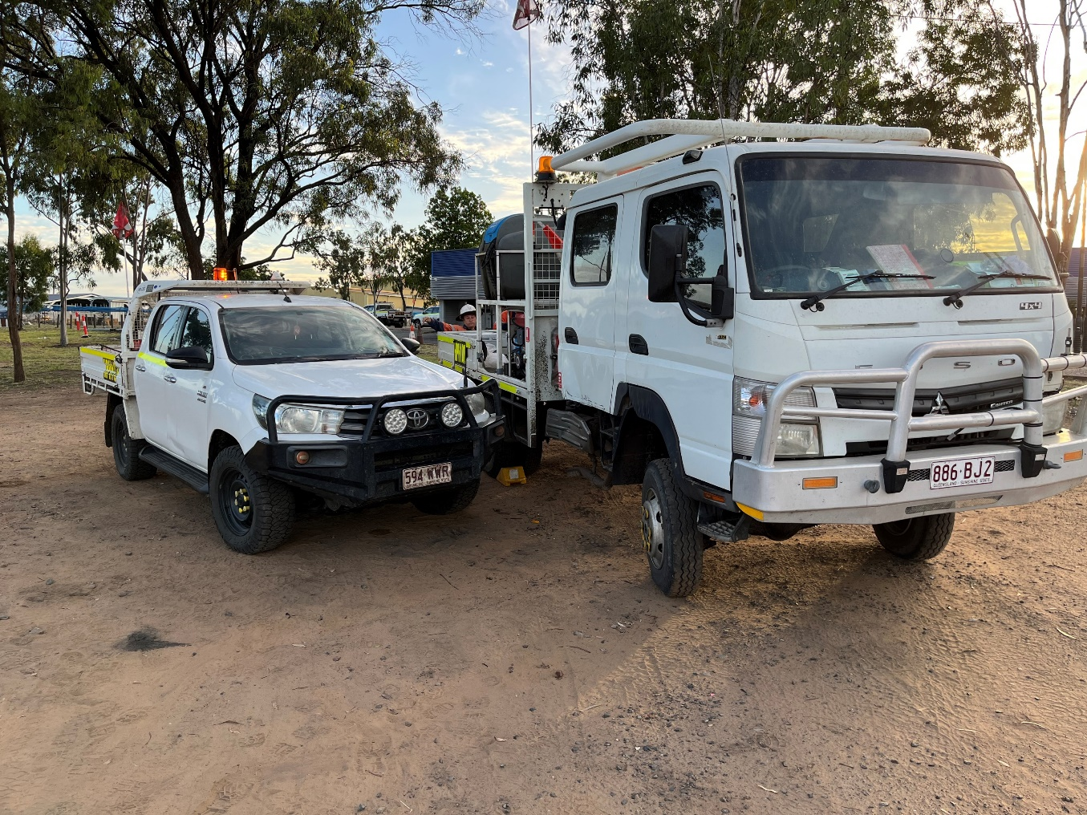
6. Unplanned movement – Service Truck
A light vehicle was waiting to be refuelled by service truck.
Communication break down between the two CMWs resulted in one of the CMWs reaching into service truck and turning on ignition.
The truck was still in gear and had been taken out of isolation to check the function of a suspected flat battery to the fuel pump.
The service truck lurched backward forcing the other CMW who was holding the fuel hose to take evasive action.
Site procedures do not cover refuelling of light vehicles, only HME.
Fortunately there were no injuries sustained.

Slide 13
Recommendations
Site Senior Executive
OCE and Supervisors
Coal Mine Workers
Review site refuelling procedures to ensure they cover all mobile plant, including light vehicles.
Routinely inspect refuelling operations giving consideration to vehicles being fundamentally stable, adherence to isolation protocols and communication.
Consider refuelling requirements for non routine/ adhoc applications including short term contractors.
Maintain clear and positive communications.
Ensure parked vehicles are always fundamentally stable.
Always present to work fit for duty.
Always remain in control of a vehicle when starting. Never start from outside the vehicle cabin.
Routinely review personal risk assessments and JSAs to ensure appropriate hazard identification.
Reinforce site protocols for presenting to work in a fit state and the importance of clear and positive communications.

Slide 14
7. Potential fluid injection injuries
A CMW suffered a suspected fluid injection injury when removing a solenoid from a loader.
The assumption was made that lowering the stairs would release pressures in all hoses.
After removing the last bolt, oil was sprayed onto the fitters hand.
The fitter was treating by site paramedic for potential fluid injection injury.
The OEMs technical information was silent on manual release of pressure.
In addition, an aftermarket ladder system had been installed to the loader rendering the OEM manual obsolete.
The accumulator fitted to the system had not been identified as a source of stored energy.
CMW cleared of any fluid injection injury.

Slide 15
Recommendations
Site Senior Executive
Supervisors
Coal Mine Workers
Review procedures for working with high pressure fluid systems giving consideration to Recognised Standard 23.
Understand the risks associated with fluid injection injury and follow site protocols with respect to prompt medical assessment.
Ensure the mines SHMS provides for effective emergency management procedures for assessing and treating suspected fluid injection injuries.
Understand potential for serious harm from fluid injection injuries.
Ensure appropriate change management undertaken when fitting aftermarket kit to OEM equipment and specifically the impacts to high pressure fluid systems.
Where practical, consider the use of dyes in high pressure fluid systems that can assist in identifying fluid injection injuries.
Immediately report any potential fluid injuries to supervisor.
Consider risks associated with high pressure fluid systems in personal risk management.
Never assume there is no stored energy without positive confirmation.
Communicate the hazards to CMW.
Review personal risk assessments and JSAs to check that risks associated with high pressure fluid systems are being identified and appropriately controlled.

Slide 16
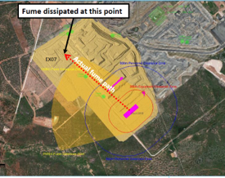
8. Potential for blast fume exposure
There was a change in wind conditions prior to initiating a blast.
This caused the fume cloud not to disperse as planned.
The fume hugged the highwall and traveled in a direction of a working excavator crew.
Vigilance of the blast controller enabled safe evacuation of the excavator crew.
Fume eventually dissipated prior to reaching the original position of the excavator.
No exposure to CMWs.

Slide 17
Recommendations
SSEs and Drill and Blast Superintendents
Blast controllers
Coal Mine Workers
Consider all available historical weather data when designing blast exclusion zones and fume management zones.
Remain vigilant up to and during blasting and continue to monitor prevailing weather conditions to anticipate impacts of sudden / late changes.
Observe blast boards and take note of when blasts are planned.
Monitor appropriate channels and take immediate action when directed to evacuate or move by blast controllers or blast guards.
Take refuge and/ or remain inside crib huts or vehicle cabins if changing conditions result in blast fume travelling in your direction.
Understand the signs and symptoms of blast fume exposure (ie. Nitrogen dioxide exposure).
Immediately notify your supervisor if exposure is suspected.
Understand the impacts of structures such as highwalls or pit design that may influence the direction and distance of travel of blast fume clouds.
Ensure that fume cloud modelling is based on the most recent and local weather forecasting data.
Ensure ability to continue to monitor local conditions are available to blast controllers and guards.
Understand operational activities adjacent to or contiguous with fume management zones and identify places of safety that may be used if conditions change.
Prior to initiating a blast understand factors that may increase the potential for fume such as recent rain, ground water or lack of confinement.
During design and planning of blasts, consider the impacts of pit design and structures such as highwalls and contours that may influence direction and duration on blast fume clouds.
Consider video recording of all blasts to capture data and assist in modelling.
Ensure the mine has a process for responding to suspected blast fume exposures.
Consider adjacent operations that may be impacted by sudden changes in environmental conditions and ensure appropriate and effective communication is available.

Slide 18
Coal Statistics – February 2023
February 2023
  135 High Potential Incidents (HPIs) received
  7 Serious Accidents
  15 Non-reportable incidents (NRIs)
  11 Cases of reportable disease, 8 not attributable to mine exposure
  Dust exceedances
    4 Respirable coal dust (1st trigger levels)
    0 Respirable dust (2nd trigger levels)
    11 Respirable crystalline silica (1st trigger levels)
    2 Respirable crystalline silica (2nd trigger levels)

Slide 19
Recognised Standards
Letters from the Chief Inspector of Coal Mines
Reporting HPIs following withdrawal of persons from an underground coal mine
Implementation of BoI Recommendations for surface operations
Obligations for maintaining rescue capability at an underground coal mine
Failure to meet the required number of respirable dust samples as stipulated in RS 14
Diesel guideline exposure limit reduction
Periodicals
Coal Mining Safety and Health Act 1999
Safety Notices
Board of Examiners
FREE Registration for the PCS Scheme
RECENT SAFETY NOTICES
Safety Alert 426
Rare earth magnets
Safety Alert 425
Fall of equipment and persons into a stope void
Safety Alert 424
Dozers entrapped in stockpile voids above feed valves
Safety Bulletin 210
Review the silica exposure risk and associated controls when encountering stone
Safety Bulletin 209
High speed bearing fires on underground loaders
Safety Bulletin 208
Bulldozer rollover events
To subscribe to communications from the Queensland Mines Inspectorate please email
QldMinesInspectorate@rshq.qld.gov.au

