Slide 1

December 2020
Incident periodical
Recent High Potential Incidents
Learnings and Recommendations
Queensland Coal Mines Inspectorate
Coal Inspectorate

Slide 2
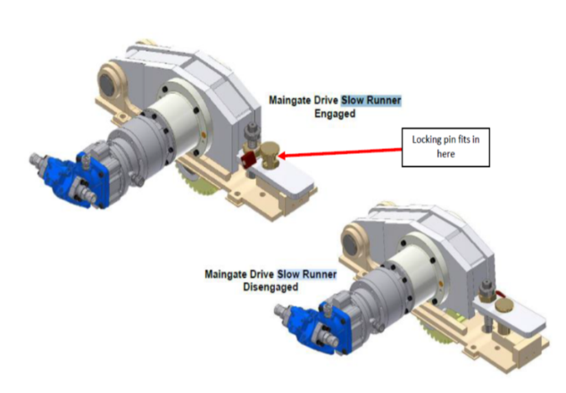
Incident – Energy Isolation Failure – Underground Mine
A coal mine worker was doing repairs to the AFC.
Electrical power to the AFC was isolated correctly.
The repairs required the hydraulic AFC slow runner be used to create slack in the top chain.
There was an energy release that allowed the chain to slip at the tailgate while the CMW was in the line of fire.
The energy release was due to not engaging the slow runner correctly.
The CMW sprained their ankle avoiding the moving chain.
Insert Photo

Slide 3
Recommendations
Site Senior Executives
  Ensure energy sources are being effectively controlled by the safety and health management system and that relevant coal mine workers are competent in the use of the controls.
The senior position responsible for mechanical maintenance within the management structure
  Design, install and implement suitable energy controls for use of the AFC slow runner.
  Provide coal mine workers with competency such as RIIAM207E Apply operational maintenance skills, or similar.
Coal mine workers
  Identify all of the line of fire possibilities affecting each task
  Stay out of the line of fire of an energy source, until you know the energy source has been controlled and you have tested and proved the control is effective.

Slide 4
Incident – Unplanned Movement – Surface Mine
A coal mine worker tasked with field service work arrived to fuel a bulldozer.
The service truck was stopped facing the bulldozer, not parallel to it.
The CMW did not apply the truck’s park brake before leaving the cabin.
As the CMW went to access the bulldozer, the truck rolled forward into the ladder.
The moving truck hit the side of the ladder, just missing the CMW.

Slide 5
Recommendations
Site Senior Executives
  Ensure the risks of vehicle movement when parking are being effectively controlled by the SHMS
The senior position responsible for field servicing within the management structure
  Ensure coal mine workers who conduct field servicing are competent to
  RIIAM212E – Service mine plant or equipment, or similar.
Coal mine workers
  Always follow the SHMS vehicle park up procedures to prevent any vehicle movement occurring when you have left the vehicle cabin.

Slide 6
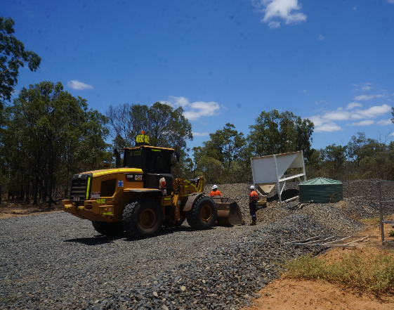
Incident – Near Miss – Underground Mine
Boreholes are used at an underground mine, to deliver materials to underground work areas.
Access to boreholes lids are locked with individually keyed locks.
A CMW went to the wrong borehole on the surface.
The lock on the borehole access was not properly closed.
The CMW was able to open the lock with the key for the other borehole.
The CMW dropped ballast down the borehole.
A CMW had been under the borehole doing inspections just beforehand.

Slide 7
Recommendations
Site Senior Executives
  Audit the effectiveness of the controls in the SHMS, designed to prevent similar near misses.
The senior position responsible for delivery of supplies underground within the management structure
  Ensure the hazards of inadvertent access to a work area, are being effectively controlled by the SHMS.
Coal mine workers
  Follow the SHMS procedure for delivering materials via boreholes.
  Stop when the conditions are not as described in the procedure and review the differences with your supervisor before recommencing work.

Slide 8
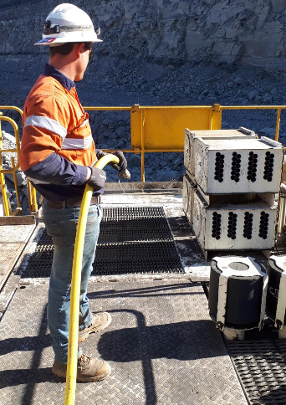
Incident – Serious Injury – Surface Mine
A CMW was cleaning the top of the excavator house using a water hose.
The CMW’s feet got tangled in the hose and the CMW fell over.
The CMW landed on their shoulder in the fall and required medical treatment.
The humerus bone was fractured during the fall.

Slide 9
Recommendations
Site Senior Executives
  Ensure the SHMS adequately provides controls for the hazards requiring management during manual handling and housekeeping tasks.
  Provide CMWs conducting housekeeping for maintenance with a competency such as RIISAM207E - Apply operational maintenance skills, or similar.
The senior position responsible for maintenance within the management structure
  Ensure coal mine workers follow the SHMS procedures applying to manual handling and housekeeping.
Coal mine workers
  Be aware that significant injury can occur to you when carrying out a low risk task.

Slide 10
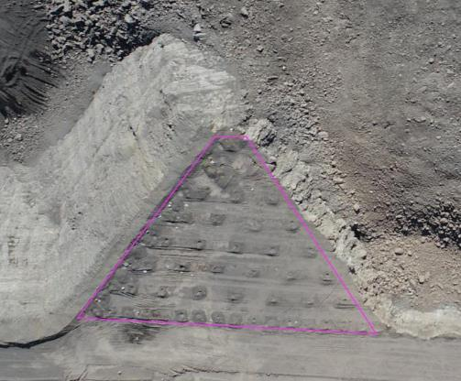
Incident – Misfire – Surface Mine
Forty nine holes misfired during an overburden blast.
The post blast inspection found a non-electric surface lead had been damaged by flyrock, causing the misfire.
Inspections confirmed the misfire could be reconnected and fired.
All holes fired at the second attempt.

Slide 11
Recommendations
Site Senior Executives
  Ensure the manager responsible for blasting activities has an effective system for designing blasts, to avoid an unacceptable level of risk from misfires developing.
  Provide coal mine workers responsible for blast design with a competency such as “RIIBLA403 – Design Blasts” or similar.
The senior position responsible for blasting within the management structure
  Provide coal mine workers who conduct blasting operations, with a competency such as “RIIBLA301E – Conduct surface shotfiring operations”, or similar.
Coal mine workers
  Strictly follow the blast designs provided.
  Stop loading and tie up activities when a blast design cannot be strictly followed in the field.

Slide 12
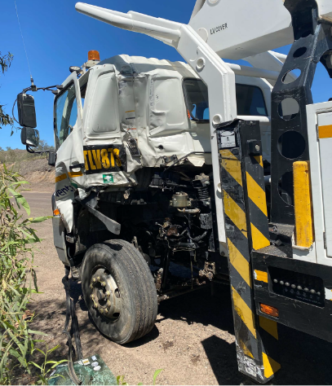
Incident – Collision – Surface Mine
A vehicle was being escorted through a surface mine.
The escort driver allowed a gap to grow behind them to the vehicle they were escorting.
A truck entered that gap.
The truck then slowed to turn off the road.
The driver of the vehicle under escort thought the truck was making a right hand turn.
The truck veered right then turned left and the vehicle under escort crashed into the side of the truck’s cab.
No injuries were reported.

Slide 13
Recommendations
Site Senior Executives
  Ensure the SHMS has procedures for escorting vehicles at an acceptable level of risk.
  Provide CMWs with competencies suitable for the task such as RIICRM201E - Escort mobile works, or similar.
The supervisor
  Ensure coal mine workers performing vehicle escort duties are competent in the relevant SHMS procedure.
Coal mine workers
  Follow SHMS escort procedures diligently to ensure an acceptable level of risk

