Slide 1
August 2020 Incident periodical
Recent High Potential Incidents
Learnings and Recommendations
Queensland Coal Mines Inspectorate
Coal Inspectorate

Slide 2
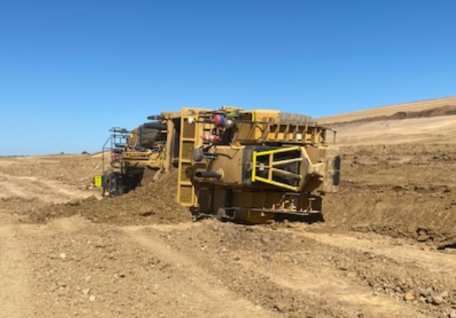
Incident – Scraper Rollover – Surface Mine
Details
A loaded scraper has rolled onto its side when endeavouring to traverse from a lower level bench up onto a higher level bench.
The operator was not injured in this incident.

Slide 3
Recommendations
Site Senior Executives
Ensure that mobile equipment must be only operated within the OEM’s specifications, e.g. crossfall and gradient.
The senior position responsible for overburden removal within the management structure
Where required access ramps should be installed to allow for the safe movement of equipment.
Coal mine workers
Work area inspections checking for hazards must be conducted by supervisors, open cut examiners and coal mine workers prior to work commencing.

Slide 4
Incident – Seal Hatch Doors Locking Mechanism – Underground
Details
When testing the locking mechanism on a newly installed final Seal Hatch door as part of the seal up it was found that the locked mesh hatch door could be opened with minimal amount of force.

Slide 5
Recommendations
Site Senior Executives
Consider alternative engineering locking mechanisms in ensuring the risk is as low as reasonably achievable.
The senior position responsible for ventilation devices within the management structure
As part of the commissioning process equipment should be tested to ensure it is fit for purpose.
Coal mine workers
Do not interfere with ventilation devices unless authorised .

Slide 6
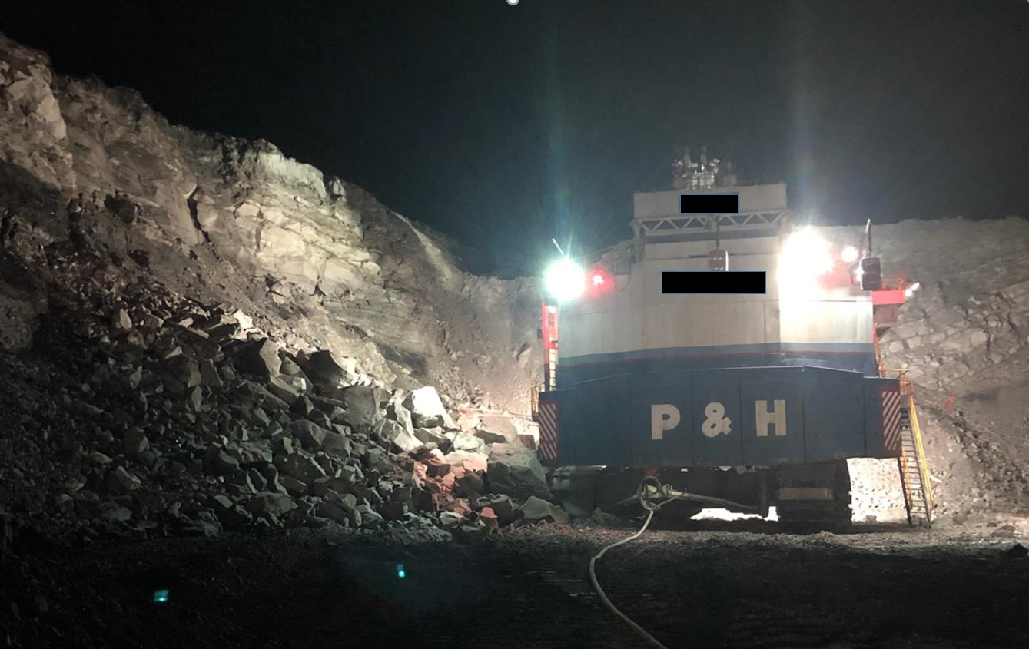
Incident – Highwall failure – Surface Mine
Details
During pre-strip operations a section of highwall failed resulting in fallen material impacting the undercarriage and counterweight on an electric shovel.

Slide 7
Recommendations
Site Senior Executives
Ensure sufficient data from exploration drilling is available that provides for accurate modelling of faults lines etc.
The senior position responsible for mine design within the management structure
Ensure sufficient geotechnical data for safe pit design and modelling is collected, analysed, interpreted and communicated.
Open Cut Examiners and Supervisors
Must carry out thorough inspections of pit walls looking for signs of potential strata failures.
Coal mine workers
Work within design parameters and report any unplanned movement of plant or material

Slide 8
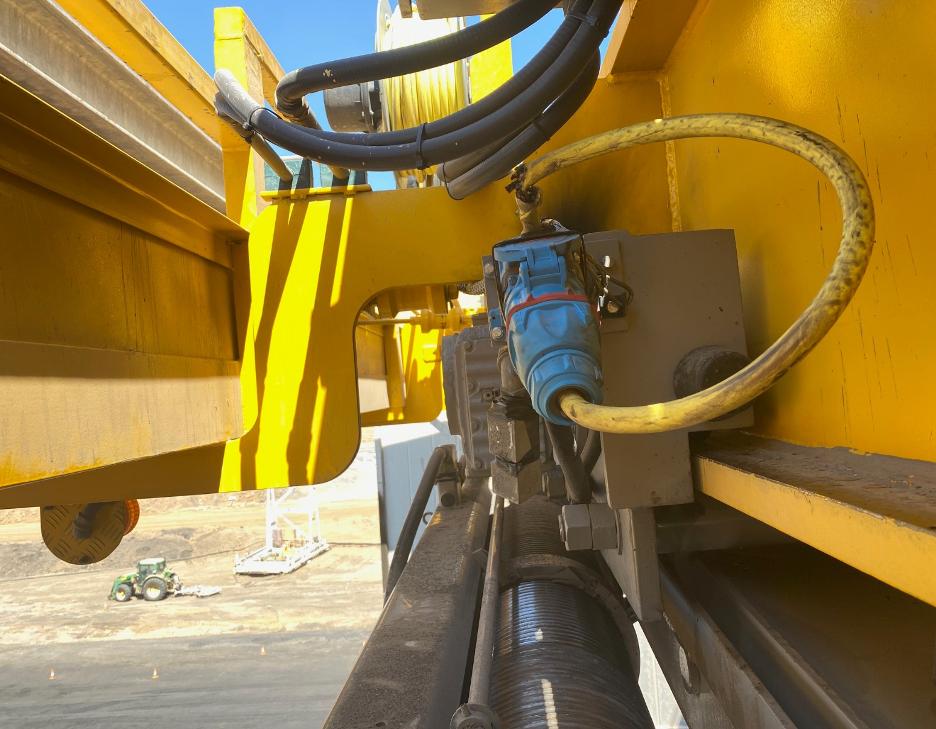
Incident – Cable damage on an overhead crane – Surface Mine
Details
Whilst relocating an overhead crane in the house of a dragline an electrical cable has become caught on structure.
The cable was damaged causing a release of energy.
The earth leakage protection tripped as per design.
The cable had been incorrectly reinstalled after a recent service.

Slide 9
Recommendations
The senior position responsible for electrical installations within the management structure
A safety file should be maintained over the life cycle of all electrical equipment to provide traceable evidence relating to the safety of the equipment as well as providing a reference for consideration prior to carrying out any upgrades, modifications or changes to maintenance practices
Supervisors and Coal Mine Workers
Ensure mechanical protection is in place for exposed electrical cables.

Slide 10
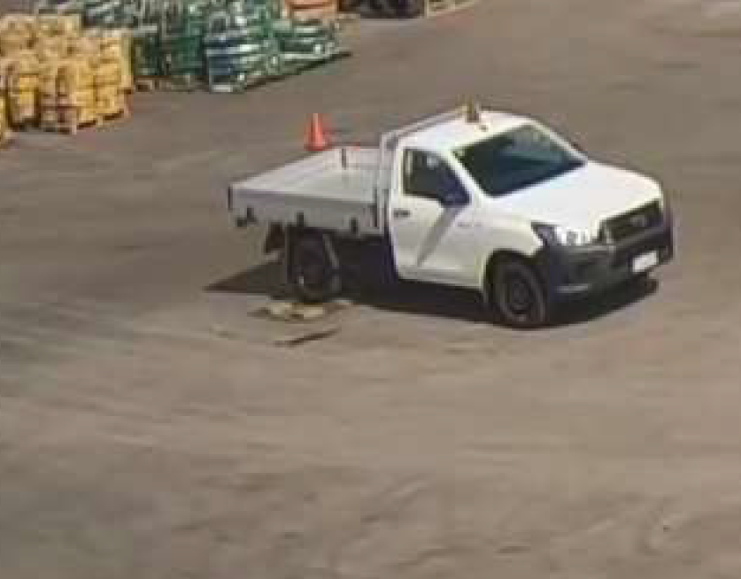
Incident – Uncontrolled Movement of Parked Equipment
Details
A light vehicle was left unattended in a store yard, still running and in gear (drive) with the park brake on.
The vehicle moved slowly down the yard until it reached a storage area, where it bumped into some pallets and equipment before coming to a stop.

Slide 11
Recommendations
Supervisors
Supervisors should regularly check and monitor that equipment is parked as per the site requirements contained in the safety and health management system.
Coal Mine Workers
Must comply with the site requirements contained in the mine safety and health management system requirements for parking equipment.

Slide 12
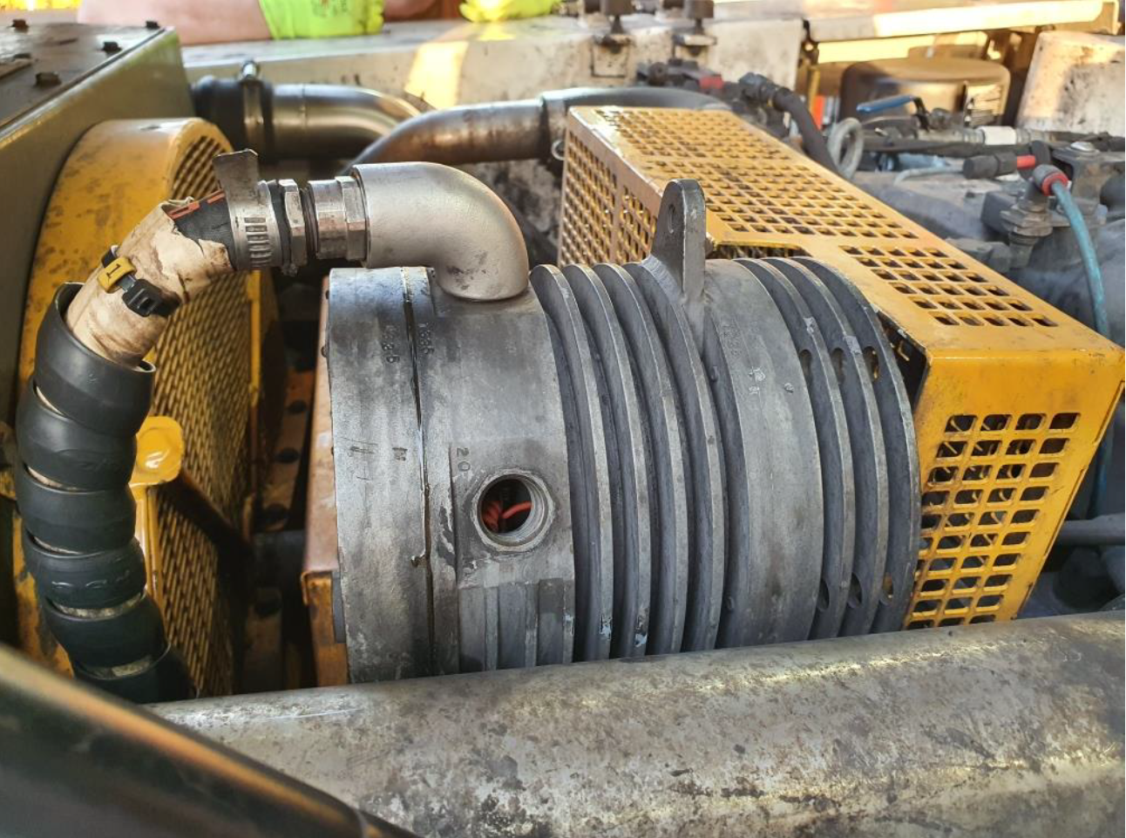
Incident – Explosion Protection compromised – Underground
Details
A daily vehicle pre-start inspection on an underground man carrier revealed that a Flameproof Exd 20mm bung was missing from the flameproof alternator.

Slide 13
Recommendations
Senior Site Executive
Review work management systems related to electrical equipment for coal mines – introduction, inspection and maintenance for adequacy – Reference AS/NZS 2290.1 : 201
The senior position responsible for maintenance within the management structure
Ensure bungs and other devices are installed and maintained so as to prevent inadvertent failure of the bungs and/or devices.
Coal Mine Workers
Ensure all defects are recorded and reported during pre start inspections of equipment

Slide 14
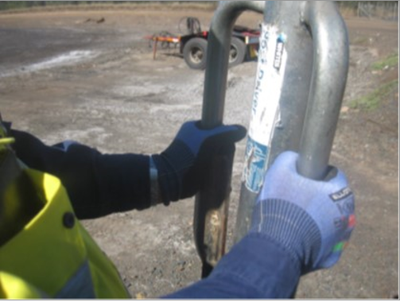
Incident – Serious Thumb Injury – Surface
Details
A coal mine worker incurred serious injuries to his left thumb when a star picket driver slid off the top of the star picket as he was driving the picket in.
The thumb was squashed between the driver and the top of the star picket resulting in fractures and a laceration that required remedial surgery.

Slide 15
Recommendations
Coal Mine Workers
All tasks must be assessed for potential hazards / risks before being commenced.
This incident is pertinent to safety at home as well as work. A simple type of task that many of us perform at home with the same potential risk present.

