Slide 1
December 2023 Incident periodical
Recent High Potential Incidents
Risk Controls identified by mine-site investigations
Communications
Queensland Coal Mines Inspectorate
Coal Inspectorate

Slide 2
Ineffective Risk Controls
The last periodical for 2023 is about ineffective risk controls.
Many HPI and accident investigations by mine management are not finding risk controls which will be effective to prevent incidents from happening again.
Investigation reports are recycling failed administrative risk controls which do not prevent the same sort of incident happening again.
Mine management must find higher order risk controls that are effective in preventing the incidents from happening again.

Slide 3
Ineffective seat belts
A coal mine recently found several vehicles (all Utes) had defective seat belts.
The seat belts were reported to unlatch while the vehicle was in motion.
101 vehicles were inspected at the mine; 6 were identified as having defects with seat belts.
Seat belts had cracked plastics around the tongue and/or failing tongue integrity.
Seat belts had latch assembly failures where the seat belt pulled out of the latch when tested.
The cause of the “unlatching” failures has not been categorically confirmed however evidence suggests dust ingress is a potential contributor.

Slide 4
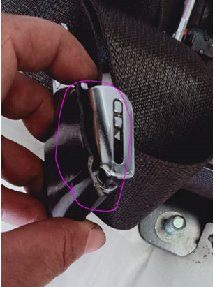
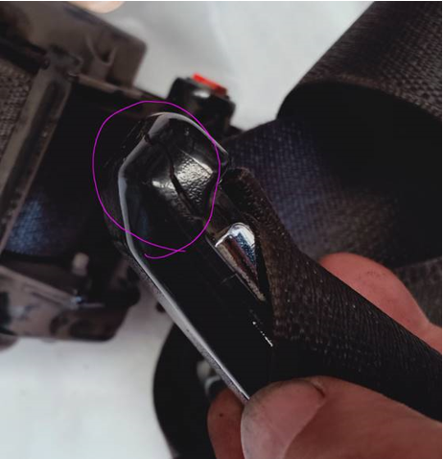
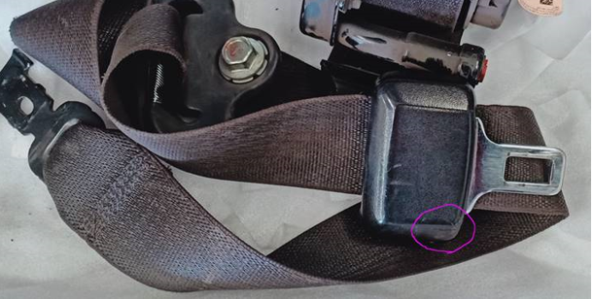
Ineffective seat belts

Slide 5
Ineffective seat belts – questions for reflection
Why are the mine’s prestart checks not adequately covering the inspection and function checks of seat belts?
Why are the field task observations / safety interactions not ensuring compliance to your SHMS, every day on every shift?
Should site vehicles be audited every day/week/month/ year for seat belt integrity and functionality?
Who checks the effectiveness of your site maintenance systems for seat belt inspections, on both light and heavy mobile plant?

Slide 6
Loss of control of dump trucks
11 notifications in September reported that coal mine workers had lost control of a dump truck.
Multiple events occurred at three mines.
Single events occurred at four mines.
Every event occurred when the dump truck was travelling downhill.
Fortunately, all the trucks stayed on their wheels.
Some trucks did cross into the uphill lane during the loss of control event.

Slide 7
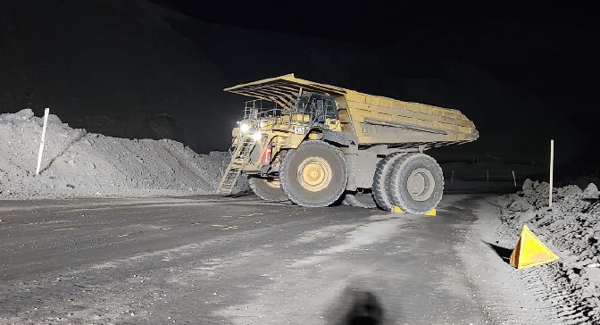
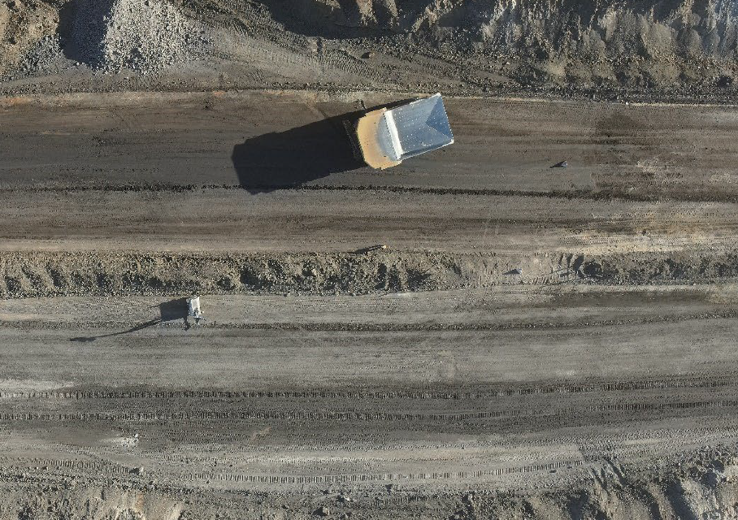
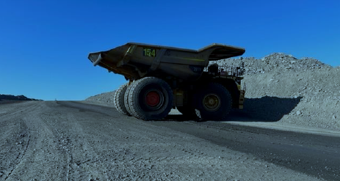
Loss of control of dump trucks

Slide 8
Ineffective administrative risk controls found by mine management
N.B. These will not stop it happening again.
Daily inspection sheets to be completed by supervisors/OCE.
Appropriate actions to be taken at time of inspection.
Educate CMW's through toolbox talk.
Conduct a spot spray trial for down ramps only.
Reminder to truck operators for first load down a ramp to take it easy on gear selection.
Retrain truck operator and retest in wet conditions.
Add in the SOP packs to the new starter training packs so truck operators can read between sessions.
Create SWI outlining the requirements and responsibilities involved in watering circuits with all water carts.
Retrain truck operator on low traction training.

Slide 9
Collisions at dumps and dig faces
11 collisions were reported during September.
Most collisions happened on dumps or at dig faces.
One coal mine worker reported an injury.
Positive communication between equipment operators was made before some of the collisions occurred and did not prevent it.

Slide 10
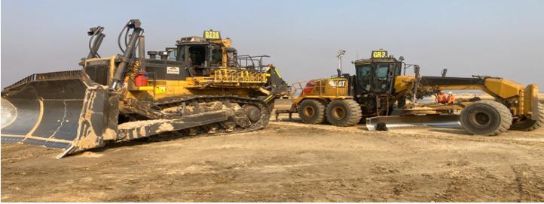
Collisions at dumps and dig faces

Slide 11
Ineffective administrative risk controls found by mine management
N.B. These will not stop it happening again.
Positive Communications between the vehicle operators.
Share DZXX and RDYYY incident and learning with mining teams.
Follow safety compliance protocol with operators involved in DZXX and RDYYY incident.
Mining equipment to keep headlights on at all times, even while queuing.
Toolbox on positive communication and site SOP refresher.
Review truck and dozer operations training package and remove any reference to switching headlights off while waiting in a queue.

Slide 12
Concrete drop hole mistake
Two concreting jobs were happening on the same day at an underground mine.
Concrete was being delivered to two different areas underground, using two different concrete drop-holes drilled for the purpose.
One concrete crew called the delivery driver they had used the day before and said they were ready to take delivery at the bottom of their concrete drop-hole.
The delivery driver went to the wrong drop-hole and sent the concrete down.
Fortunately, no-one was under that drop-hole at the time.

Slide 13
Ineffective administrative risk controls found by mine management
N.B. These will not stop it happening again.
Escort phones to have more effective identification when allocated and comms protocols reviewed.
Update safe work procedures (SWPs) and create checklist.
Re-establish drophole familiarisation for surface and underground.
Update safe work instructions (SWIs) to reflect phone and not DACs.
Addition of pre-checks.
Drophole checklist added to procedure.
Investigate Comms - Direct link to UG from Surface for all Dropholes.

Slide 14
Medical emergencies at mines
During September, workers at two mines became unwell during their shift and were taken to hospital.
Site senior executives are reminded they are obliged to conduct an effective investigation to determine that work-related activity did not cause the medical emergency.
For example, examining for:
exposure of the worker to excessive heat,
exposure to chemical agents,
situations where the worker may have received a head knock.
Do not presume that just because it looks like a personal medical matter, no investigation is required.

Slide 15
NOTICE BOARD
QUICK LINKS
COMMUNICATIONS
Board of Examiners
RSHQ Consultation
OCE Seminars March + April 2024
Information share for summer 2023/24
FREE Registration for the PCS Scheme
Periodicals
Mining Hazards Database
Coal Mining Safety and Health Act 1999
ERZC Seminars February 2024
Annual obligation reminder
Recognised Standards
Safety Notices
RECENT SAFETY NOTICES
Safety Alert 441
Counterfeit PLC hardware
Safety Alert 440
Fluid injected into CMW’s skin
Safety Alert 439
CMW’s foot crushed in scissor lift accident
Safety Alert 438
Excavator and water truck collision
To subscribe to communications from the Queensland Mines Inspectorate please email
QldMinesInspectorate@rshq.qld.gov.au

