Slide 1
2021 Safety Reset Pack
August – September 2021

Slide 2
2021 Safety Reset
Run Sheet
Safety Reset Slide Pack
A message from Minister Stewart
2021 Safety Reset Theme
Expected Content Slides:
  a minute of silence – a time for reflection
  learnings from 2019 Brady Review
  learnings from 2020 Board of Inquiry
  sharing safety stories
Expected Content Slides (cont’d.)
  our commitment to a culture of safety
  our safety roles may be different
  statutory roles and obligations (by sector)
  wrap-up
Background
  Resources
  Frequently Asked Questions
  Stakeholder Steering Group Members

Slide 3
A. 2021 Safety Reset – Run Sheet
# | Activity | Led by | Notes
1 | Welcome; purpose of Safety Reset | SSE, Manager, Team Leader | See FAQs 1-4
2 | Message from Minister Stewart | Play Video
3 | Discussion – Safety Reset theme | SSE, Manager, Team Leader | See FAQ 3
4 | One minute silence | SSE, Manager, Team Leader
5 | Learnings from the Brady review |  | See FAQ 1
6 | Learnings from coal mining inquiry
7 | Sharing stories | All
8 | Commitment to culture of safety | All
9 | We all have a role to play in safety | SSE, Manager, Supervisor, Safety Rep, Worker | See FAQ 14
10 | Statutory roles and obligations | SSE, SSHR, Safety Rep, ISHR, DWR | Sector specific
11 | Wrap up | SSE, Manager, Team Leader

Slide 4
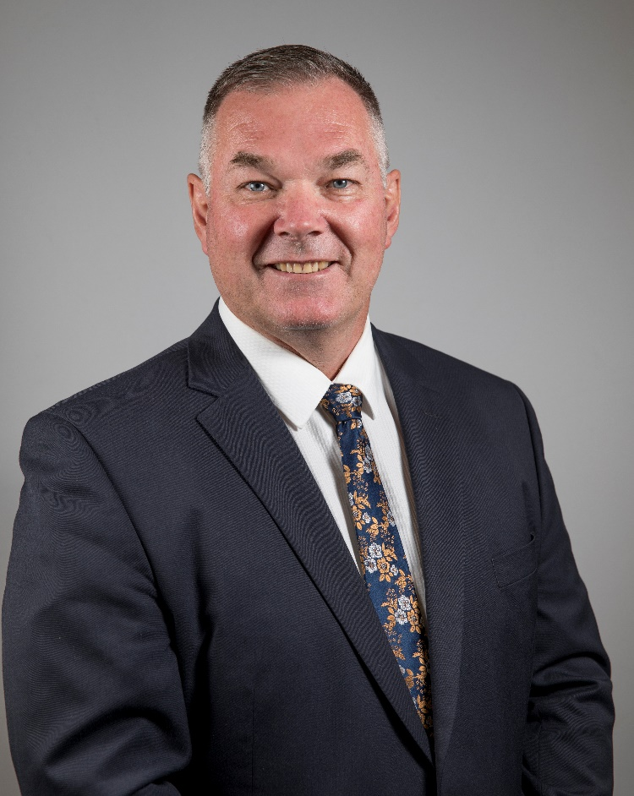

1. Message from Minister Stewart
Introduction to 2021 Safety Reset by Minister for Resources, Scott Stewart MP
What the industry has conveyed to the Minister and his expectations
Include here the high points from Minister Speech (use additional slide if necessary)

Slide 5
2. 2021 Safety Reset Theme
Chronic unease: improving safety culture through better hazard and incident reporting: A focus on building a culture of open and comprehensive reporting and investigation of near miss events (or high potential incidents) without fear, to encourage vigilance and diligence in hazard identification and risk control.
Discussion may include:
Why is this a focus for us? Why do we want to improve, and why are we holding a safety reset?
Fostering chronic unease through both incident reporting and keeping safety failure front of mind
How can we encourage better hazard and incident reporting and improve communication?
What are the real and perceived barriers to reporting? What would prompt you to speak up?
How does management encourage workers to raise safety issues without fear of reprisal?
How do site and corporate management react to “bad news”?

Slide 6
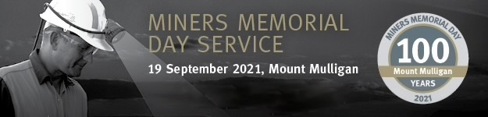
3.i. Expected Content Slide: a minute silence (a time for reflection)
Miners’ Memorial Day takes place on 19 September each year. It commemorates the first mining disaster in Queensland in 1921 at Mount Mulligan, where 75 miners lost their lives.
A century has passed since that tragic day.
The memorial is an opportunity to reflect on those who have been hurt or lost their lives at work – in any industry.

Slide 7
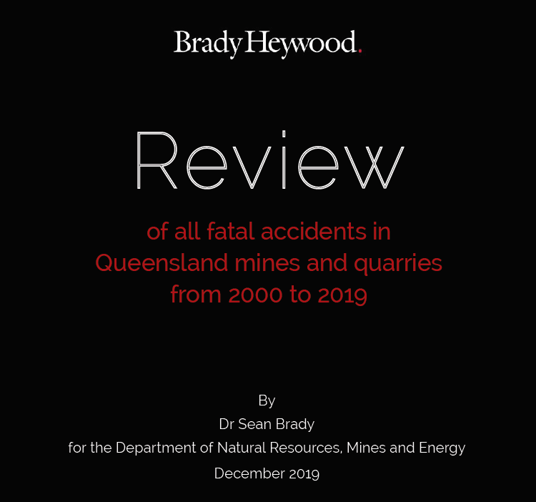
3. ii. Expected Content Slide: learnings from the 2019 Brady Review
Dr Brady studied 20 years of accident and incident data in Qld mines and quarries
  Humans make errors, that’s part of being human – we need systems and controls that protect workers even where human errors happen
  If you don’t report an incident, you can’t learn from it –whatever caused it to happen is still out there and can cause harm (it’s an opportunity wasted)
  Incident reporting and thorough investigation are the most useful and practical early warning system available – get the ‘bad news’ flowing

Slide 8
3.iii. Expected Content Slide: learnings from the Coal Mining Board of Inquiry
Investigation of the serious accident which injured 5 workers in 2020, and preceding methane incidents
  The board highlighted the importance of raising safety concerns as soon as possible after they arise
  It also said all workers must be confident they can raise concerns about safety without fear
  The findings highlight how production must never be put before safety

Slide 9
3.iv. Expected Content Slide: sharing safety stories
Discuss or present safety stories involving personal experiences:
  may relate to an unsafe condition or an incident, not reported due to X …
  worker experiences in reporting incidents; both positive and negative
  shared experience of an injury or near-miss
  sites may include examples of where an incident has occurred where there was a known hazard but it had been worked around
  (identify beforehand, individuals willing to share experiences, to get the conversation started)

Slide 10
3.v. Expected Content Slide: our commitment to a culture of safety
Discuss our current situation and our level of commitment
  are workers and supervisors empowered and encouraged to report?
  is the process of hazard and incident reporting straightforward?
  are reports acknowledged and corrective actions communicated?
  is management visibly committed to effective incident reporting, spanning process and personal safety?
  are workers involved in identifying solutions and corrective actions?

Slide 11
3.vi. Expected Content Slide:
our safety roles may be different
Site Senior Executive Site Safety Manager Manager/Owner | Supervisor Safety and Health Representative Leading Hand | Individual Worker
enforce everyone’s obligations under relevant legislation ensure the workplace is safe ensure the workforce is trained appropriately ensure hazard and risk controls are in place and effective ensure safety and health management systems are relevant and understood by all periodically review historic incidents to ensure learnings are not forgotten | raise issues around poor practices confidently report hazards act to ensure workers are safe ensure team members are trained for assigned duties investigate hazards that are reported ensure tasks are planned, risk-assessed, resourced, communicated and inspected ensure team understands and adheres to the safety and health management system | be able to identify and report hazards and risks on site call out poor practices be confident my workplace is safe and be able to speak up without fear of reprisal not start work if risks are not understood or not acceptable be alert around machinery and other hazards understand and adhere to the safety and health management system

Slide 12
3.vii. Expected Content Slide:
Coal Mines, statutory roles and obligations
Every person on a mine site – whether they work on the floor or in a management position – has an obligation to do what they can to ensure the safety and health of themselves and of others (s39 Act).
People in certain positions of responsibility, like supervisors, managers and executives have additional, special obligations under legislation depending on their role.
If you make a safety and health complaint to an inspector, they must investigate it (s275 Act).
You can also raise complaints with your elected site safety and health representatives and union appointed industry safety and health representatives, who have powers to investigate them. Site senior executives must provide SSHRs and ISHRs assistance when they investigate complaints.
Your safety is serious; it is illegal for anyone to discriminate against you, or cause you any detriment, if you make a genuine complaint about a safety or health issue (s275AA Act). You have a legal right to stop the job if you believe it is unsafe (s274 Act).

Slide 13
3.vii. Expected Content Slide:
Mines & Quarries, statutory roles and obligations
Every person on a mine site – whether they work on the floor or in a management position – has an obligation to do what they can to ensure the safety and health of themselves and of others.
People in certain positions of responsibility, like supervisors, managers and executives have additional, special obligations under legislation depending on their role.
If you make a safety and health complaint to an inspector, they must investigate it.
You can also raise complaints with your elected site safety and health representatives and union nominated district workers’ representatives, who have powers to investigate them. Site senior executives must provide SSHRs and DWRs assistance when they investigate complaints.
Your safety is serious; it is illegal for anyone to discriminate against you, or cause you any detriment, if you make a genuine complaint about a safety or health issue. You have a legal right to stop the job if you believe it is unsafe.

Slide 14
Options for workers to raise complaints about safety and health matters
SSHR must make a written report, give a copy to SSE and IOM if immediate danger
1
Raise with SSHR
SSHR may investigate
DWR must make a written report and give a copy to SSE and IOM
When raising a safety and health matter, a worker is protected from reprisal
2
Mine or Quarry worker has a safety and health complaint
Raise with DWR / ISHR
ISHR / DWR may investigate
ISHR to tell SSE if SHMS is inadequate or ineffective
Definitions
SSHR = Site Safety and Health Representative
DWR = District Workers’ Representative
ISHR = Industry Safety and Health Representative
IOM = Inspector of Mines
SSE = Site Senior Executive
SHMS = Safety and Health Management System
3
Raise with IOM
IOM must investigate
IOM must provide report to complainant

Slide 15
3.vii. Expected Content Slide:
Petroleum & Gas, statutory roles and obligations
Every person, regardless of role, has an obligation to do what they can to ensure the safety and health of themselves and of others.
Authorisation and license holders and people in certain positions of responsibility have additional, special obligations under legislation, depending on the type of authority, license or role.
If you make a safety and health complaint to an inspector, they must investigate it. Specific protections from reprisal are contained in s708C of the Petroleum and Gas Act 2004, and under the WHS Act.
You can also raise concerns with your supervisor/line or senior manager, or business owner for gasfitters. Contact the P&G Inspectorate on 1300 910 933 or gassafe@rshq.qld.gov.au.
Your safety is serious; it is illegal for anyone to discriminate against you, or cause you any detriment, if you make a genuine complaint about a safety or health issue. You have a legal right to stop the job if you believe it is unsafe.

Slide 16
3.vii. Expected Content Slide:
Explosives, statutory roles and obligations
Every person, regardless of role, has an obligation to do what they can to ensure the safety and health of themselves and of others.
Authority holders and people in certain positions of responsibility have additional, special obligations under legislation depending on the type of authority they hold, or their role.
If you make a safety and health complaint to an inspector, they must investigate it. Specific protections from reprisal are contained in s126A of the Explosives Act 1999
You can also raise concerns with your supervisor/line or senior manager i.e. SSE on a mine site. SSHR are an alternative pathway for raising explosives safety concerns on mine sites. Contact the Explosives Inspectorate Hotline 1300 739 868 or explosives@rshq.qld.gov.au.
Your safety is serious; it is illegal for anyone to discriminate against you, or cause you any detriment, if you make a genuine complaint about a safety or health issue. You have a legal right to stop the job if you believe it is unsafe.

Slide 17
3.viii. Expected Content Slide:
wrap-up … what do we want to change after today?
Discuss expectations and the actions we commit to, for improvement
  what are the agreed behaviours that we need from everyone involved?
  what action will we take to fill the gaps from our current state?
  what action will we take to remove the barriers to reporting hazards and incidents?
  how will we know if our safety reset has been successful?
  Chronic unease is more about the way we think – the way we look at things, not normalising what we observe – and responding to the signals.

Slide 18
Background, stakeholder steering group quotes
“ Trust and open communication fostering cooperation”
Queensland Sapphire Miners Association
“Every employee is acutely attentive to indications of danger”
Glencore Coal Assets Australia
“… there must be a system in place that all workers have been trained in hazard ID & risk control. If not, the ability of a worker to maintain vigilance and diligence in the workplace will not be effective or occur”
CFMMEU
“Everybody has a right and a duty to report unsafe work conditions”
SaferTogether
“Recognise that regardless of the very best systems and intentions, an incident may occur here, and that we all need to remain vigilant in identifying hazards, reviewing lessons learnt and controlling risk, so we all go home safe every day”
Australian Explosives Industry Safety Group
“Mental load – having stuff on your mind the whole time. Worrying that you’ve forgotten something”
Association of Mining and Exploration Companies
“Everyone at this workplace has a role to play in ensuring we are always vigilant about identifying the risks and potential for accidents to occur”
Queensland Resources Council
“Being mindful of the possibility of what could go wrong and creating a culture in which it is safe to speak up and report hazards and incidents”
BHP – Mitsubishi Alliance
“Fear of reporting due to the repercussions on the individual if negligent in taking remedial action or recognising the issue exists in the first place”
Master Plumbers’ Association of Queensland

Slide 19
Background: High Reliability Organisation resources
2019 Brady Review of Qld Mining & Quarrying Fatalities:
“And the next step is for the mining industry, as a whole, to adopt the practices of High Reliability Organisations”
“HROs are preoccupied with failure; they have chronic unease”
“A management focus on reducing LTIs can have the effect of encouraging under-reporting of incidents”
Learning from High Reliability Organisations (Hopkins, 2009):
“Blame is often the enemy of understanding”
“Asking why process operators made mistakes helps expose system errors that led to, or allowed, the human error”
“Encourage reporting of ‘bad news’, e.g. hazards that are not adequately controlled; critical controls not working”
Must accidents happen?: Lessons from HROs (Roberts, 2001):
“The three major recommendations we offer are that managers should:
1. aggressively seek to know what they don't know
2. design incentive systems to recognize the cost of failure and the benefits of reliability
3. communicate the big picture to everyone in the organisation”

Slide 20
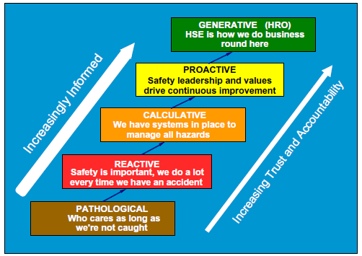
Background, safety culture model
after Hudson

Slide 21
Background, FAQs (i)
FAQ 1: Why has the Minister called for a safety reset this year?
The 2019 review of mining and quarrying fatalities, serious accidents and other incidents (by Dr Sean Brady) recommended industry recognise that it has a fatality cycle and that while the rates of serious accidents are currently trending downwards, this trend is simply part of that cycle. To change this pattern, Dr Brady recommends industry adopts a chronic sense of unease – even when operations appear to be running safely, there may be underlying issues and problems not being detected, reported and appropriately acted upon.
FAQ 2: Why is the 2021 Safety Reset being held across the whole resources sector?
The 2021 Safety Reset will engage some 70,000 Queensland workers across mining, quarrying, petroleum and gas, and explosives sectors. The Minister has heard from stakeholders that there are opportunities to share safety and health learnings and best practices and that extending the reset across all sectors will only benefit this process.
FAQ 3: What is meant by the Minister’s theme “Chronic unease: improving safety culture through better incident reporting”?
The Minister’s expectation is that the theme will focus the industry on building a culture of open and comprehensive reporting and investigation of near miss events (or high potential incidents), without fear, to encourage vigilance and diligence in hazard identification and risk control.
FAQ 4: When are the 2021 Safety Resets to be held?
The Minister has asked the resources sector to complete its safety resets during August and September 2021.
FAQ 5: What role does Resources Safety & Health Queensland (RSHQ) have in the safety reset?
The Minister asked RSHQ to coordinate a stakeholder steering group, charged with developing key messages and information in support of the theme of the reset. RSHQ subsequently developed safety reset communication materials for the Minister’s endorsement and distribution.

Slide 22
Background, FAQs (ii)
FAQ 6: Hazards, activities and risk vary across the resources sector. Can the safety resets be adapted to acknowledge this?
While some parts of the safety reset will be identical, the materials developed with the stakeholder steering group and distributed by RSHQ envisage that some tailoring of key messages is likely in order to make the resets valuable for workers and achieve the theme.
FAQ 7: How will participation in the safety reset be monitored?
Participation will be monitored at the site or operational level (e.g. how many of your sites or operations held a safety recent event?). Industries, peak bodies and associations will collect this information and provide it to RSHQ for aggregation and reporting to the Minister. It is requested that fortnightly reporting to RSHQ commences on Friday 13 August 2021. RSHQ will provide operators, peak bodies and associations with a template report, for return to safetyreset@rshq.qld.gov.au
FAQ 8: How will industry provide feedback to the Minister on the discussions held and actions arising from safety resets?
Industry is encouraged to provide this information to RSHQ in the same way that site participation is reported.
FAQ 9: How will RSHQ participate in the safety resets?
As in the 2019 safety reset, RSHQ Inspectors will attend at least one reset. Other agency staff will also attend resets.
FAQ 10: Will a summary of the safety reset (participation, discussion, actions, etc.) be made available to workers?
Yes. RSHQ will summarise and distribute this information; initially to the Stakeholder Steering Group, then more broadly.

Slide 23
Background, FAQs (iii)
FAQ 11: What about the actions recorded at my site or operation? How will these be tracked?
The stakeholder steering group – comprising unions, industry and peak bodies and associations, and the regulator – agreed it’s important that sites manage issues raised and that stakeholders continue to keep the Minister briefed on activities and progress.
FAQ 12: How long should the safety reset sessions last?
The Minister expects the resources sector to hold meaningful and thoughtful safety resets that engage the workforce in discussion and sharing. With that in mind, it’s not possible to specify a duration. In 2019, most safety resets ranged from 90 minutes to a few hours.
FAQ 13: Is there a specific role for peak bodies in reporting on the participation, discussions held, actions and initiatives arising from the safety resets?
Peak bodies are requested to gather this information from their member sites and provide it to RSHQ for collation and fortnightly reporting to the Minister. Fortnightly reporting to RSHQ commences on Friday 13 August 2021.
RSHQ will provide peak bodies with a template report, to be returned to safetyreset@rshq.qld.gov.au
FAQ 14: For safety resets at coal mines, is there an expectation for the statutory roles of SSHR and ISHR to present or speak?
Yes. This supports findings and recommendations of the coal mining board of inquiry. It is recommended that these roles are invited to participate and afforded an opportunity to present on the functions and obligations of the roles, protections for workers raising safety matters and complaints, and other relevant safety and health matters.

Slide 24

Background: reporting
Minister for Resources
Industry reporting of Safety Reset participation, discussion topics and initiatives
See FAQ 7 and 13
Peak Body
Operator
Site(s)
Operator(s)
Site(s)

Slide 25
Background: stakeholder steering group
Stephen Smyth, President, Construction, Forestry, Mining and Energy Union
Ryan Brogden, General Manager, Australasian Explosives Industry Safety Group
Judy Bertram, Deputy CEO, Queensland Resources Council
Carol Graham, President, Queensland Sapphire Miners Association
Matthew Paul, Director Policy, Australian Petroleum Production and Exploration Association
Gavin Lawrence, District Organiser, Australian Workers’ Union
Kent Vickers, President, Master Plumbers’ Association of Queensland
Cassandra Koutouridis, Director, Cement, Concrete & Aggregates Australia
Kate Dickson, CEO, Association of Mining and Exploration Companies
Kylie Ah Wong, General Manager (Health, Safety & Training), Glencore Coal Assets Australia
Lynette Mossman, General Manager, Occupational Safety and Health, BHP Mitsubishi Alliance
Todd Simms, General Manager HSE, Rio Tinto
Mark Stone, CEO, Resources Safety and Health Queensland

