Slide 1
June 2021 Incident periodical
Recent High Potential Incidents
Learnings and Recommendations
Queensland Coal Mines Inspectorate
Coal Inspectorate

Slide 2
June HPI and Serious Accident performance
Month | HPI | Serious Accidents | June Serious accidents
June May April | 108 138 91 21% reduction in HPI reporting in June | 3 4 5 Lowest number of Serious accidents in June for the quarter | Crushed finger caught between component Back injury lifting 43Kg shackle Burns from lancing rod CMW having fallen from 3 step ladder
142 HPIs reported in July
7 Serious accidents in July

Slide 3
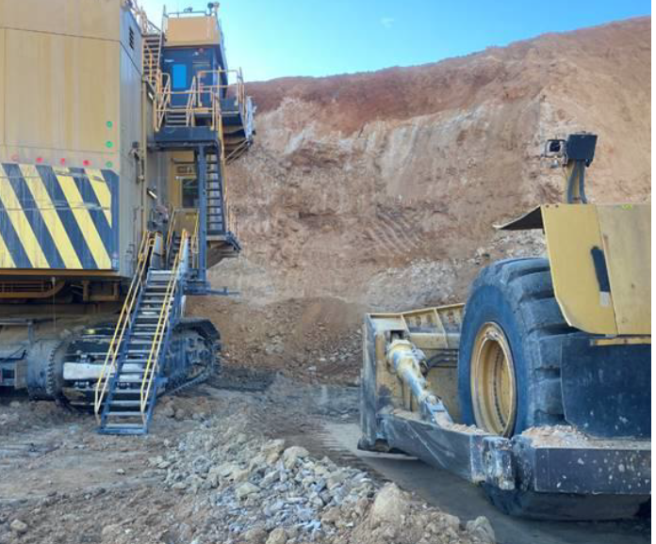
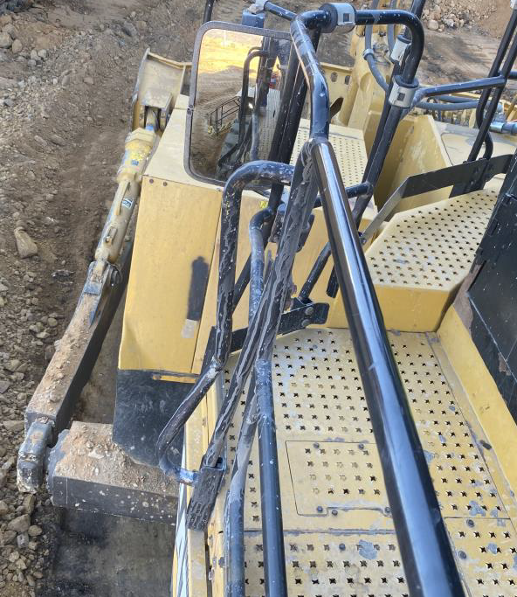
Incident – Collision – Surface Mine
A shovel operator requested a wheel dozer operator dress the bench beside the shovel.
The wheel dozer operator entered the shovel swing radius without positive communications to the shovel operator.
The shovel slewed to load the offside and the counterweight hit the wheel dozer, damaging handrails and mirror.

Slide 4
Recommendations
Site Senior Executive
Ensure the SHMS contains effective procedures for shovel operations.
Ensure there is a senior position within the management structure responsible for Mobile Plant operations and that this person is competent.
Ensure adequate inspections are conducted by a competent person.
Supervisors / Open Cut Examiners
Ensure all controls for managing and monitoring shovel operations are implemented
Monitor coal mine workers compliance with the requirements of positive communications protocols.
Stop mobile plant operations when positive communications are not implemented.
Coal mine workers
Must conduct their work in accordance with the work procedures for shovel operations.
Always use positive communication protocols when approaching mobile plant.
Stop work where those procedures are not, or cannot be complied with in the operation.

Slide 5
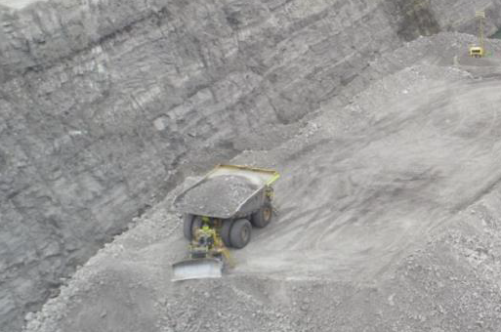
2. Incident – Collision – Surface Mine
On nightshift, a rear dump reversing to the tip face, collided with the dump dozer.
The narrow tip head was not identified as a hazard by the coal mine workers or their supervisors.
Positive communications protocols were not correctly followed.

Slide 6
Recommendations
Site Senior Executive
Review safety and health management plans and, if necessary, require changes to be made to those plans to enable them to be effective.
Supervisors
Ensure workers are complying with requirements of the mine’s SHMS.
Conduct regular inspections of work areas and ensure potential hazards associated with the task being performed are effectively identified and controlled.
Coal mine workers
Ensure their personal risk assessment identifies all potential hazards associated with the task they are to perform, and that effective controls are applied to manage the risk.
Check if you have missed any hazards by asking your workmates and supervisors.
Check dump areas against design criteria

Slide 7
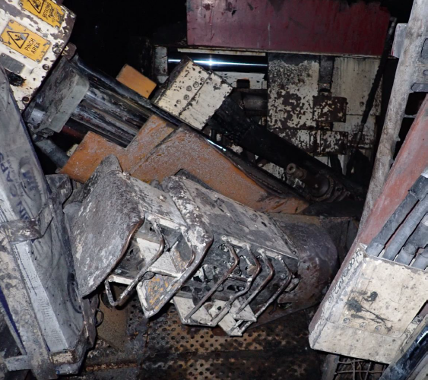
3. Incident – Equipment Failure - Underground
A CMW was using the drill rig on a continuous miner when the mounting bolts failed.
The drill rig fell onto the working platform, striking the CMW on the arm.
The continuous miner’s maintenance program was not specific about the method and frequency of mounting bolt checks.

Slide 8
Recommendations
Site Senior Executive
Ensure there are adequate maintenance programs in place necessary for the safe use of equipment.
Supervisors / ERZC’s
Identify critical components on equipment and ensure they are included in the inspection and testing program.
Coal mine workers
Regularly check the physical condition of all the equipment you use for safe operation.
Use the defect reporting system effectively, do not rely on word of mouth to communicate potential defects.

Slide 9
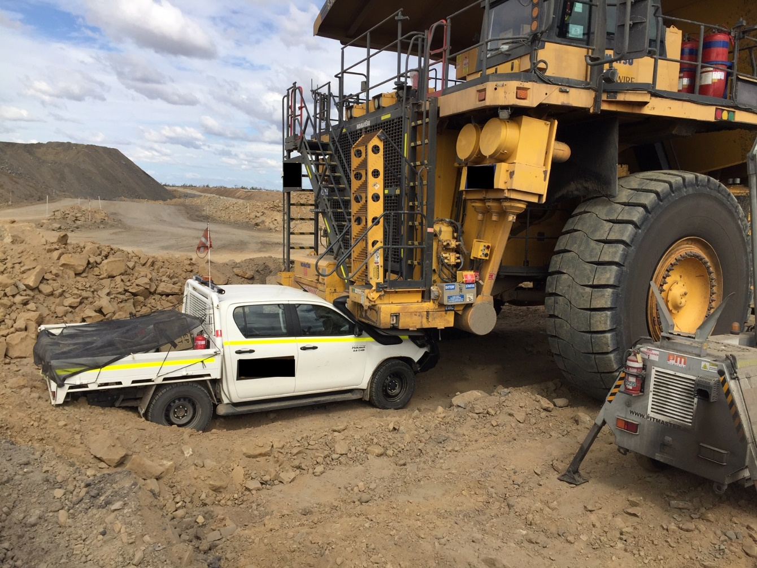
4. Incident – Collision – Surface Mine
Light vehicle was parked in park up bay beside a lighting plant.
A RDT operator during nightshift mistook the bunding around the lighting plant for the dump exit bunding.
RDT turned beside the lighting plant and collided with the front of the unoccupied light vehicle.

Slide 10
Recommendations
Site Senior Executive
Ensure the design standard for dumps considers all the activities expected to occur on the dumps.
Supervisors
Implement dump traffic management plans and ensure they are fit for purpose.
Coal mine workers
Comply with their mine’s procedures when operating mobile equipment.
Ensure delineation of parking areas, lighting plant locations and dump entry and exit points are in place and effective.
Ensure mobile plant operations have effective traffic management plans in place.

Slide 11
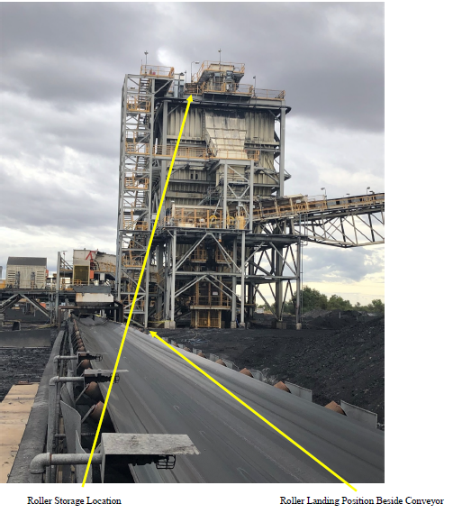
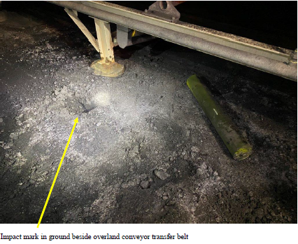
5. Incident – Falling object risk – CHPP
A loose conveyor roller was found on the ground next to a conveyor.
A clear impact mark was found in the ground beside the roller.
The loose roller had dislodged from a storage pallet on the floor of the coal bin and rolled off the platform, falling to the ground.

Slide 12
Recommendations
Site Senior Executive
Must ensure the design of material and spares storage places at the mine provides for the prevention of inadvertent movement of materials or spare parts
Supervisors
Ensure procedures and processes for managing and controlling risks associated with storage of materials and spare parts, are effective.
Coal Mine Workers
Conduct risk assessments to identify and control potential hazards when storing materials and spare parts.
Have a preoccupation with failure and ask “The what If?”
Have a preoccupation with failure and ask the “The what If?”
Have a preoccupation with failure and ask “The what If?”

