Slide 1
June 2023 Incident periodical
Recent High Potential Incidents
Learnings and Recommendations
Communications
Incidents occurred in April 2023
Coal Inspectorate

Slide 2
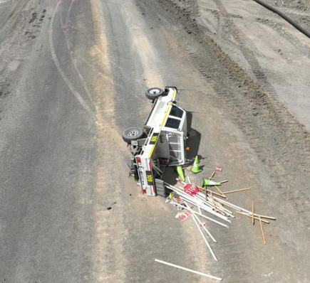
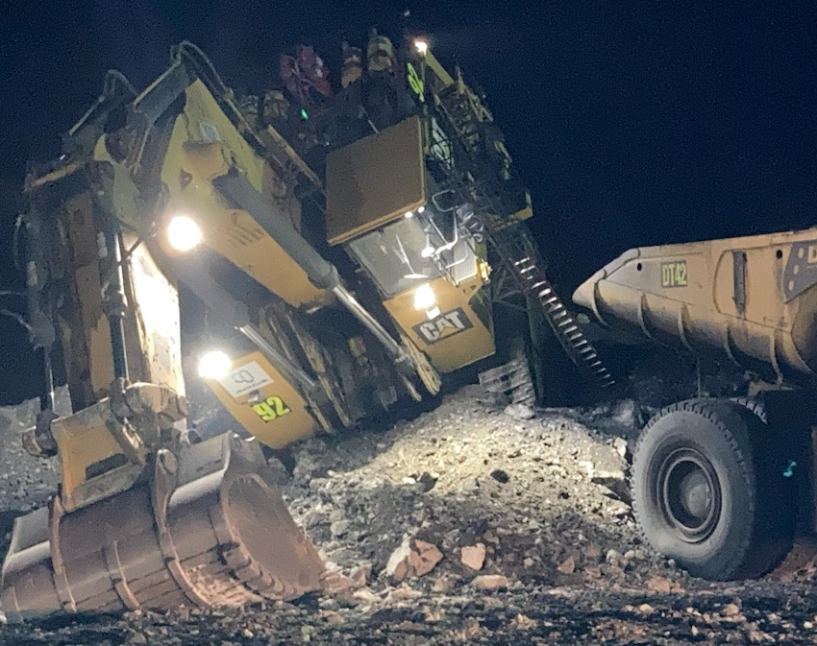
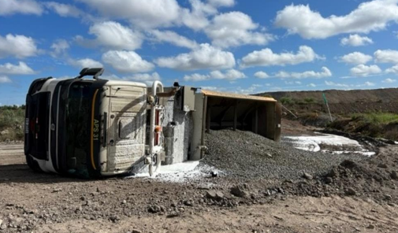
Incidents – Uncontrolled Movement of Mobile plant
The photographs below are of three separate incidents that occurred in April 2023.

Slide 3
Recommendations
Site Senior Executive
Supervisors
Coal Mine Workers
Ensure the mines SHMS provides for appropriate action to be taken if the SHMS risk control measures are identified as not being effectively applied.
Carry out activities and work in a way that does not expose coal mine workers to an unacceptable level of risk.
During work area inspections, ensure all potential hazards have been identified by coal mine workers
Cease work immediately if you believe a hazard is not being adequately controlled.
Ensure the critical controls for the uncontrolled movement of mobile equipment are continually being verified.
Ensure critical controls for the uncontrolled movement of mobile equipment are effective in minimising risk.
Ensure effective supervision is being provided.
Ensure that all hazards are identified and effective controls have been put in place to manage risks in your work area.

Slide 4
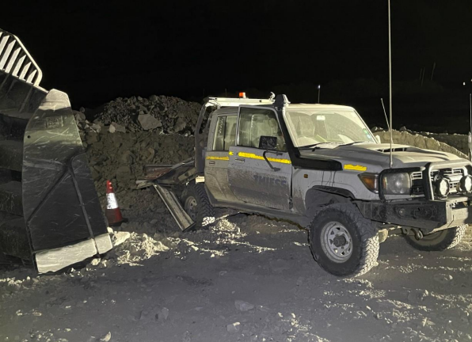
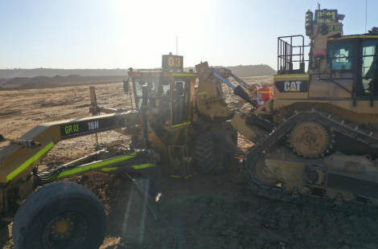
2. Incidents – Collisions (Unplanned Movement of Equipment)
The photographs below are of incidents that occurred at two mines in April 2023.

Slide 5
Recommendations
Site Senior Executive
Supervisors
Coal Mine Workers
Follow site procedures and work instructions.
Regularly audit dump & dig face operating standards for compliance with site procedures.
Continually monitor and review the effectiveness of risk control measures, and take appropriate corrective and preventive action where non-conformance is identified.
Maintain situational awareness and positive radio communications, including confirmation of radio calls.
Ensure the mines SHMS provides adequate monitoring for effective application of risk control measures to prevent unintended movement of mobile equipment.
Carry out their activities / work in a way that does not expose themselves or someone else to an unacceptable level of risk.
Establish and implement effective controls that minimise the risk of collisions.
Consider implementing higher order controls, such as collision avoidance systems.

Slide 6
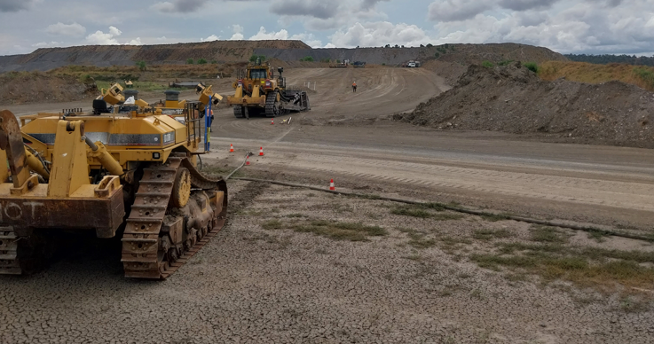
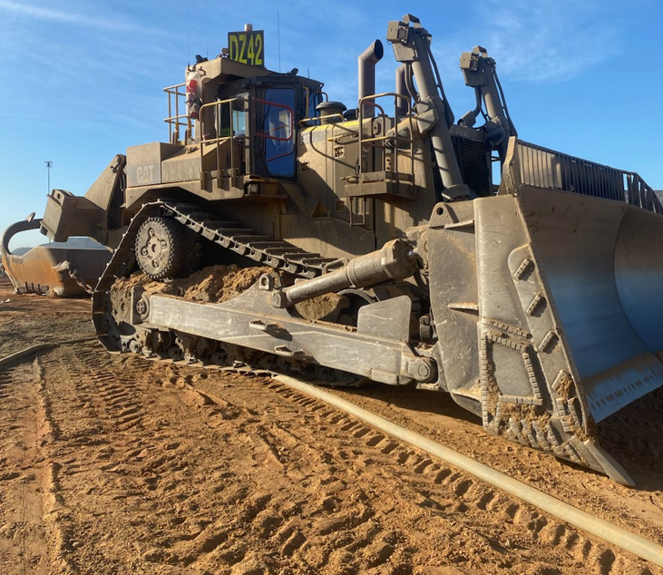
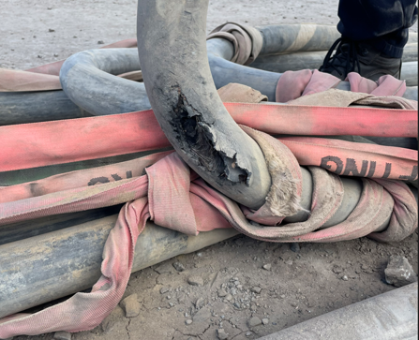
3. Incident – Cable Damage

Slide 7
Recommendations
Site Senior Executive
Supervisors
Coal Mine Workers
Inspect your work area for potential hazards around high voltage trailing cables.
Ensure cable management procedures are being effectively implemented by coal mine workers.
Ensure that the SHMS has effective controls in place to manage high voltage cables.
Cease work immediately if you believe a hazard is not being adequately controlled .
Inform your supervisor of any concerns about the work environment.
Ensure that Supervisors are competent in assessing the risks and hazards associated with the work environment under their control.
Ensure effective supervision is being conducted in work areas where high voltage trailing cables are located.

Slide 8
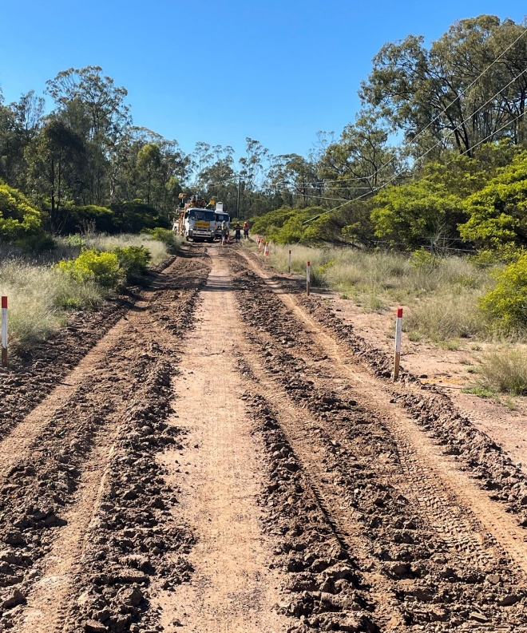
4. Incident – Collision with Electrical Equipment

Slide 9
Recommendations
Site Senior Executive
Supervisors
Coal Mine Workers
Ensure all persons who operate mobile plant are trained and competent and aware of this SOP.
Verify compliance for procedures for working in the vicinity of High Voltage powerlines.
Coal mine workers must inspect their work area prior to conducting work.
Planned work must take in to consideration the proximity of high voltage powerlines.
Ensure the mine’s safety and health management system has effective procedures for working near power lines.
Ensure that all hazards are identified and effective controls have been put in place to manage these risks.

Slide 10
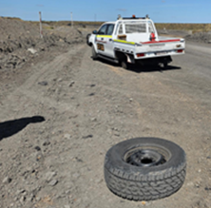
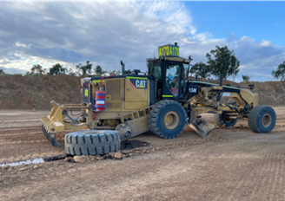
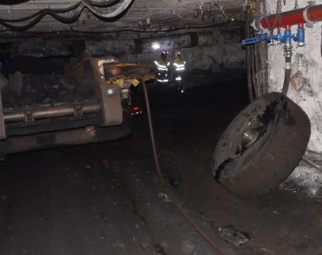
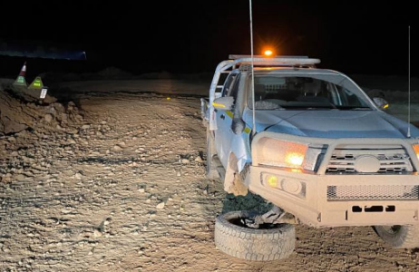
5. Incidents – Unplanned Movements (Tyres)

Slide 11
Recommendations
Site Senior Executive
Supervisors
Coal Mine Workers
Pre-start inspection of equipment are effective in identifying potential hazards before commencing work.
Monitor and verify the controls for the inspection of mobile equipment are effective.
Ensure that all hazards are identified and effective controls have been put in place to manage these.
Inform your supervisor of any concerns about any concerns you may have identified.
Ensure management of critical controls in relation to uncontrolled movement of mobile equipment control are effective in minimising risk.
Ensure the maintenance system is effective in managing the risk of unplanned movement of equipment.
Ensure retorque periods for tyre tensioning are effective.

Slide 12
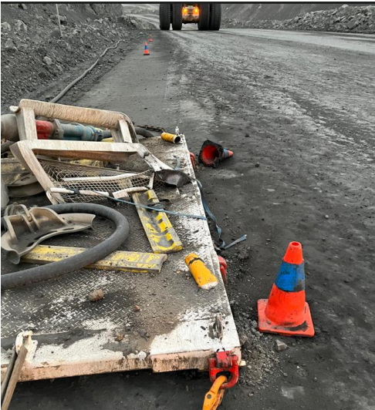
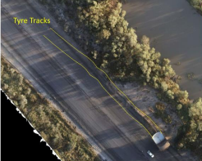
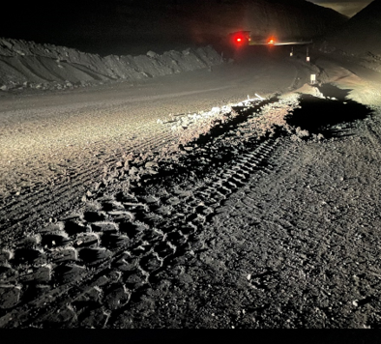
6. Incident – Unplanned Movement (Micro Sleep)

Slide 13
Recommendations
Site Senior Executive
Supervisors
Coal Mine Workers
Ensure the mine’s safety and health management system contains effective procedures and controls for fitness for duty.
Ensure CMW’s understand the requirements for fitness for duty requirements.
Monitor adherence to the processes for fatigue management.
Ensure that presenting to work you have complied with the fitness for duty requirements.
Inform your supervisor of any concerns about issues related to fitness for work.
Implement effective controls to mitigate fatigue related issues.

Slide 14
COMMUNICATIONS
Reporting HPIs following withdrawal of persons from an underground coal mine
Reminder - Implementation of BoI Recommendations for surface operations
Obligations for maintaining rescue capability at an underground coal mine
Message from the RSTWG for Recognised Standard 02
Review of Exposure Data for 2022 - Open Cut / Underground
Commissioner’s Queensland mining industry safety reporting survey
Recognised Standards
Periodicals
Coal Mining Safety and Health Act 1999
Safety Notices
Board of Examiners
FREE Registration for the PCS Scheme
RECENT SAFETY ALERTS
Safety Alert 429
Inservice failure of an explosion protected diesel engine safety system
Safety Alert 428
Coal mine worker injured undertaking conveyor belt repairs
Safety Alert 427
Fingertip severed when caught in a motorised hood tarp system
Safety Alert 426
Rare earth magnets
Safety Alert 425
Fall of equipment and persons into a stope void
Mining Hazards Database
To subscribe to communications from the Queensland Mines Inspectorate please email
QldMinesInspectorate@rshq.qld.gov.au

