Slide 1
March 2021 Incident periodical
Recent High Potential Incidents
Learnings and Recommendations
Queensland Coal Mines Inspectorate
Coal Inspectorate

Slide 2
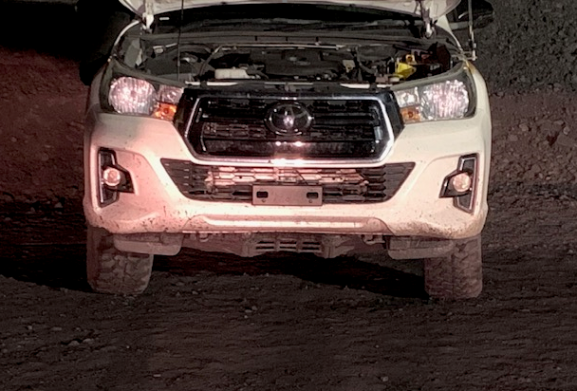
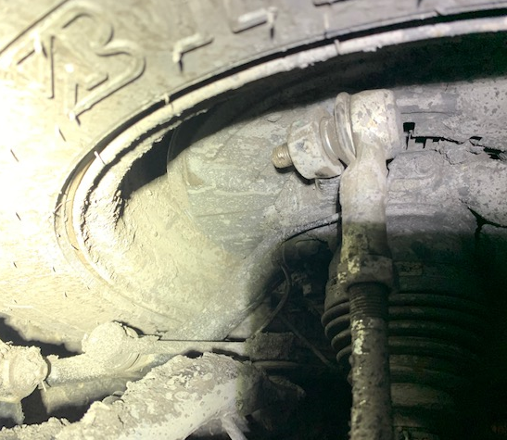
Incident – Steering joint failure – Surface Mine
Whilst travelling a light vehicle lost steering when the right hand side tie rod end nuts came off.
The light vehicle had the steering rack and pinion replaced on the shift prior to the incident occurring.

Slide 3
Recommendations
Site Senior Executive
Ensure the SHMS contains an effective maintenance strategy and plans for maintaining mobile plant.
Ensure the persons carrying out maintenance on mobile plant are competent to perform the work.
Supervisors
Ensure mobile equipment componentry is maintained and replaced as per the OEM’s specifications and recommendations.
Check that critical maintenance steps have been completed as required.
Coal mine workers
Must maintain mobile plant as per the requirements of their mine’s SHMS and the relevant OEM.

Slide 4
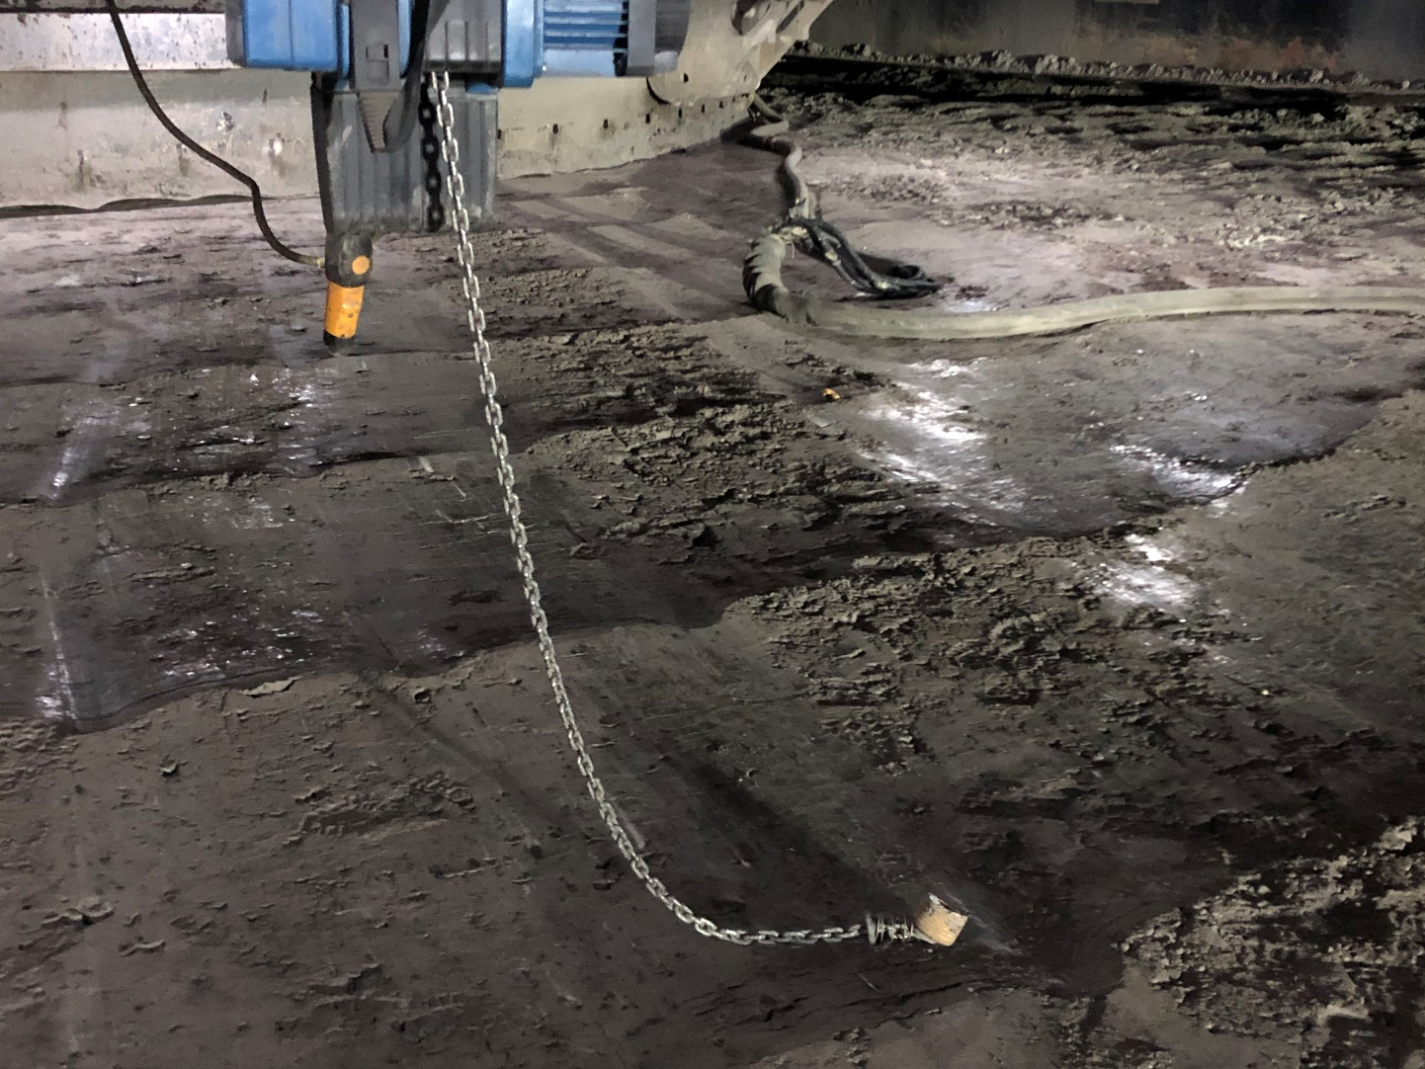
2. Incident – HV Cable damaged – Surface Mine
A dragline was repositioning due to sinking in soft ground.
A worker on the ground at the front of the dragline directed the operator to swing to the right. The cable winch under the house was still attached to the cable, and this resulted in significant cable damage when the dragline swung.

Slide 5
Recommendations
Site Senior Executive
Ensure the mine’s safety and health management system contains an effective procedure for handling high voltage trailing cables.
Ensure that all coal mine workers handling high voltage trailing cables are competent to perform the task.
Supervisors
Should be checking that workers handling high voltage trailing cables are complying with the requirements of their mine’s SHMS.
Coal mine workers
Always ensure high voltage trailing cable are handled as per the requirements of their mine’s SHMS.

Slide 6
3. Incident – Fire - Underground
Whilst conducting a belt shutdown inspection on North Mains Trunk belt a CMW smelt burning coal. Upon investigation the CMW found a small pile of smouldering coal fines on the floor under the belt approximately 300mm x 300mm in area and approximately 100mm high.
The area was saturated with water and cleaned, and a fire watch was established.
The roller directly above the incident area had been changed out earlier in the shift. The roller’s bearing was not retained sufficiently to prevent shell inadvertently moving with minor force.

Slide 7
Recommendations
Site Senior Executive
Ensure the SHMS contains a procedure for maintaining conveyor systems, and that this includes the methods required for handling and replacing conveyor rollers.
Ensure the workers handling and replacing conveyor rollers are competent to perform the task.
Mechanical Engineering Manager
Ensure the design parameters of conveyor rollers are appropriate.
Ensure the method of handling and replacing conveyor rollers does not cause their integrity to be compromised.
Coal mine workers
Handle and replace conveyor rollers as per the mine’s procedure.

Slide 8
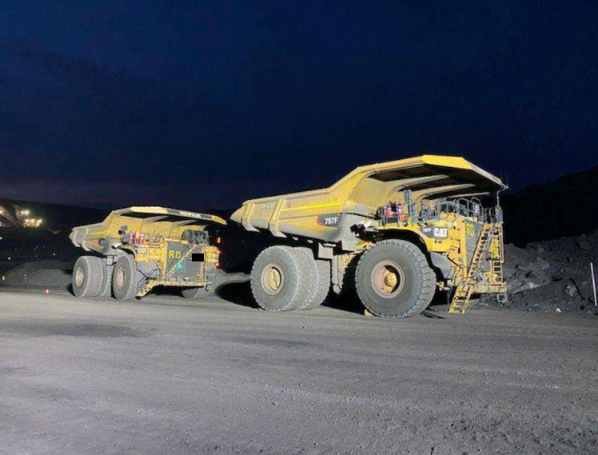
4. Incident – Equipment Collision – Surface Mine
The operator of a large rear dump truck parked in a queue at a dig face with the truck left in gear and only the retarder brake applied.
The operator has then fell asleep.
The retarder brake released after a period of time, and the truck then idled forward and run into the tail of another truck that was parked in front of it.
No injuries, but damaged handrailing resulted.

Slide 9
Recommendations
Site Senior Executive
Ensure the standard operating procedure for using mobile plant contains effective ways of minimising the risks associated with the parking of mobile equipment.
Senior person responsible for Equipment Interaction
Ensure the parking of mobile equipment is monitored and audited for compliance with the mine’s procedure, and this may be done by periodically checking the vehicle’s Vital Information Monitoring System (VIMS) data.
Coal mine workers
Must always park mobile equipment as per the requirements of the mine’s standard operating procedure for using mobile plant.

Slide 10
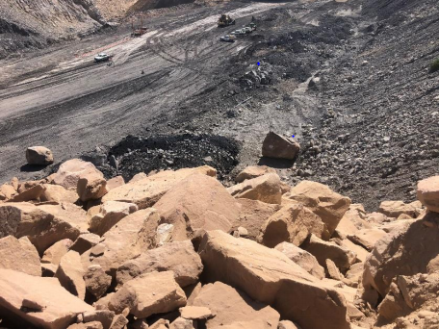
5. Incident – Failure of Strata Control – Surface Mine
A dozer operator maintaining an active dump noticed a large rock had rolled down from the tip-head and breached the catch rill below the dump.
The large rock ended up on the active access leading into an operating dragline’s work area.

Slide 11
Recommendations
Site Senior Executive
Must ensure the mine’s principal hazard management plan for ground / strata control has identified all potential risks and contains effective controls.
Supervisors
Conduct shiftly inspections of active work areas checking that all of the required controls are implemented for managing strata, and the effectiveness of these controls is verified.
Must ensure a check and examination of each coal mine worker’s specific work area is carried out by the coal mine worker.
Coal Mine Workers
To carry out their activities / work in a way that does not expose themselves or someone else to an unacceptable level of risk.
Must check the condition of their work area before commencing the activity.

Slide 12
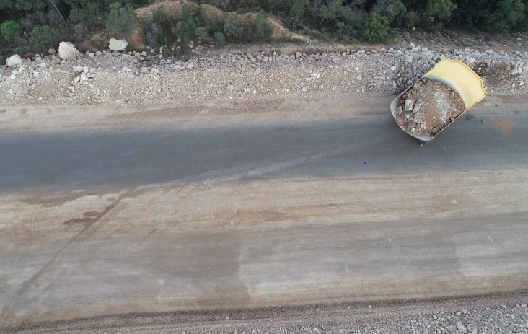
6. Incident – Micrrosleep – Surface Mine
At approximately 5:00am an operator of a loaded rear dump truck travelling along a haulroad. experienced a microsleep.
This resulted in the truck contacting the haulroad’s left hand side safety berm.

Slide 13
Recommendations
Site Senior Executive
Must ensure the coal mine’s safety and health management system provides for controlling risks at the mine associated with the personal fatigue.
Supervisors
Periodically monitor and check on the fatigue level of workers.
Encourage workers to report any fatigue related issues.
Adopt methods that may reduce the likelihood of fatigue, for example job rotation.
Coal mine workers
Ensure they make the necessary pre-shift preparation required for managing fatigue.
To stop and report any fatigue related issues that they may be experiencing.

Slide 14
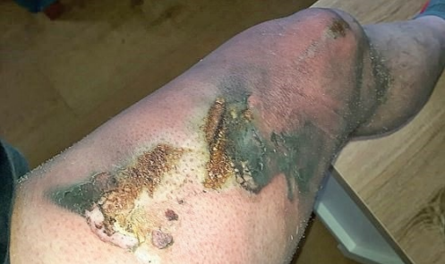
7. Hazards associated with the use of e-cigarette devices.
In January 2021 the WA Dept of Mines received a report of an incident at a mine site where an electronic cigarette (vape) battery spontaneously ignited in a worker’s pocket whilst he was travelling in a utility with two other workers. Statements described it as a combustion event not unlike fireworks going off and flying around inside the vehicle that they were travelling in. The worker received serious burns to his leg.

Slide 15
Contributing Factors E-cigarettes contain interchangeable parts, often including extra-low voltage lithium batteries. Failure of these parts has been linked to ignition of E-cigarettes, with a number of incidences of burn injuries reported overseas. Many have been linked to overcharging and overheating of the batteries, causing the device to ignite or explode in close proximity to the user.
Recommendations
Given the foreseeability of these occurrences and their potential consequences, the risks associated with carrying electronic cigarette devices (i.e. vaping equipment) on persons on site, particularly in hazardous areas, should be reviewed and preventative and control measures developed and implemented.
Refer to “Mines Safety Bulletin No. 181” issued by WA Department of Mines, Industry Regulation and Safety.

