Slide 1
Safety reset Team presentation

Slide 2
Trouble with video? Watch it here: https://youtu.be/CyPTFfM2OTI

Slide 3
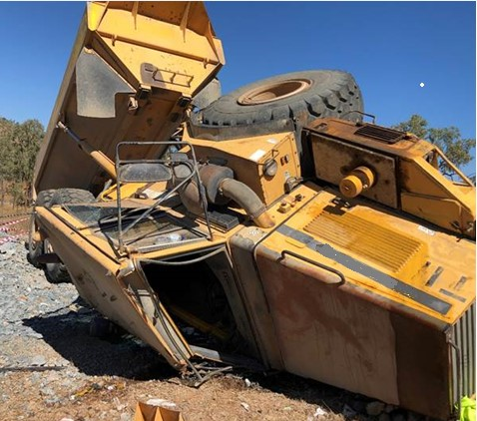
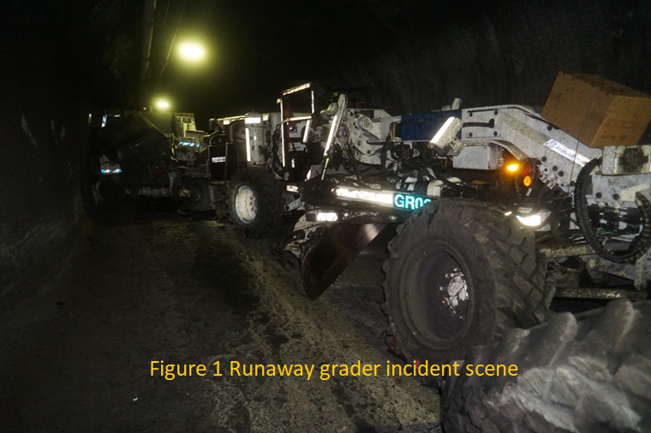
Why are we here?

Slide 4
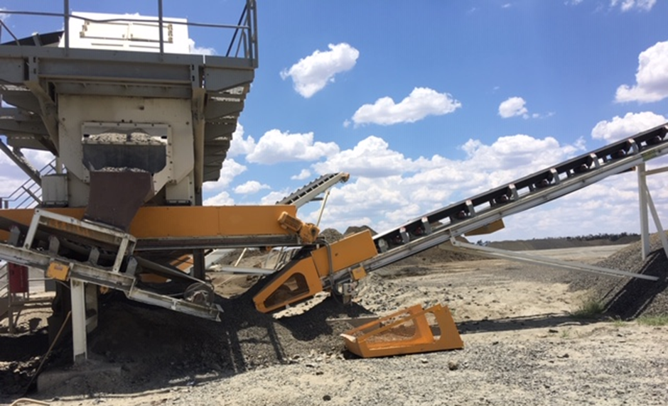
Six of our community have died in 12 months

Slide 5
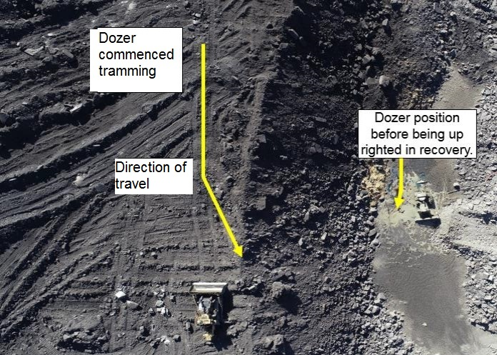
We need to reset

Slide 6
One minute’s silence
Please stand in respect for our colleagues

Slide 7
Miners Memorial Day
Miners Memorial Day is the day we pause and remember 1500+ QLD miners who have died.
Let’s not wait until 19 September – we need to do it now
No one wants to hear your name read out.

Slide 8
Our safety history and performance
The safety facts on our site
Reporting of HPIs (near misses) is a reflection of good safety culture but we must learn from them

Slide 9
Safety culture starts at the top
Nothing is important enough to lose a life
Fatalities are preventable
Today we draw a line in the sand and reset

Slide 10
Fatal hazards, critical controls, reporting processes
This is an opportunity to review fatal hazards on this site

Slide 11
We all have safety roles and responsibilities
We all have a right to be safe at work
My responsibility to you - no blame or fear of reprisal

Slide 12
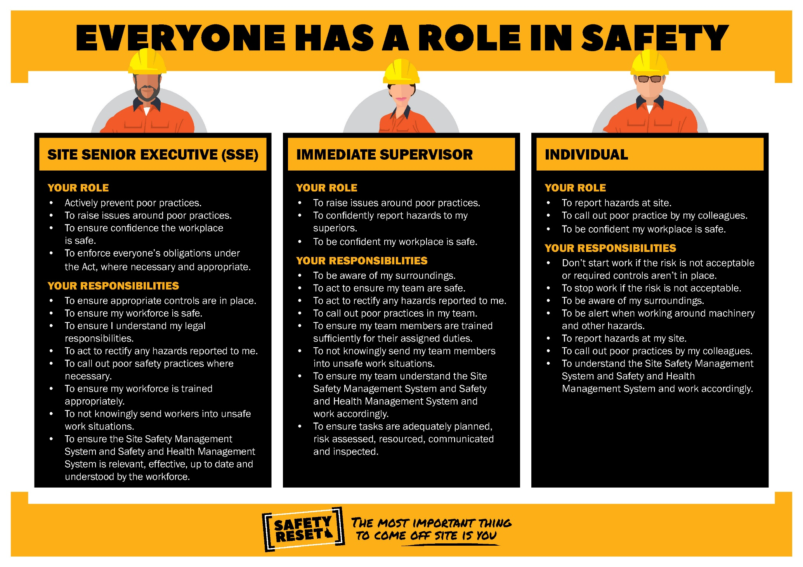

Slide 13
Safety stories and personal experiences

Slide 14
Feedback, concerns, improvements and commitments
Tell someone if you are concerned about safety in your workplace
In addition to existing feedback processes, complete an anonymous survey at www.qld.gov.au/safety-reset
To add a Facebook filter to your profile, visit www.facebook.com/miningqld

Slide 15
Thank you for participating

