Slide 1

May 2023
Incident periodical
Recent High Potential Incidents
Learnings and Recommendations
Communications
Incidents occurred in March 2023
Coal Inspectorate

Slide 2
Incident – Finger Injuries
Finger injuries are painful and avoidable. They are a regular contributor to the serious accident notifications to RSHQ.
Two incidents were caused by moving objects trapping or pinching fingers during surface activities, one by activation of the roof bolter jaw grippers underground.

Slide 3
Recommendations
When planning jobs consider alternate work methods/tools/jigs that eliminate or reduce the risk of hand injury.
Site Senior Executive
Supervisors
Coal Mine Workers
Confirm the SHMS provides for appropriate action to be taken when SHMS risk control measures are identified as not being effectively applied.
Carry out activities and work in according to SHMS procedures in place to avoid an unacceptable level of risk.
During your inspections, ensure all hazards have been identified and risk controlled by coal mine workers
Cease work immediately if you believe a hazard is not being adequately controlled.
Confirm the SHMS has effective risk controls for protecting hands and fingers from injury.
Ensure the risk controls in place for each task include controls to prevent hand and finger injuries.
Provide effective supervision by confirming the effectiveness of the risk controls.
Identify the hazards to hands and fingers in each task and put effective controls in place to manage the risks.

Slide 4
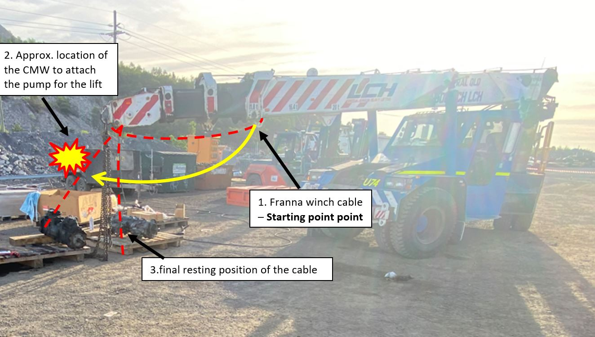
2. Incidents – Head Injuries
Coal mine workers received head injuries when the plant they were working on moved unexpectedly. One incident occurred during lifting activities, the other while dismantling an equipment part. Head injuries are high consequence injuries, requiring effective risk controls to reduce the likelihood of occurrence.

Slide 5
Recommendations
Site Senior Executive
Supervisors
Coal Mine Workers
Work in a way to avoid exposure to an unacceptable level of risk.
Follow site procedures and work instructions.
Regularly audit work areas for compliance with site procedures.
Continually monitor and review the effectiveness of risk control measures,
Maintain situational awareness particularly in regard to unexpected movement of equipment
Confirm the SHMS provides adequate monitoring of effective application of risk control measures.
Establish and implement effective controls to minimise the risk of head injuries.
Take appropriate corrective and preventive action where non-conformance is identified.

Slide 6
3. Incident – Projectile injury
A coal mine worker using a sledge hammer to remove an excavator drive sprocket.
A steel shard projectile created by the hammer striking the sprocket has penetrated coal mine worker’s leg.

Slide 7
Recommendations
Site Senior Executive
Supervisors
Coal Mine Workers
Be aware of potential for creating steel shard projectiles during hammer on steel contact..
Confirm task procedures are being effectively implemented by coal mine workers.
Confirm that the SHMS has effective controls in place to prevent the creation of steel shard projectiles.
Cease work immediately if you believe a hazard is not being adequately controlled .
Inform your supervisor of any concerns about the work environment.
Ensure that Supervisors are competent in assessing the risks and hazards associated with the work environment under their control.
Ensure effective supervision is conducted in areas where work may create steel shard projectiles to identify when additional risk controls are required.

Slide 8
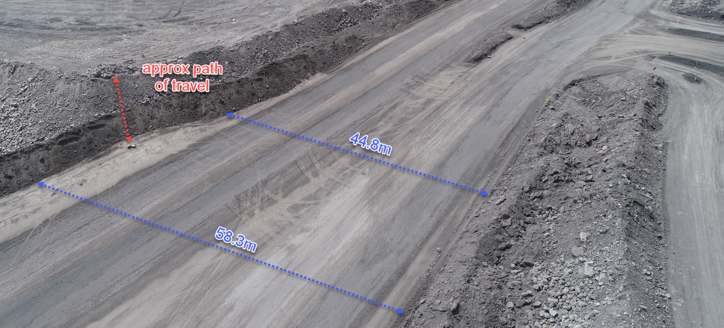
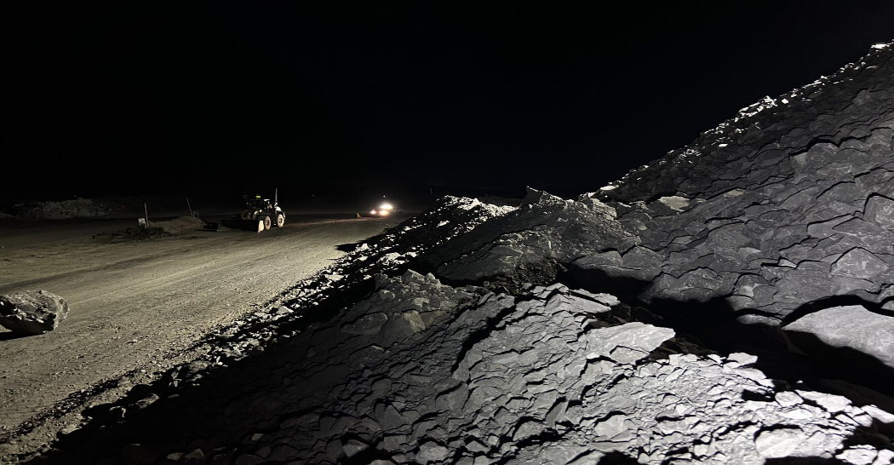
4. Incident – Rocks breaching catch bunds
Bulldozers maintaining dumps have inadvertently created hazards on roads at the dump toe. Rocks have rolled down the dump slope and landed on the road running along the tow of the dump, creating a hazard for road traffic.

Slide 9
Recommendations
Site Senior Executive
Supervisors
Coal Mine Workers
Confirm the mine’s SHMS has effective procedures for preventing rocks from dumping activities entering haul roads.
Ensure all persons who operate on dumps are trained and competent to prevent rocks entering roadways below dumps.
Verify procedures for working on dumps controls the hazard of rocks entering haul roads running past the dump toe.
Planned work must take in to consideration the proximity roads to active and inactive dumps.
Coal mine workers must inspect their work area prior to conducting work.
Ensure catch bunds are inspected and maintained to design so that they are effective and not three parts full material.
Ensure that catch bunds are in place and fit for purpose to prevent rocks entering roads running past the dump toe.

Slide 10
5. Incident – Coal Mine Workers not following procedures.
Two coal mine workers were assigned to maintain a surface drill.
During an inspection by their supervisor the following deviations from the SHMS were found:
The drill was not isolated
The CMW were working under a suspended load
The PPE requirements for the task were not being used.

Slide 11
Recommendations
Site Senior Executive
Supervisors
Coal Mine Workers
Inspection of equipment work areas must be effective in identifying potential hazards before commencing work.
Ensure that all hazards are identified and effective controls have been put in place to manage these.
Inform your supervisor of any concerns you have identified.
Confirm coal mine workers ae trained and competent in the relevant procedures required by the SHMS.
Monitor and verify that all risk controls for the tasks are being used and are effective.
Ensure the maintenance system is effective in managing the risks.
Confirm CMW are trained and competent in the procedures relevant to the tasks they are assigned.
Ensure supervisors are monitoring and verifying effective use of risk controls.

Slide 12
COMMUNICATIONS
Reporting HPIs following withdrawal of persons from an underground coal mine
Implementation of BoI Recommendations for surface operations
Obligations for maintaining rescue capability at an underground coal mine
Failure to meet the required number of respirable dust samples as stipulated in RS 14
Diesel guideline exposure limit reduction
Recognised Standards
Periodicals
Coal Mining Safety and Health Act 1999
Safety Notices
Board of Examiners
FREE Registration for the PCS Scheme
RECENT SAFETY ALERTS
Safety Alert 429
Inservice failure of an explosion protected diesel engine safety system
Safety Alert 428
Coal mine worker injured undertaking conveyor belt repairs
Safety Alert 427
Fingertip severed when caught in a motorised hood tarp system
Safety Alert 426
Rare earth magnets
Safety Alert 425
Fall of equipment and persons into a stope void
To subscribe to communications from the Queensland Mines Inspectorate please email
QldMinesInspectorate@rshq.qld.gov.au

