Slide 1

July 2022
Incident periodical
Recent High Potential Incidents**
Learnings and Recommendations
Communications and Safety Notices
Queensland Coal Mines Inspectorate
**Selection of the 127 HPIs
reported during the period
Coal Inspectorate

Slide 2
1. Incident – tyre fire
A rear dump truck was totally destroyed by fire
The truck was being escorted to a hot tyre bay when a CMW noticed flames coming from Pos 4 wheel and called the emergency
The operator safety exited the truck
Investigations identified likely tyre damage (cuts & tread separation) due to poor road conditions, potentially exacerbated by wet weather
Prior to the incident two other trucks had been stood down for suspected hot tyres
Travel speed and distance to a hot tyre bay were not considered when relocating the truck
Internal tyre temp & pressure sensors did not indicate the likelihood of an external tyre tread fire

Slide 3
Recommendations
Site Senior Executive
Supervisors
Coal Mine Workers
Understand and comply with site roadway operating standards
Make sure road standards and conditions meet or exceed the site standards
Review mine road design and operating standards. Including location of “hot tyre” bays.
Confirm vehicle tyre selection is appropriate
Review “hot tyre” response procedures including defect identification, use of thermal imaging, proximity to “hot tyre” areas and relocation requirements
Review emergency response capability for dealing with “hot tyres”
Understand and communicate to CMWs current site procedures for dealing with “hot tyres” including emergency response procedures
Understand and follow site procedures for dealing with “hot tyres”, including emergency response requirements

Slide 4
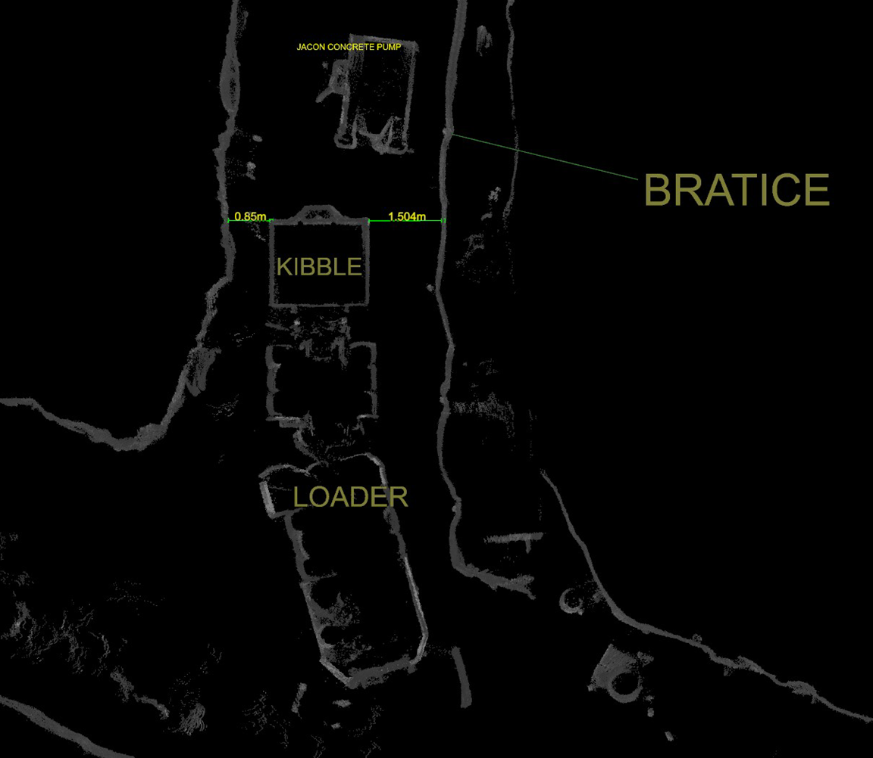
2. Incident – CMW crush injury
A CMW suffered serious crush injuries to their right leg and hip when pinned between a Load Haul Dump (LHD)/ concrete kibble and a Jacon concrete pump.
CMWs were constructing a Longwall goaf seal. A load of concrete had been delivered by the LHD/kibble and pumping of the load had been completed.
The LHD/kibble backed out from pump and on re-entry the LHD/kibble operator heard the injured person shout out.
The injured CMW was found trapped between the kibble and the Jacon concrete pump.

Slide 5
Recommendations
Site Senior Executive
Supervisors
Coal Mine Workers
Ensure work tasks are properly planned, prepared and risk assessed prior to being undertaken.
Must follow site procedures and work instructions
To ensure tasks are not allocated or proceed unless they have been properly planned, prepared and risk assessed.
To make sure CMWs understand systems and procedures including site requirements for spotters and ‘No-go "zones when working around machinery
Consider higher order controls which eliminate people/machine interface such as collision avoidance or pumping concrete from the surface
Make sure that tasks are properly resourced and competently supervised
To have systems in place that ensure requirements for spotters and “no-go” zones are implemented and enforced.
Carry out their activities and work in a way that does not expose themselves or someone else to an unacceptable level of risk
Enforce compliance with critical controls identified that would prevent injury

Slide 6
3. Incident – Methane drainage plant
Failure of a surface gas drainage plant resulted in methane exceeding 2.5% being recorded in areas of an underground coal mine.
At the time of the incident the longwall shearer was heading towards the tailgate. The methane level at the 243A detector (TG 150m monitor) was rising when the goaf drainage plant tripped. When methane levels reached 1.7% at the 243A detector the shearer haulage tripped.
At about the same time the control room operator contacted the longwall and informed them of the situation with the goaf drainage plant and the increasing gas levels in the tailgate, instructing the crew to cease production. Methane at the 243A detector continued to rise, exceeding 2.5% and peaking at 3.08%.
Once the methane drainage plant was restarted with all streams back on line the gas readings in the LW tailgate reduced to normal levels.
The investigation identified multiple engineering failures in the drainage plant, inexperienced operators and inconsistencies in risk, commissioning and swp documentation.

Slide 7
Recommendations
Site Senior Executive
Supervisors
Coal Mine Workers
CMWs should make sure they have received sufficient training before undertaking work
Make sure CMWs have been trained and competent in works they are undertaking
Initiate reviews of engineering designs and installations, including commissioning, operations and maintenance processes of safety critical plant aimed at identifying and eliminating operational reliability issues
Review applicable TARPs, ensuring detailed response information is available to enable CMWs to respond to triggers
Make sure sufficient trained and competent personnel available to operate and maintain plant required for safe operations
Make sure up to date TARPs and supporting documentation for installations are available and accessible

Slide 8
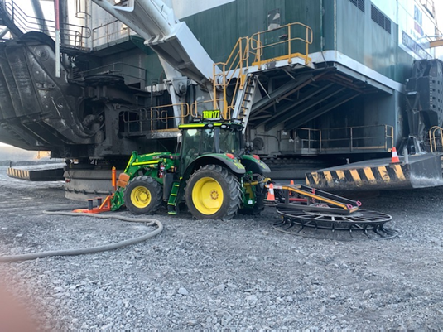
4. Incident – Dragline contacting tractor
CMWs were using a cable tractor to position cable
The cable tractor moved a loop of cable and was repositioned to move another cable loop.
The dragline operator assumed the tractor to be clear of the “no-go” zone and started to swing the dragline at slow speed.
The dragline contacted the cable tractor reeler and cab mirror
The cable tractor operator has then called on the 2 way twice to stop the dragline, however the dragline operator could not hear him clearly.
The cable tractor operator exited the tractor and waved at the dragline operator to get his attention.
At this point the dragline operator has stopped the dragline from swinging.
There have been 22 reported HPIs between 2017 and 2021 involving interactions between draglines and vehicles / machinery. A further two incidents have been reported in June and July 2022

Slide 9
Recommendations
Site Senior Executive
Supervisors
Coal Mine Workers
Implement higher level controls, over and above positive communications, that ensure inadvertent contact between draglines and machinery, and / or personnel does not occur.
Carry out their activities and work in a way that does not expose themselves or someone else to an unacceptable level of risk.
Must follow site procedures and work instructions.
Should ensure compliance with procedures and processes. This includes conducting behavioural observations during dragline operations.
Ensure “No Go Zones” are defined and clearly delineated.
Ensure compliance with procedures regarding personnel and equipment entering areas where they may be struck by operating equipment are adequate and effective.
If in doubt “STOP” outside of the “No Go Zone”

Slide 10
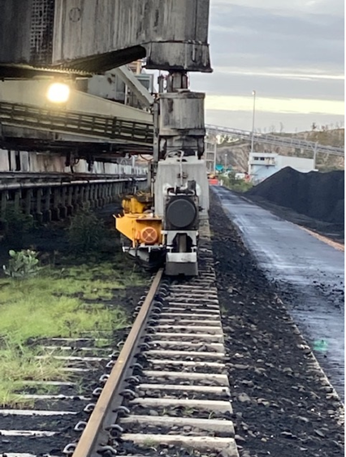
5. Incident – Bucketwheel stacker/reclaimer derailment
A bucket wheel reclaimer/stacker derailed whilst the machine was being repositioned to begin stacking.
The stacker boom was slewed and lowered contacting the stockpile. During this action, bogie wheels were partially derailed and the machine power tripped.
The front bogie came off the rail and moved about 250 mm sideways when machine power was reset and the stacker boom slewed back into the park position.
The control room operator was undertaking other production tasks at the time of the incident and did not stop the machine prior to the derailment occurring.
Investigation identified PLC control system design defects.

Slide 11
Recommendations
Site Senior Executive
Engineering
Coal mine workers
Ensure plant and equipment is fit for purpose.
Undertake periodic functional safety audits of PLC codes
Initiate safety reviews of automated or semi-automated control systems with the aim of identifying and controlling foreseeable errors.
Consider collision avoidance detection, code error checking, ground force protection systems
Don’t multi-task when critical tasks are being undertaken
Communicate with CMWs the importance of monitoring remote operations

Slide 12

Reporting sexual assault or harassment to RSHQ
RSHQ has a dedicated response team for complaints and notifications of sexual assault or sexual harassment
To contact the team call 1300 581 077 or email complaints@rshq.qld.gov.au.
If you are in immediate danger or your health and wellbeing has been threatened, contact the police (phone 000) and seek medical advice.
Further information is available on RSHQ’s website by scanning the QR code.

Slide 13
What RSHQ can help with
RSHQ’s role is to ensure operators have effective controls and processes in place to:
  reduce the risk of sexual harassment and assault in the workplace
  receive and respond to complaints and incidents.
RSHQ can also assist workers with referral to support services.
What RSHQ can’t help with
legal advice
workers’ compensation
jurisdiction of other agencies (e.g. incidents occurring off-site)
industrial relations

Slide 14
Communications from the Coal Mines Inspectorate
Letter from the CICM to OCEs on the Certificate of proficiency in Mine Gases and Gas Testing
Letter from the CICM - Ventilation Officer Certificate of Competency Requirements
Letter from the CICM – Implementation of BoI Recommendations
Fast facts for July 2022
127 HPI & serious accident reports received
11 Non-reportable incidents
10 Cases of COPD not attributable to mines
Safety Alert 415
Bolt projectile from final drive
Safety Alert 414
Hauling equipment failure during conveyor belt change out
Safety Alert 413
Underground grader
unplanned movement
Safety Bulletin 204
Spontaneous combustion monitoring and response systems
Petroleum & Gas
Safety Alert 108 Finger Crush Injury
To subscribe to communications from the Queensland Mines Inspectorate please email
QldMinesInspectorate@rshq.qld.gov.au

